Slide 1
2 Corinthians 3:5-6
Not that we are sufficient in ourselves to claim anything as coming from us, but our sufficiency is from God, who has made us sufficient to be ministers of a new covenant, not of the letter but of the Spirit.

Slide 2
Paul’s Dependence on God

Slide 3
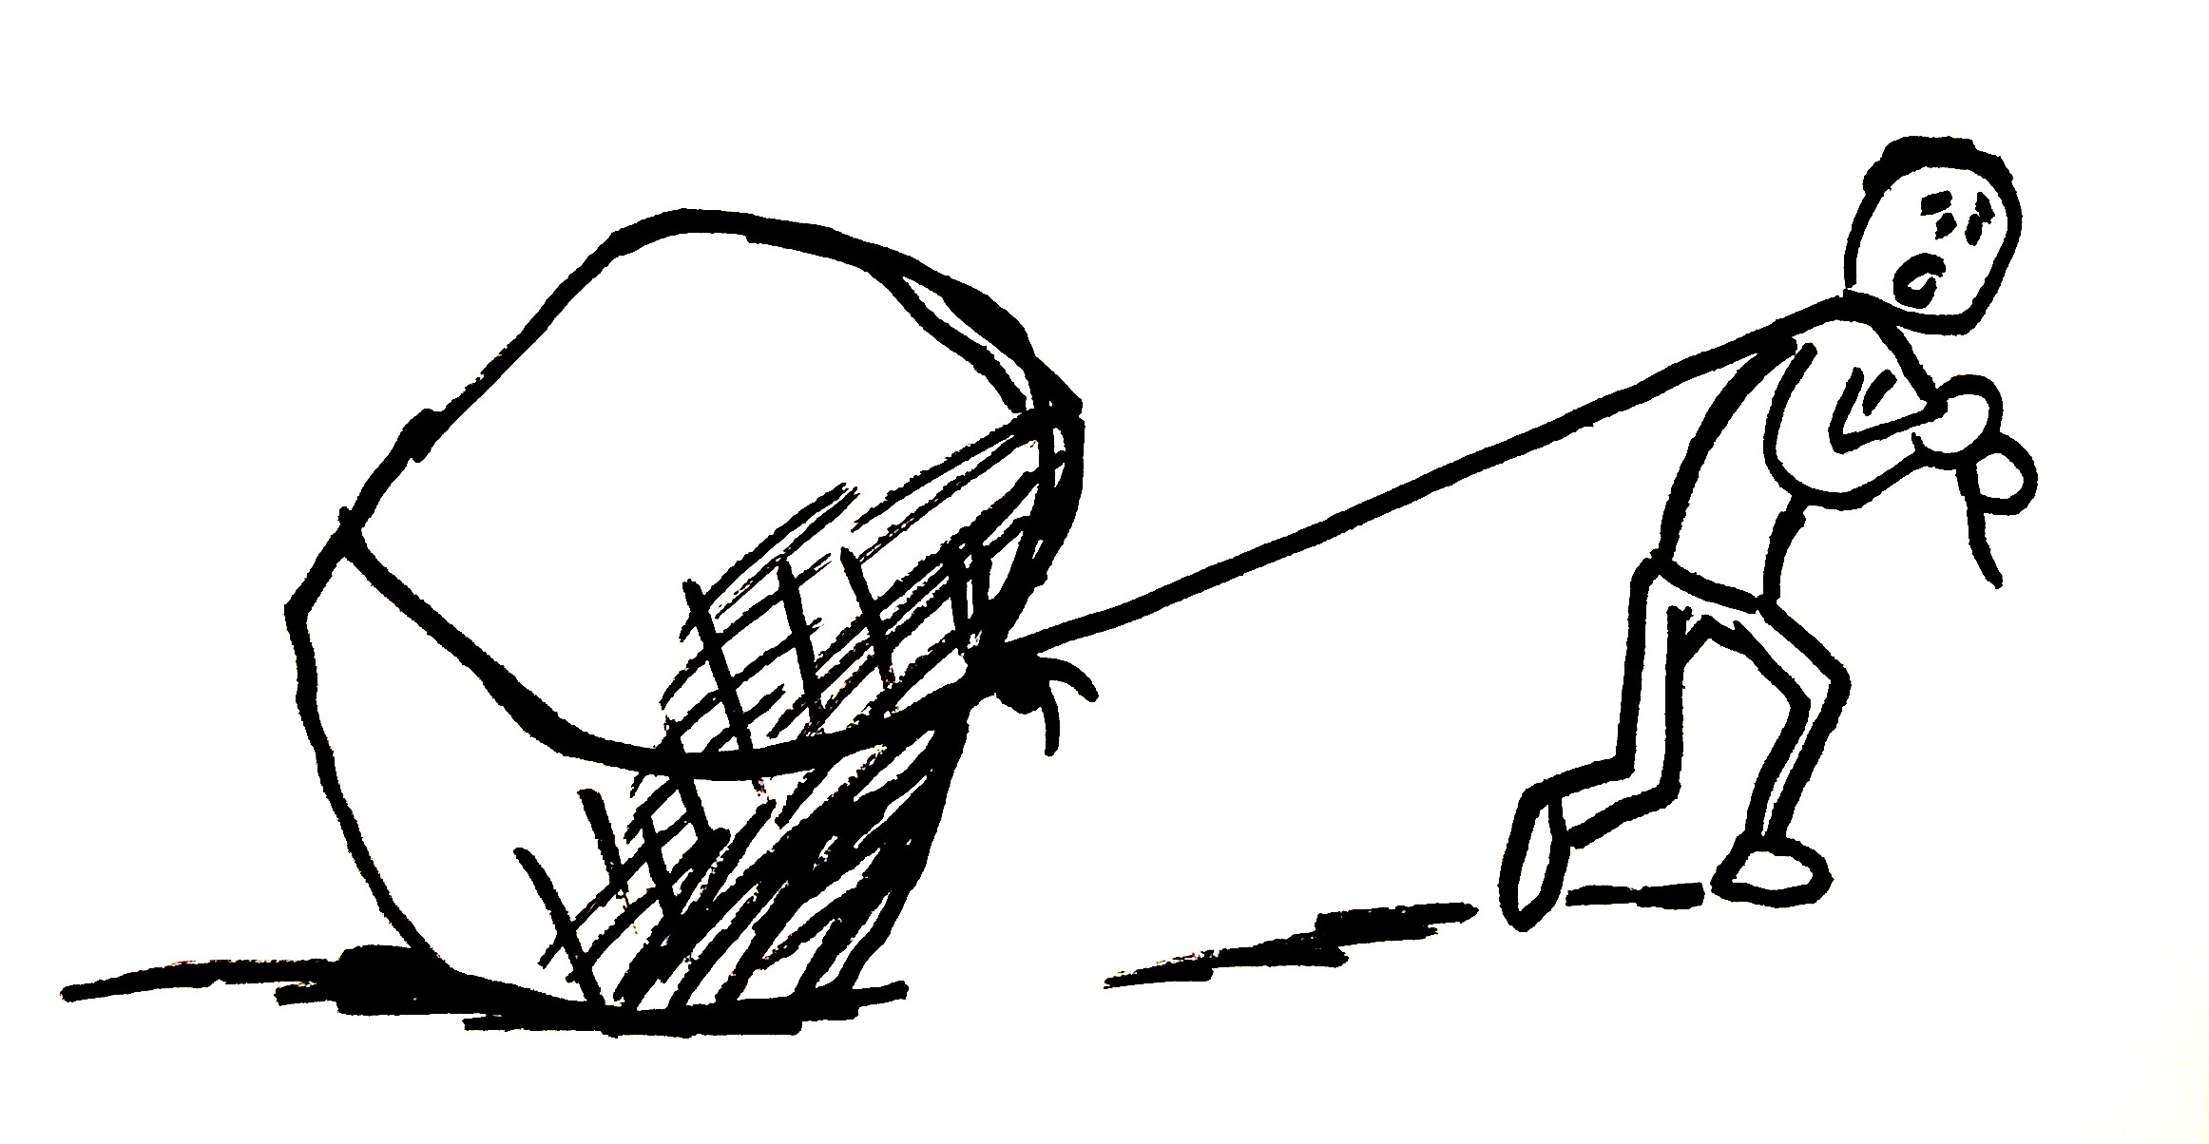
Relationship

Slide 4
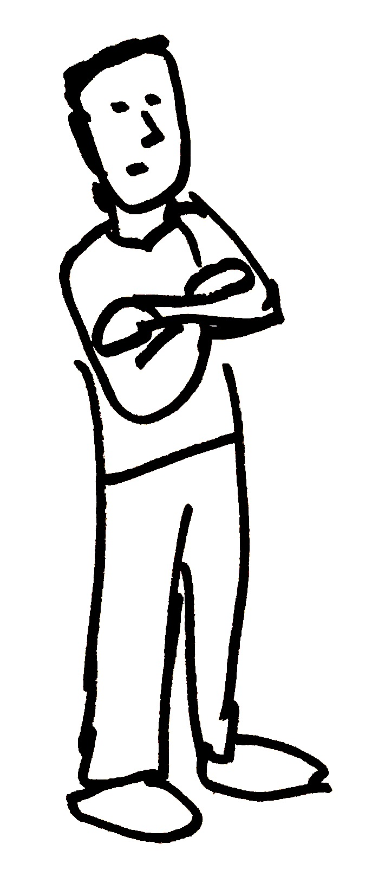
Relationship

Slide 5
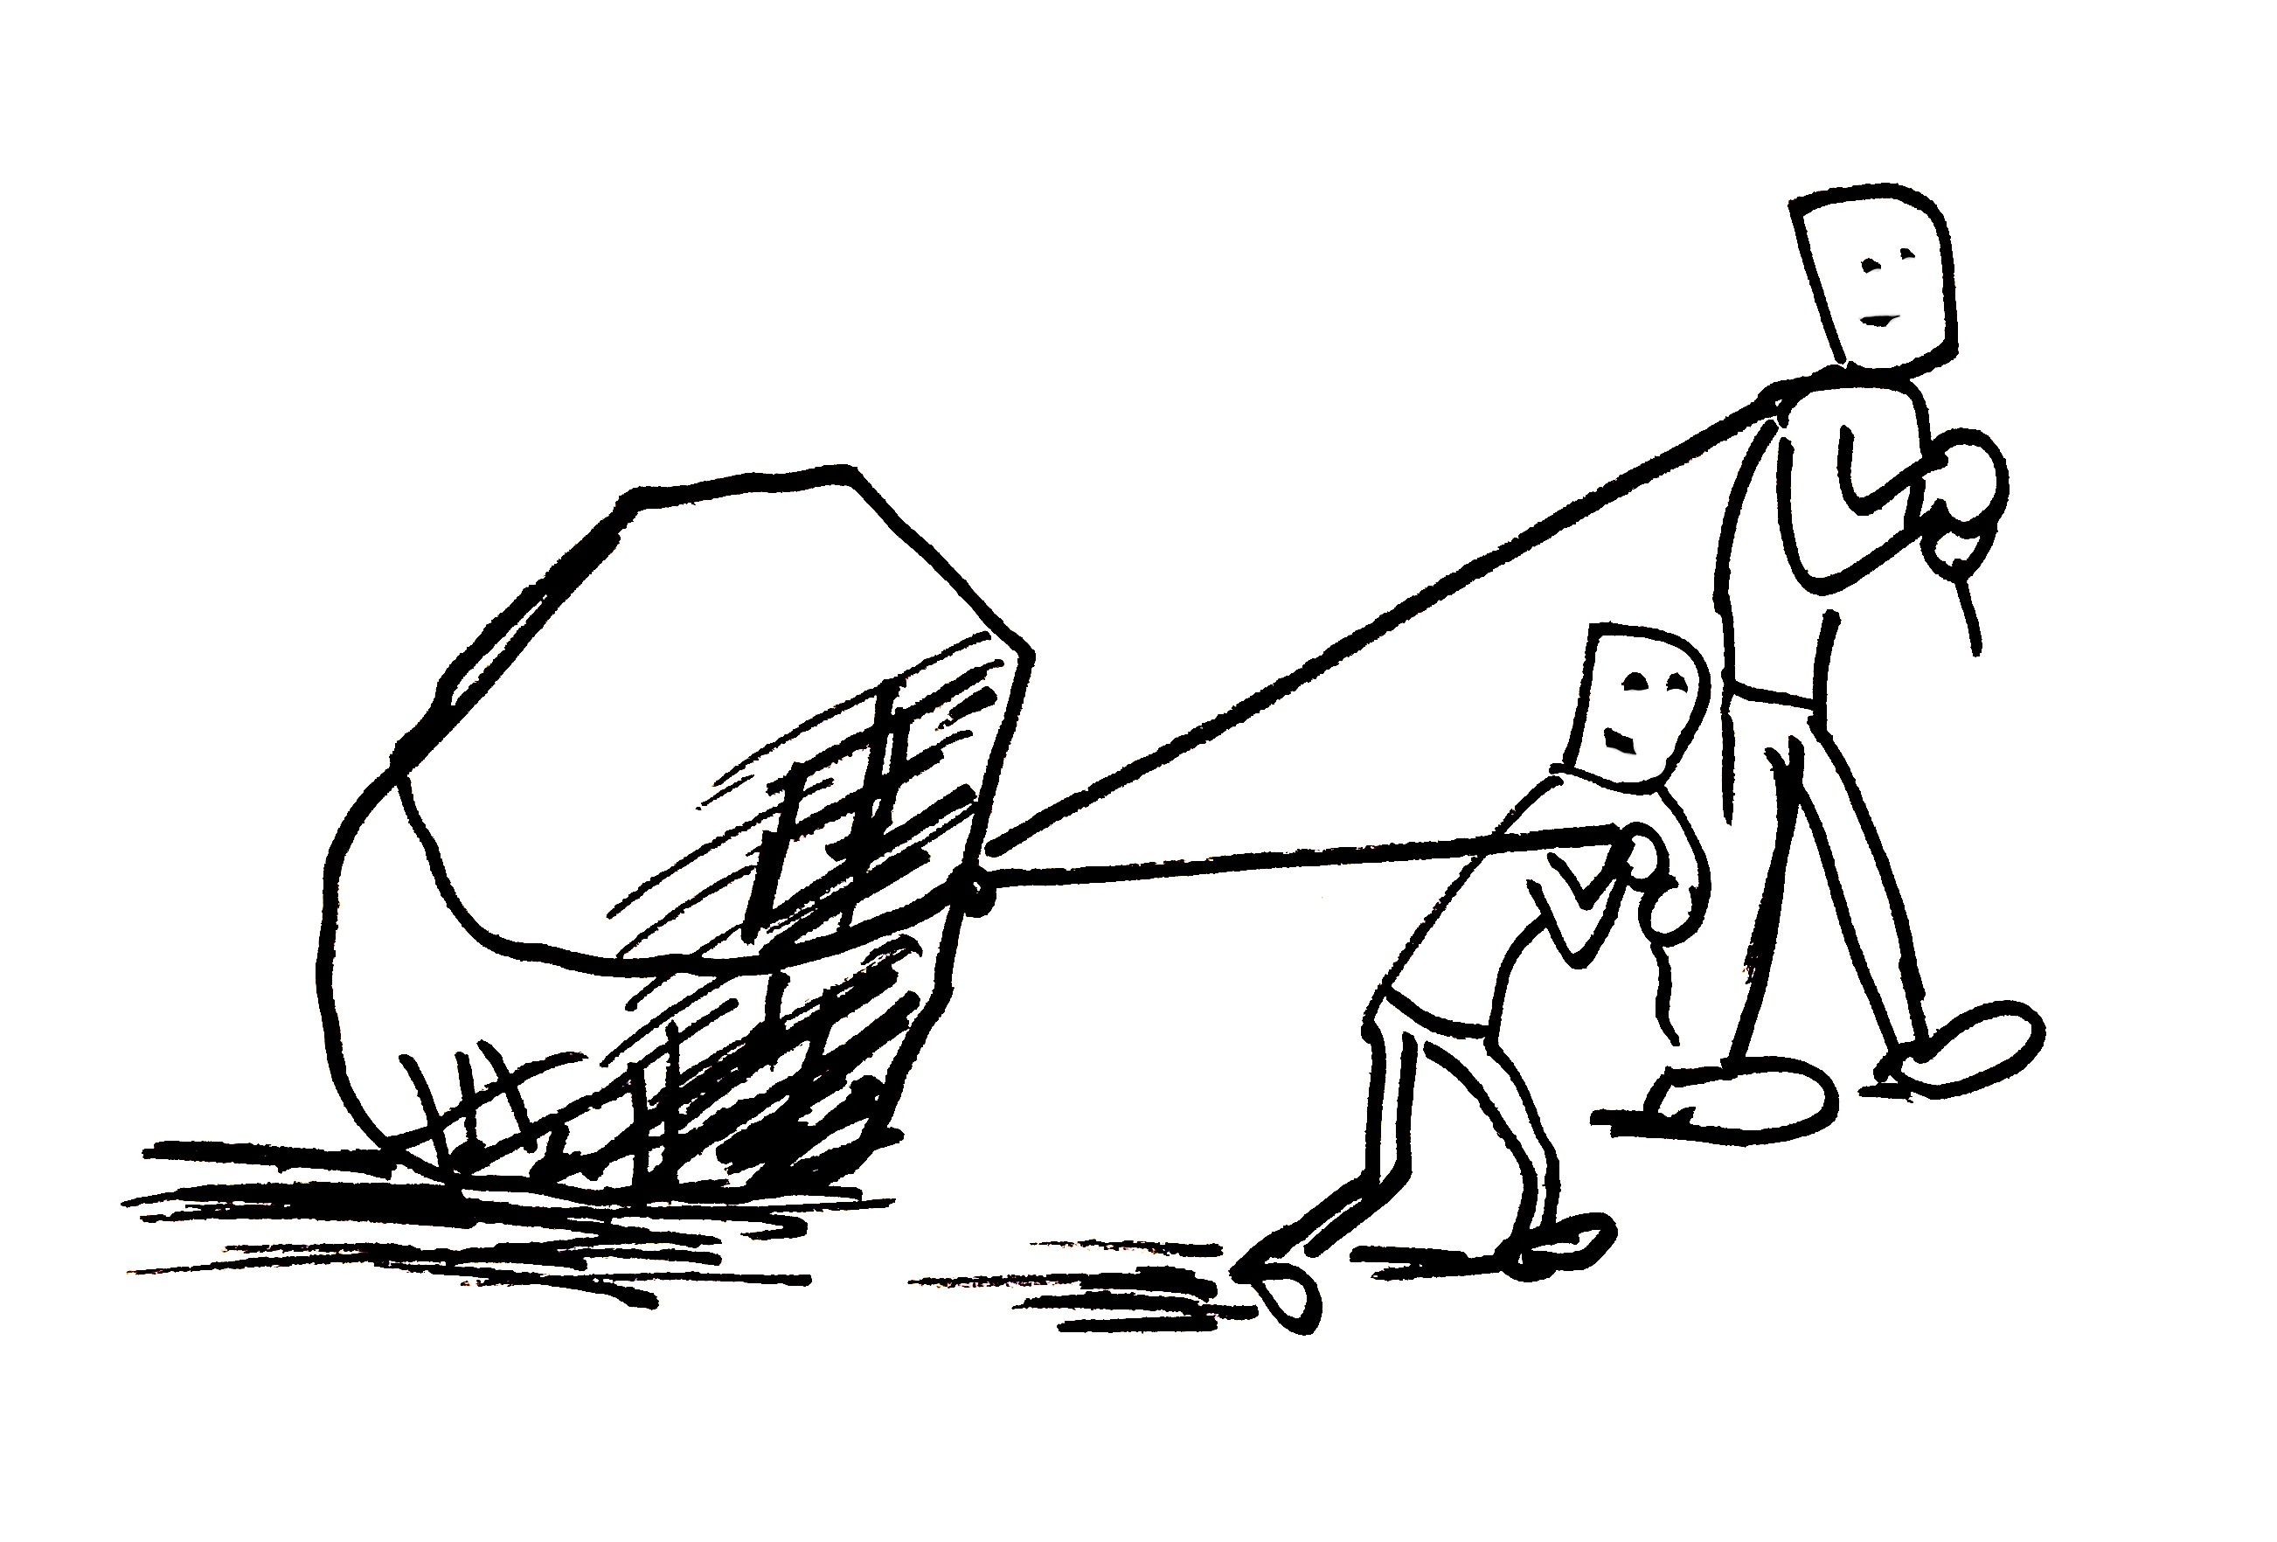
Relationship

Slide 6
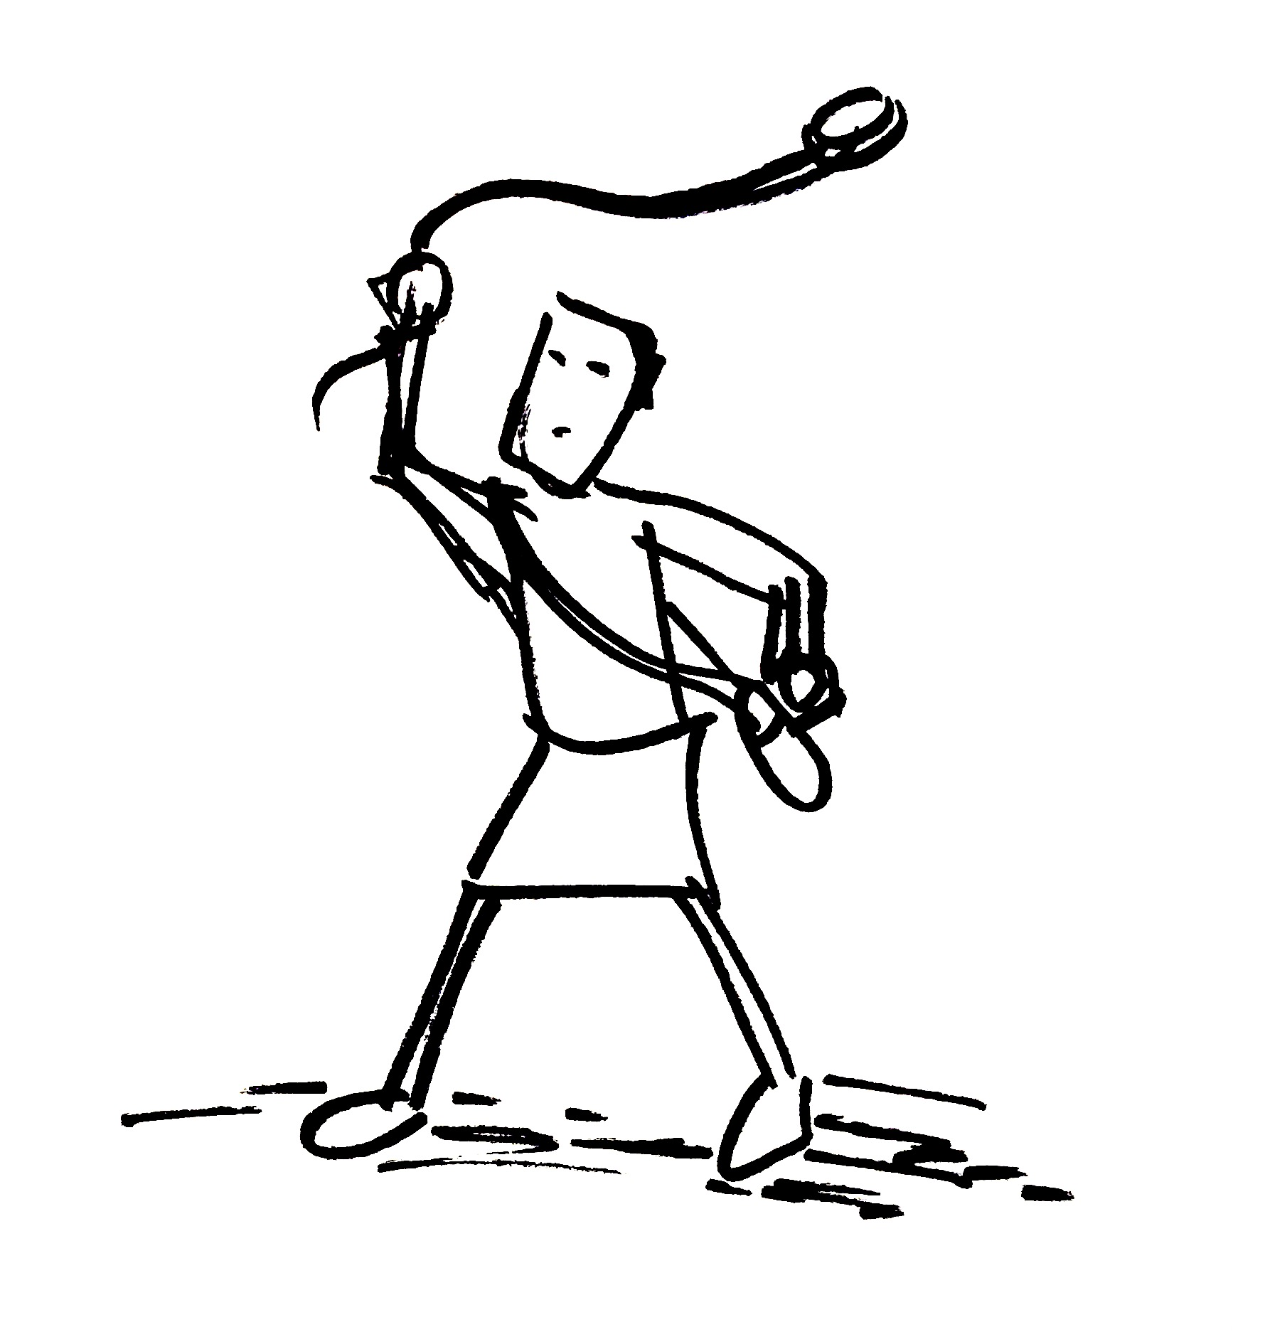
Motivation

Slide 7
1 Samuel 17:45-46
Then David said to the Philistine, “You come to me with a sword and with a spear and with a javelin, but I come to you in the name of the Lord of hosts, the God of the armies of Israel, whom you have defied. This day the Lord will deliver you into my hand,

Slide 8
Motivation

Slide 9
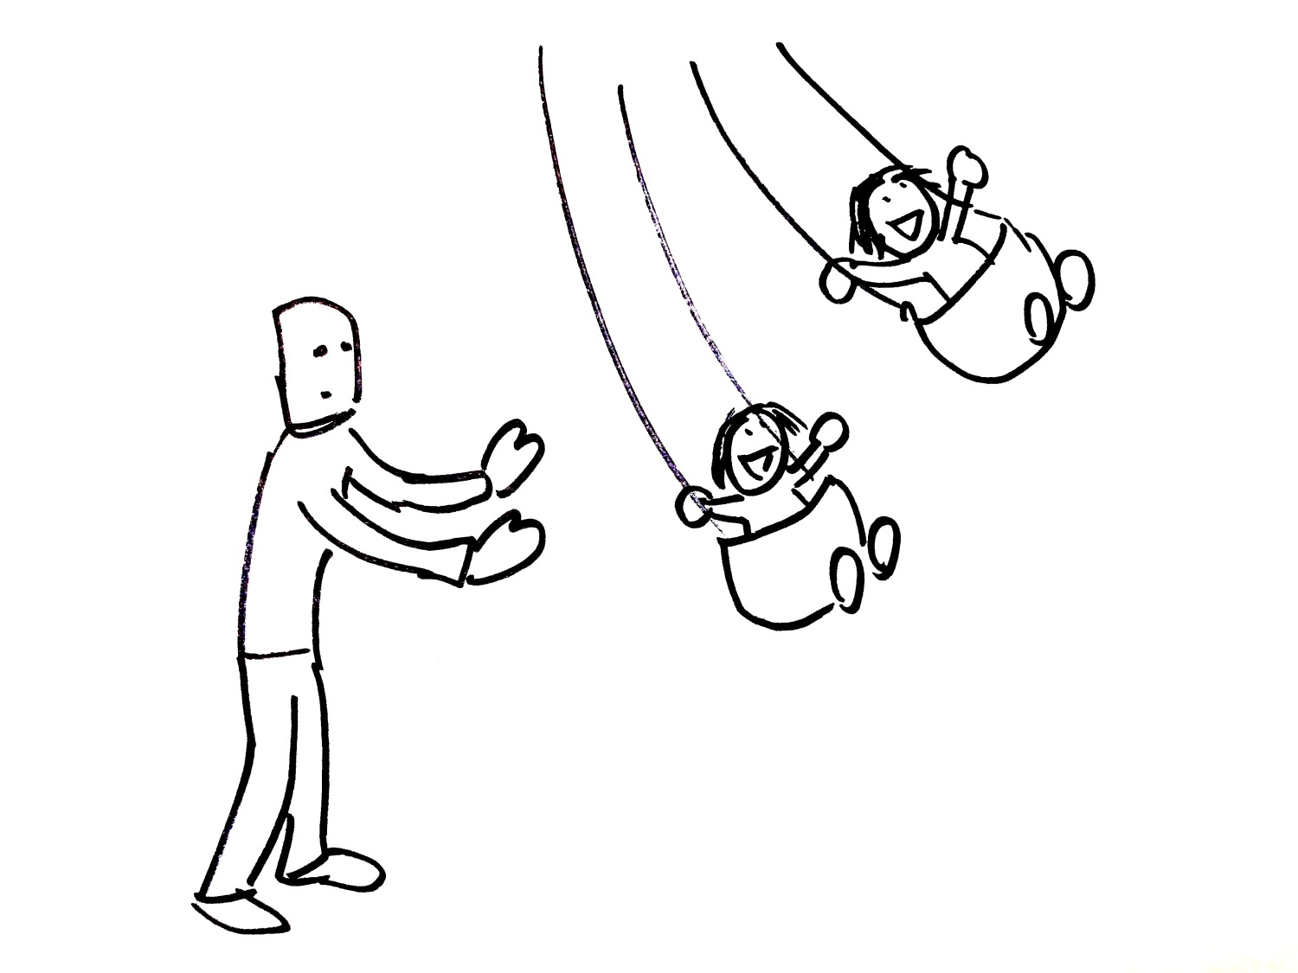
Humility

Slide 10
Endurance

Slide 11
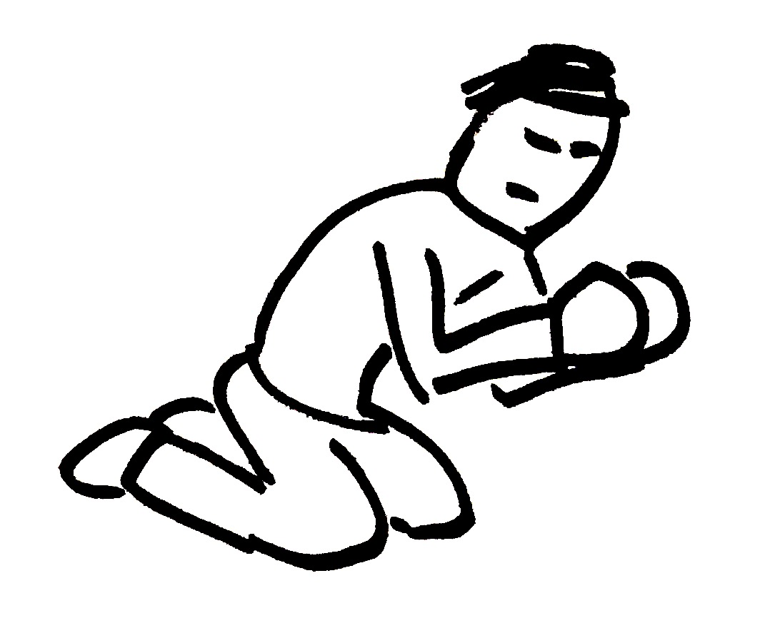
Prayer

Slide 12
We need God just as much as Paul did.

