Slide 1
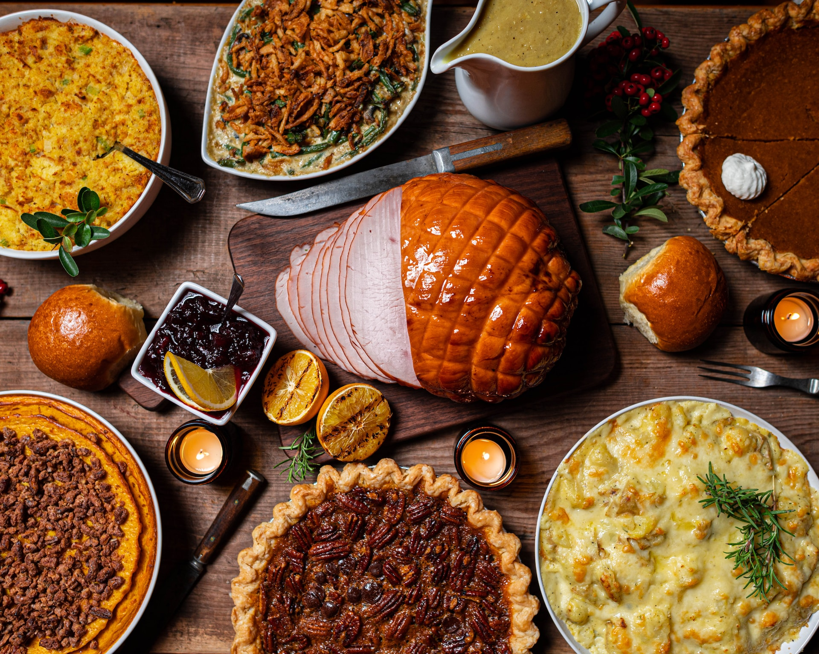
Looking Forward toThe Greatest Feast of All
is a

Slide 2
Matthew 8:11-12
I tell you, many will come from east and west and recline at table with Abraham, Isaac, and Jacob in the kingdom of heaven, while the sons of the kingdom will be thrown into the outer darkness. In that place there will be weeping and gnashing of teeth.”

Slide 3
The Best Dinner Ever
is a

Slide 4
Looking Forward to
The Greatest Feast of All
is a

Slide 5
The Judgment

Slide 6
Judgment
for All

Slide 7
We Destroyed
the Earth

Slide 8
The Party
is Over

Slide 9
And Yet There Will Be Great Joy

Slide 10
Wicked
Can’t Escape

Slide 11
God Will Reign

Slide 12
The Celebration

Slide 13
Praising God for What He Did

Slide 14
Destruction of
the Powerful
& Protection of the Vulnerable

Slide 15
The Feast

Slide 16
Death is Over

Slide 17
It’s Worth
Waiting For

Slide 18
But Don’t
Forget the Judgment Part

Slide 19
Let’s look forward
to that great feast!
is a

