Slide 1
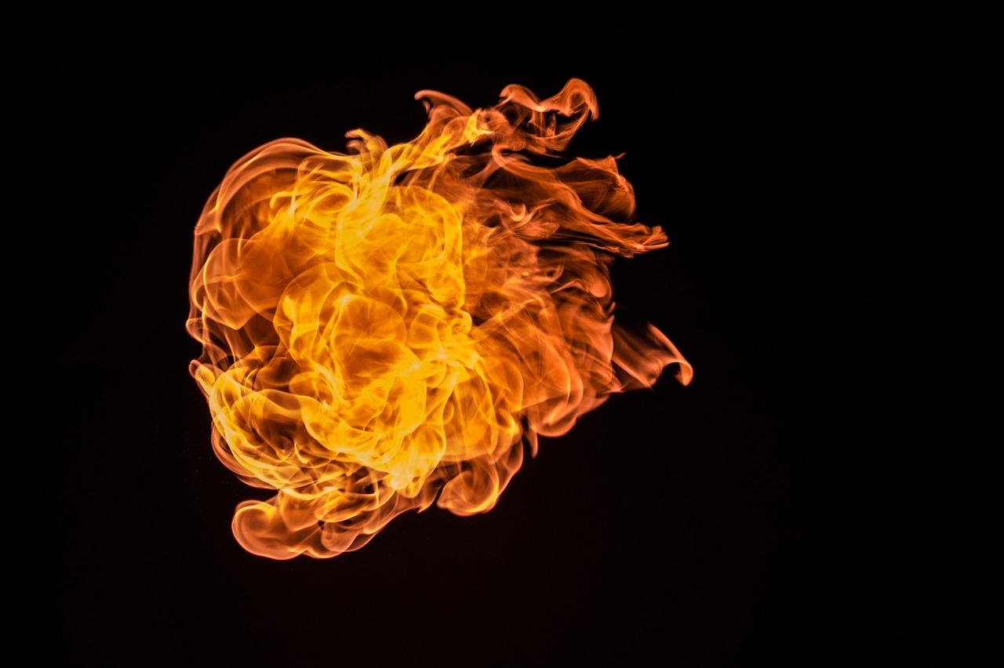
Tonight:
Satan’s Backstory

Slide 2
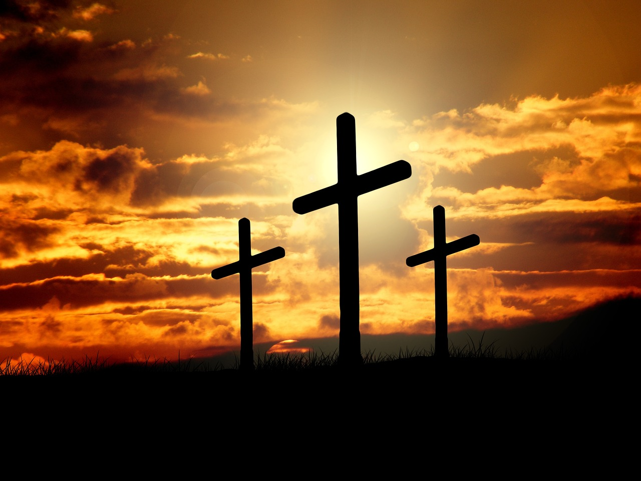
The Comfort of the Cross

Slide 3
The Key Principle

Slide 4
Romans 8:31-32
What then shall we say to these things? If God is for us, who can be against us? He who did not spare his own Son but gave him up for us all, how will he not also with him graciously give us all things?

Slide 5
He who did not spare his own Son but gave him up for us all,
how will he not also with him graciously give us all things?

Slide 6
What He Suffered
Matthew 27:27-31
Then the soldiers of the governor took Jesus into the governor's headquarters, and they gathered the whole battalion before him. And they stripped him and put a scarlet robe on him, and twisting together a crown of thorns, they put it on his head and put a reed in his right hand. And kneeling before him, they mocked him, saying, “Hail, King of the Jews!” And they spit on him and took the reed and struck him on the head. And when they had mocked him, they stripped him of the robe and put his own clothes on him and led him away to crucify him.

Slide 7
What He Gave Up
Philippians 2:6-8
Though he was in the form of God, did not count equality with God a thing to be grasped, but emptied himself, by taking the form of a servant, being born in the likeness of men. And being found in human form, he humbled himself by becoming obedient to the point of death, even death on a cross.

Slide 8
What He Felt
Psalm 22:14-18
I am poured out like water, and all my bones are out of joint; my heart is like wax; it is melted within my breast; my strength is dried up like a potsherd, and my tongue sticks to my jaws; you lay me in the dust of death. For dogs encompass me; a company of evildoers encircles me; they have pierced my hands and feet—I can count all my bones—they stare and gloat over me; they divide my garments among them, and for my clothing they cast lots.

Slide 9
What He Chose
Matthew 26:39
And going a little farther he fell on his face and prayed, saying, “My Father, if it be possible, let this cup pass from me; nevertheless, not as I will, but as you will.”

Slide 10
What His Father Chose
Genesis 22:2
He said, “Take your son, your only son Isaac, whom you love, and go to the land of Moriah, and offer him there as a burnt offering on one of the mountains of which I shall tell you.”

Slide 11
He who did not spare his own Son but gave him up for us all,
how will he not also with him graciously give us all things?

Slide 12
What This Knowledge Does For Us

Slide 13
What I See
What I know
What I know
Sin & Guilt
Saved

Slide 14
What I See
What I know
What I know
Trials, suffering, turmoil
Victory

Slide 15
Psalm 44

Slide 16
What he sees
What he knows
What he knows
Past salvation
Only hope is in God
Suffering
Doesn’t deserve this
?

Slide 17
What I See
What I know
What I know
Trials, suffering, turmoil
Victory

Slide 18
We have to stay focused on the cross.

