Slide 1
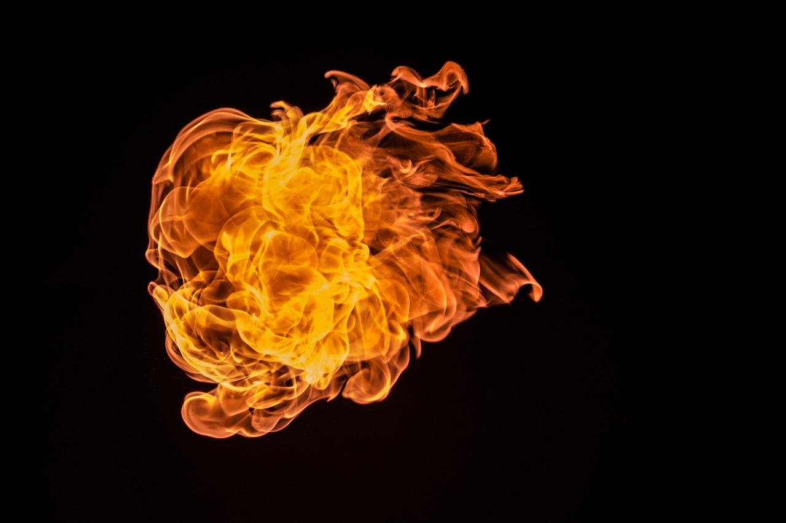
Satan’s Backstory

Slide 2
Scriptures People Often Use

Slide 3
Isaiah 14
Ezekiel 28
Revelation 12

Slide 4
What We Do Know

Slide 5
God made everything

Slide 6
Colossians 1:16
For by him all things were created, in heaven and on earth, visible and invisible, whether thrones or dominions or rulers or authorities—all things were created through him and for him.

Slide 7
God made everything
Everything God makes is good

Slide 8
Genesis 1:31
And God saw everything that he had made, and behold, it was very good. And there was evening and there was morning, the sixth day.

Slide 9
James 1:13-17
Let no one say when he is tempted, “I am being tempted by God,” for God cannot be tempted with evil, and he himself tempts no one. But each person is tempted when he is lured and enticed by his own desire. Then desire when it has conceived gives birth to sin, and sin when it is fully grown brings forth death. Do not be deceived, my beloved brothers. Every good gift and every perfect gift is from above, coming down from the Father of lights, with whom there is no variation or shadow due to change.

Slide 10
God made everything
Everything God makes is good
So Satan must have started good and turned evil.

Slide 11
Is Satan a Fallen Angel?

Slide 12
He’s with angels.

Slide 13
Job 1:6-12
Now there was a day when the sons of God came to present themselves before the Lord, and Satan also came among them. The Lord said to Satan, “From where have you come?” Satan answered the Lord and said, “From going to and fro on the earth, and from walking up and down on it.” And the Lord said to Satan, “Have you considered my servant Job, that there is none like him on the earth, a blameless and upright man, who fears God and turns away from evil?”

Slide 14
He’s with angels.
He has angels who follow him.

Slide 15
Matthew 25:41
“Then he will say to those on his left, ‘Depart from me, you cursed, into the eternal fire prepared for the devil and his angels.

Slide 16
He’s with angels.
He has angels who follow him.
He pretends to be a good angel.

Slide 17
2 Corinthians 11:14
And no wonder, for even Satan disguises himself as an angel of light.

Slide 18
He’s with angels.
He has angels who follow him.
He pretends to be a good angel.
Angels have freewill.

Slide 19
2 Peter 2:4
For if God did not spare angels when they sinned, but cast them into hell and committed them to chains of gloomy darkness to be kept until the judgment;

Slide 20
He’s with angels.
He has angels who follow him.
He pretends to be a good angel.
Angels have freewill.
Angels are very powerful,
but also very limited.

Slide 21
1 Peter 1:10-12
Concerning this salvation, the prophets who prophesied about the grace that was to be yours searched and inquired carefully, inquiring what person or time the Spirit of Christ in them was indicating when he predicted the sufferings of Christ and the subsequent glories. It was revealed to them that they were serving not themselves but you, in the things that have now been announced to you through those who preached the good news to you by the Holy Spirit sent from heaven, things into which angels long to look.

Slide 22
Job 1:9-11
Then Satan answered the Lord and said, “Does Job fear God for no reason? Have you not put a hedge around him and his house and all that he has, on every side? You have blessed the work of his hands, and his possessions have increased in the land. But stretch out your hand and touch all that he has, and he will curse you to your face.”

Slide 23
What We Can
Learn from
Revelation 12

Slide 24
He’s trying to defeat God’s plan.
He’s in a conflict with other spiritual forces.
That war extends to us.
He uses the societies/cultures of this world to aid him in that fight.

Slide 25
The Point of This:
We are in the midst of a massive spiritual conflict.

Slide 26
John 5:19
We know that we are from God, and the whole world lies in the power of the evil one.

Slide 27
2 Corinthians 4:4
In their case the god of this world has blinded the minds of the unbelievers, to keep them from seeing the light of the gospel of the glory of Christ, who is the image of God.

Slide 28
1 John 4:4
Little children, you are from God and have overcome them, for he who is in you is greater than he who is in the world.

Slide 29
Ephesians 6:11-16
Put on the whole armor of God, that you may be able to stand against the schemes of the devil. For we do not wrestle against flesh and blood, but against the rulers, against the authorities, against the cosmic powers over this present darkness, against the spiritual forces of evil in the heavenly places.

