Slide 1
Don’t Waste Your Life

Slide 2
The End of Paul’s Life

Slide 3
Paul
Demas
Being poured out like a drink offering
Fighting a fight
Running a race
Reward in the end
In love with this world

Slide 4
Jesus Describes a Wasted Life

Slide 5
Rich Fool
Extremely Successful
Life was a waste

Slide 6
Jesus Describes a Truly Successful Life

Slide 7
a seed

Slide 8
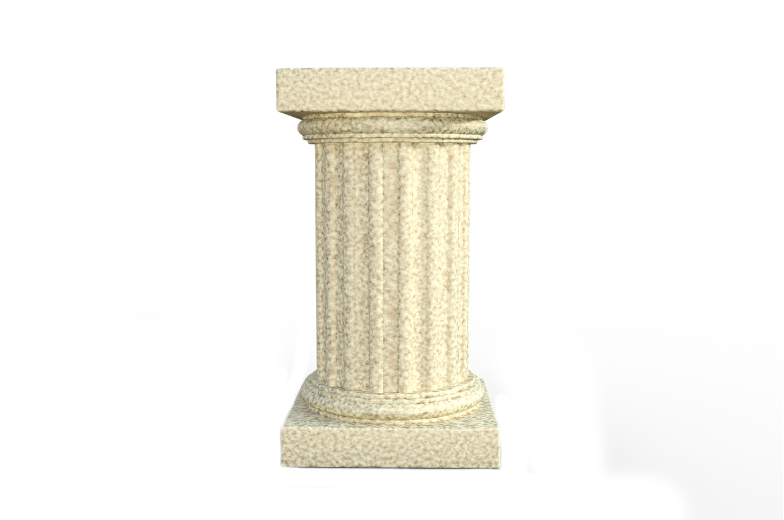

Slide 9
Dies

Slide 11
What this Looks Like

Slide 12
How It Starts

Slide 13
Dying

Slide 14
How It Continues

Slide 15
Paul
Others
Eat & drink because tomorrow we die.
Influenced by how others think.
Die every day
Fought beasts

Slide 16
Paul
Demas

Slide 17
Examples of This From the Early Church

Slide 18
Barnabas
Acts 4:36-37
There was not a needy person among them, for as many as were owners of lands or houses sold them and brought the proceeds of what was sold and laid it at the apostles' feet, and it was distributed to each as any had need. Thus Joseph, who was also called by the apostles Barnabas (which means son of encouragement), a Levite, a native of Cyprus, sold a field that belonged to him and brought the money and laid it at the apostles' feet.

Slide 19
Tabitha
Acts 9:36
Now there was in Joppa a disciple named Tabitha, which, translated, means Dorcas. She was full of good works and acts of charity.
Acts 9:39
So Peter rose and went with them. And when he arrived, they took him to the upper room. All the widows stood beside him weeping and showing tunics and other garments that Dorcas made while she was with them.

Slide 20
Ephesians
Acts 19:18-20
Also many of those who were now believers came, confessing and divulging their practices. And a number of those who had practiced magic arts brought their books together and burned them in the sight of all. And they counted the value of them and found it came to fifty thousand pieces of silver. So the word of the Lord continued to increase and prevail mightily.

Slide 21
Jerusalem Christians
Acts 8:3-4
But Saul was ravaging the church, and entering house after house, he dragged off men and women and committed them to prison. Now those who were scattered went about preaching the word.

Slide 22
Unless a grain of wheat falls into the earth and dies, it remains alone.

Slide 23
Don’t waste your life.

