Slide 1
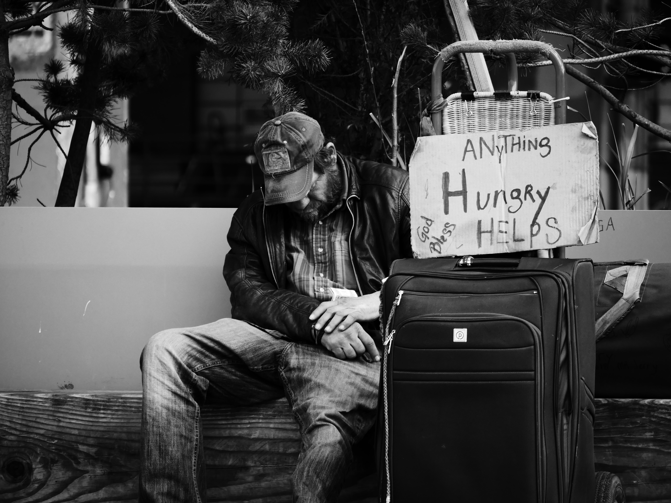
Do You Love the Poor?

Slide 2
Obstacles:
We’ve been burned by people we tried to help.
Giving can harm people.
Some charities misuse money.
Some government programs hinder people.
Some are poor because of bad choices.
Money we collect as a church should be used for helping people who are Christians.

Slide 3
Philippians 1:9-10
And it is my prayer that your love may abound more and more, with knowledge and all discernment, so that you may approve what is excellent, and so be pure and blameless for the day of Christ.

Slide 4
Treat the Poor as Lesser

Slide 5
Proverbs 17:5
Whoever mocks the poor insults his Maker; he who is glad at calamity will not go unpunished.

Slide 6
Proverbs 14:21
Whoever despises his neighbor is a sinner, but blessed is he who is generous to the poor.

Slide 7
James 2:1-6
My brothers, show no partiality as you hold the faith in our Lord Jesus Christ, the Lord of glory. For if a man wearing a gold ring and fine clothing comes into your assembly, and a poor man in shabby clothing also comes in, and if you pay attention to the one who wears the fine clothing and say, “You sit here in a good place,” while you say to the poor man, “You stand over there,” or, “Sit down at my feet,” have you not then made distinctions among yourselves and become judges with evil thoughts?

Slide 8
Listen, my beloved brothers, has not God chosen those who are poor in the world to be rich in faith and heirs of the kingdom, which he has promised to those who love him? But you have dishonored the poor man.

Slide 9
Ignore the Poor
Treat the Poor as Lesser

Slide 10
Ezekiel 16:49
Behold, this was the guilt of your sister Sodom: she and her daughters had pride, excess of food, and prosperous ease, but did not aid the poor and needy.

Slide 11
Proverbs 21:13
Whoever closes his ear to the cry of the poor will himself call out and not be answered.

Slide 12
Matthew 25:41-43
“Then he will say to those on his left, ‘Depart from me, you cursed, into the eternal fire prepared for the devil and his angels. For I was hungry and you gave me no food, I was thirsty and you gave me no drink, I was a stranger and you did not welcome me, naked and you did not clothe me, sick and in prison and you did not visit me.’

Slide 13
1 John 3:17
But if anyone has the world's goods and sees his brother in need, yet closes his heart against him, how does God's love abide in him?

Slide 14
Care About the Poor
Ignore the Poor
Treat the Poor as Lesser

Slide 15
Psalm 9:18
But God will never forget the needy; the hope of the afflicted will never perish.

Slide 16
Psalm 10:14
But you, God, see the trouble of the afflicted; you consider their grief and take it in hand. The victims commit themselves to you; you are the helper of the fatherless.

Slide 17
Deuteronomy 10:17-19
For the Lord your God is God of gods and Lord of lords, the great, the mighty, and the awesome God, who is not partial and takes no bribe. He executes justice for the fatherless and the widow, and loves the sojourner, giving him food and clothing. Love the sojourner, therefore, for you were sojourners in the land of Egypt.

Slide 18
Galatians 2:9-10
and when James and Cephas and John, who seemed to be pillars, perceived the grace that was given to me, they gave the right hand of fellowship to Barnabas and me, that we should go to the Gentiles and they to the circumcised. Only, they asked us to remember the poor, the very thing I was eager to do.

Slide 19
Help the Poor
Care About the Poor
Ignore the Poor
Treat the Poor as Lesser

Slide 20
1 Samuel 2:8
He raises up the poor from the dust; he lifts the needy from the ash heap to make them sit with princes and inherit a seat of honor. For the pillars of the earth are the Lord's, and on them he has set the world.

Slide 21
Deuteronomy 15:7-11
“If among you, one of your brothers should become poor, in any of your towns within your land that the Lord your God is giving you, you shall not harden your heart or shut your hand against your poor brother, but you shall open your hand to him and lend him sufficient for his need, whatever it may be.

Slide 22
Proverbs 31:20
She opens her hand to the poor and reaches out her hands to the needy.

Slide 23
Ephesians 4:28
Let the thief no longer steal, but rather let him labor, doing honest work with his own hands, so that he may have something to share with anyone in need.

Slide 24
Be Around the Poor
Help the Poor
Care About the Poor
Ignore the Poor
Treat the Poor as Lesser

Slide 25
Leviticus 25:35
“If your brother becomes poor and cannot maintain himself with you, you shall support him as though he were a stranger and a sojourner, and he shall live with you.

Slide 26
Luke 14:13-14
“But when you give a banquet, invite the poor, the crippled, the lame, the blind, and you will be blessed. Although they cannot repay you, you will be repaid at the resurrection of the righteous.”

Slide 27
Fight for the Poor
Be Around the Poor
Help the Poor
Care About the Poor
Ignore the Poor
Treat the Poor as Lesser

Slide 28
Psalm 140:12
I know that the Lord will maintain the cause of the afflicted, and will execute justice for the needy.

Slide 29
Psalm 140:12-13
I know that the Lord secures justice for the poor and upholds the cause of the needy. Surely the righteous will praise your name, and the upright will live in your presence.

Slide 30
Psalm 12:5
“Because the poor are plundered, because the needy groan, I will now arise,” says the Lord; “I will place him in the safety for which he longs.”

Slide 31
Proverbs 31:8-9
“Speak up for those who cannot speak for themselves, for the rights of all who are destitute. Speak up and judge fairly; defend the rights of the poor and needy.”

Slide 32
Proverbs 29:7 ESV
A righteous man knows the rights of the poor; a wicked man does not understand such knowledge.

Slide 33
Jeremiah 22:16
He judged the cause of the poor and needy; then it was well. Is not this to know me? declares the Lord.

Slide 34
Psalm 72:1-4
Give the king your justice, O God, and your righteousness to the royal son!
May he judge your people with righteousness, and your poor with justice!
Let the mountains bear prosperity for the people, and the hills, in righteousness!
May he defend the cause of the poor of the people, give deliverance to the children of the needy, and crush the oppressor!

Slide 35
Sacrifice for the Poor
Fight for the Poor
Be Around the Poor
Help the Poor
Care About the Poor
Ignore the Poor
Treat the Poor as Lesser

Slide 36
2 Corinthians 8:9
For you know the grace of our Lord Jesus Christ, that though he was rich, yet for your sake he became poor, so that you by his poverty might become rich.

Slide 37
Isaiah 58:10
If you pour yourself out for the hungry and satisfy the desire of the afflicted, then shall your light rise in the darkness and your gloom be as the noonday.

Slide 38
Luke 12:33-34
“Sell your possessions and give to the poor. Provide purses for yourselves that will not wear out, a treasure in heaven that will never fail, where no thief comes near and no moth destroys. For where your treasure is, there your heart will be also.”

Slide 39
Sacrifice for the Poor
Fight for the Poor
Do You Love the Poor?
Be Around the Poor
Help the Poor
Care About the Poor
Ignore the Poor
Treat the Poor as Lesser

