Slide 1
Unless the Lord builds a house,
They who build it labor in vain.
-Psalm 127:1

Slide 2
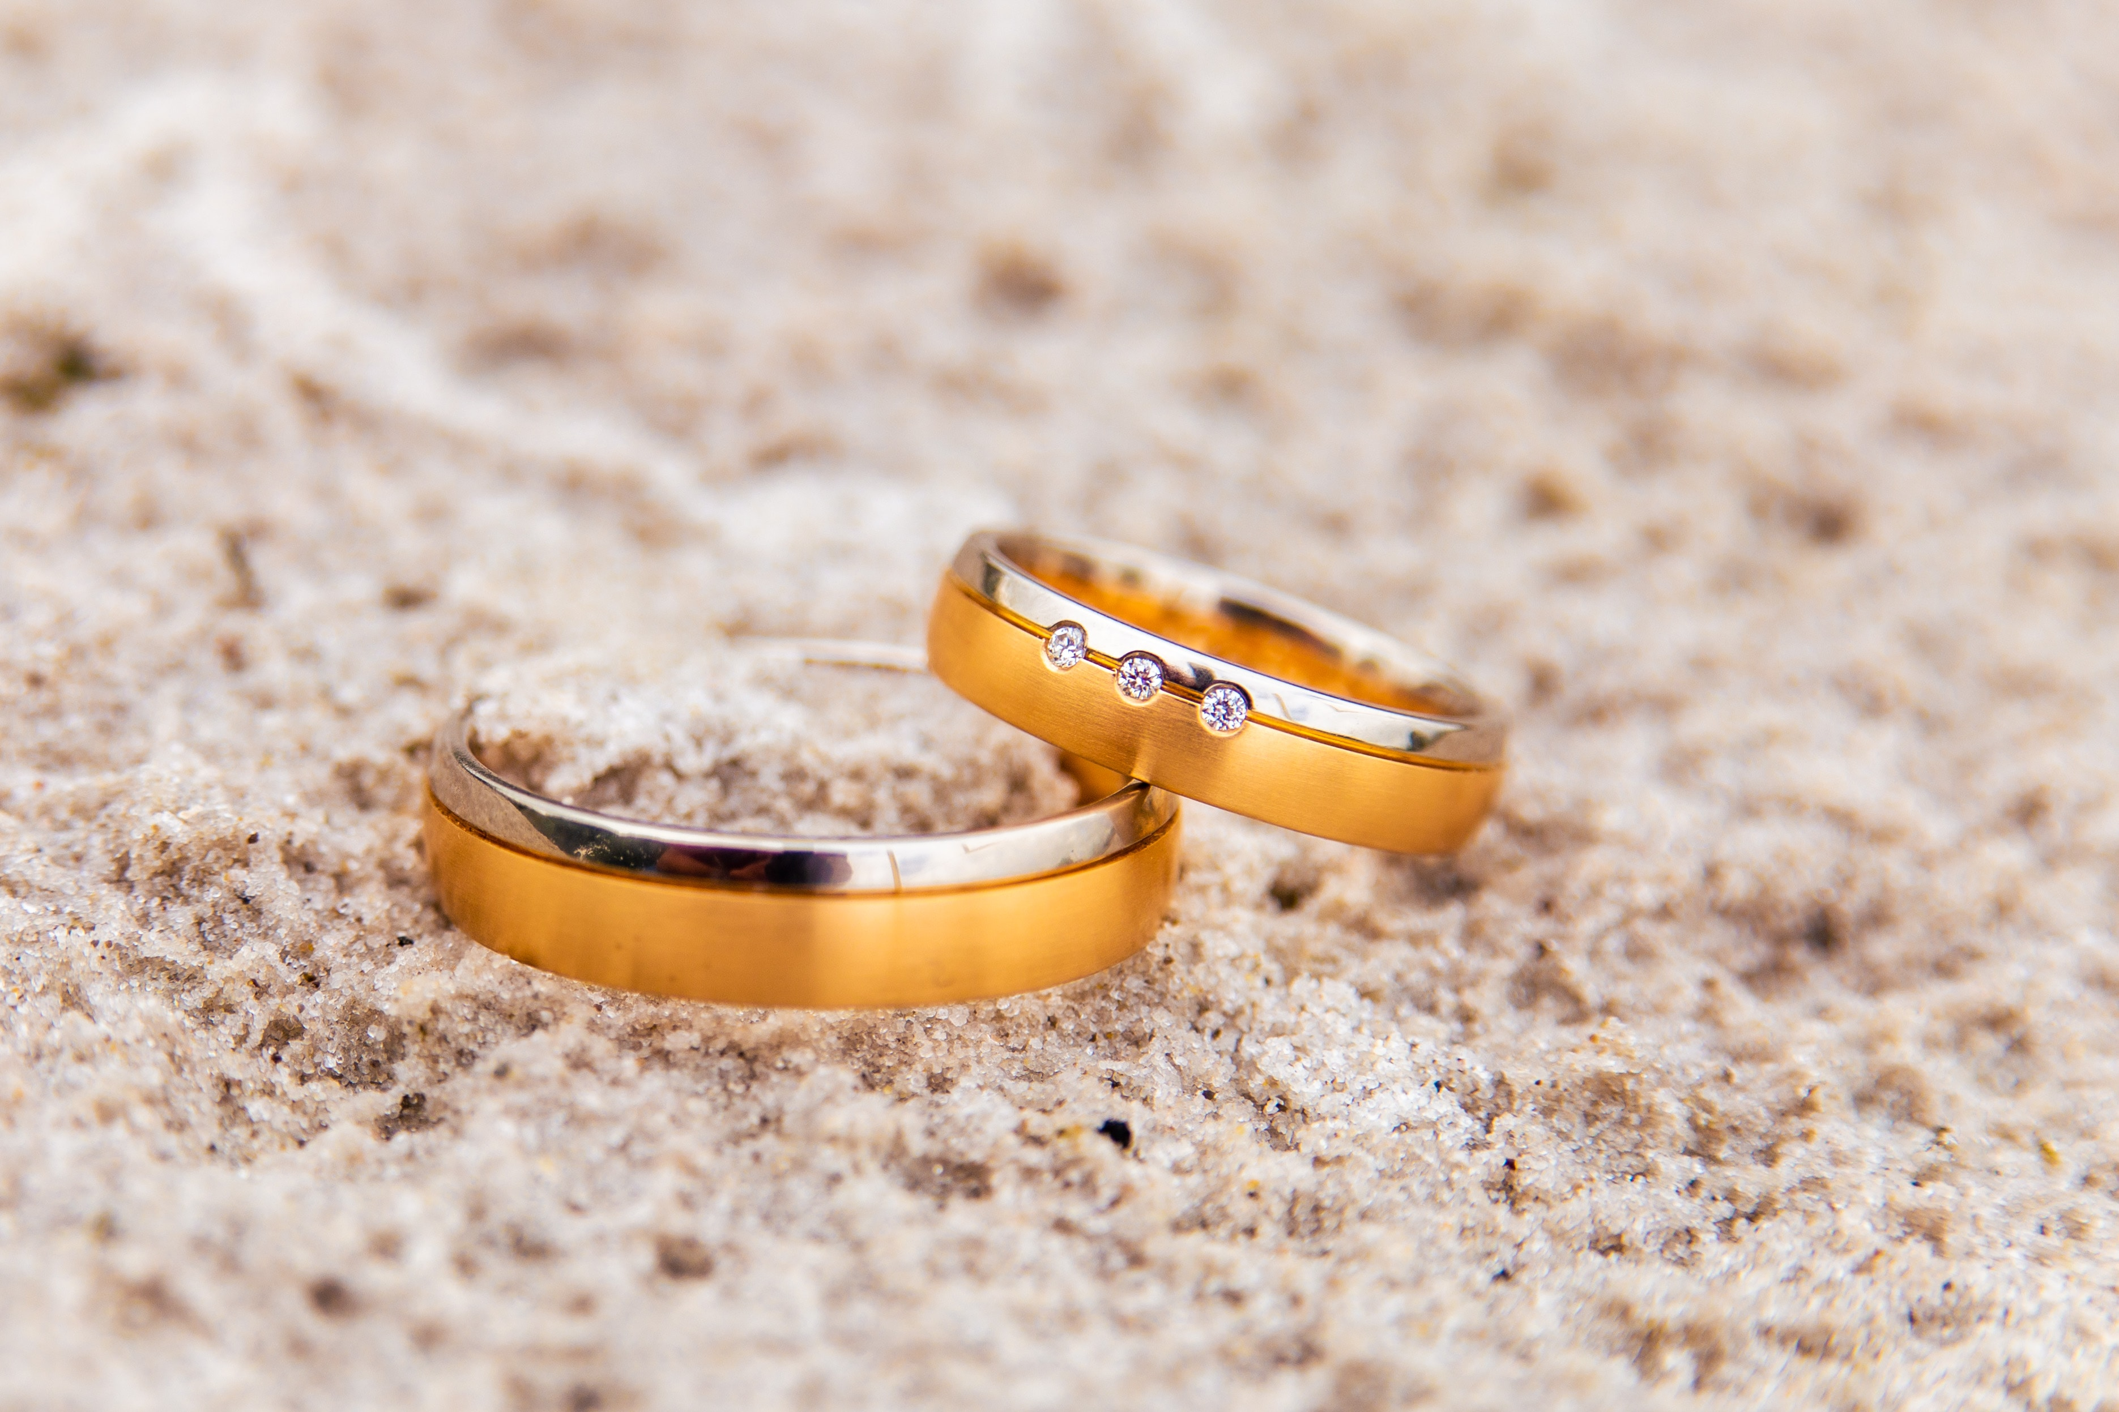
What is the Purpose of My Marriage?
Part 1

Slide 3
Do good works
Fear God & keep his commandments
Please God
Live for Christ (not for self)
Love God Love others
Persuade others
Glorify God by doing His work
Save others
Serve others

Slide 4
Children
Marriage
Worship
Job
Entertainment
Free time

Slide 5
Marriage
Worship
Children
Free time
Entertainment
Job

Slide 6
Two Important Truths About Marriage

Slide 7
Marriage is Short.

Slide 8
25
50+ years?
Birth
Wedding
Death

Slide 9
Eternity

Slide 10
Marriage is Short.
Marriage is a gift.

Slide 11
Genesis 2:21-22
So the Lord God caused a deep sleep to fall upon the man, and while he slept took one of his ribs and closed up its place with flesh. And the rib that the Lord God had taken from the man he made into a woman and brought her to the man.

Slide 12
Marriage is Short.
Marriage is a gift.

Slide 13
The Danger of Worshiping the Gift Instead of the Giver

Slide 14
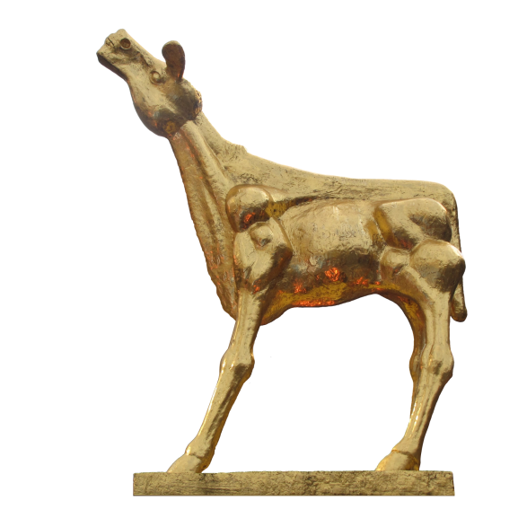
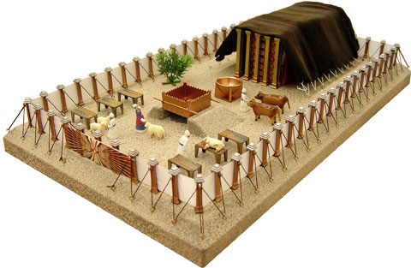
God’s Gift
God’s Purpose:
A way to worship
Man’s Purpose:
An Item to Worship

Slide 15
Hosea 2:8
And she did not know that it was I who gave her the grain, the wine, and the oil, and who lavished on her silver and gold, which they used for Baal.

Slide 16
What This Looks Like with Marriage

Slide 17
Matthew 10:37
Whoever loves father or mother more than me is not worthy of me, and whoever loves son or daughter more than me is not worthy of me.

Slide 18
Luke 14:26
“If anyone comes to me and does not hate his own father and mother and wife and children and brothers and sisters, yes, and even his own life, he cannot be my disciple.

Slide 19
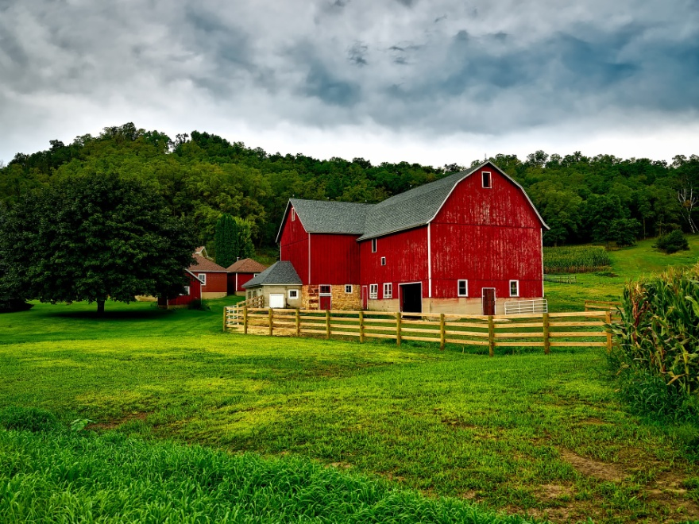
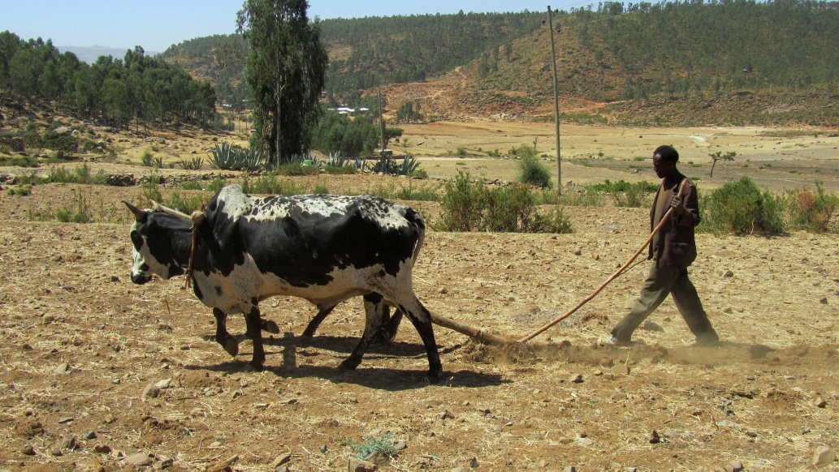
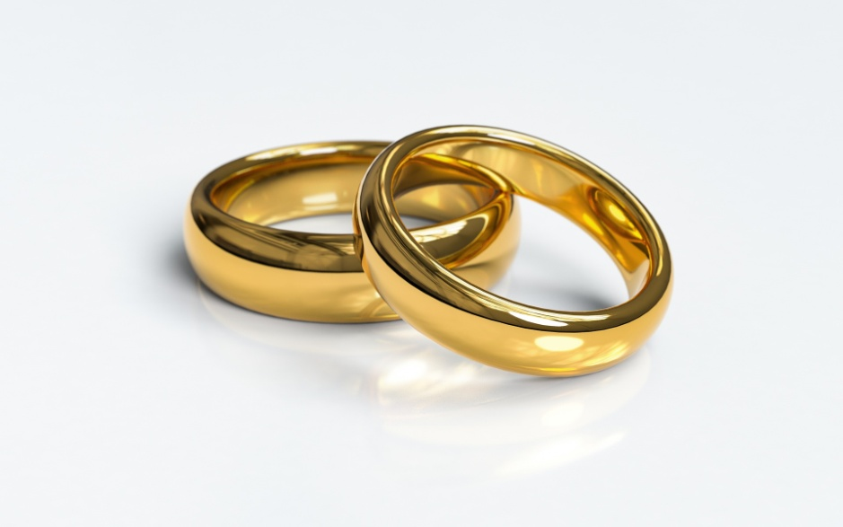
What kept them from coming?

Slide 20
Using God’s Gifts For God

Slide 21
1 Timothy 6:17-19
As for the rich in this present age, charge them not to be haughty, nor to set their hopes on the uncertainty of riches, but on God, who richly provides us with everything to enjoy. They are to do good, to be rich in good works, to be generous and ready to share, thus storing up treasure for themselves as a good foundation for the future, so that they may take hold of that which is truly life.

Slide 22
Marriage is short.

