Slide 1
The Entire Christian Life From Beginning to End

Slide 2
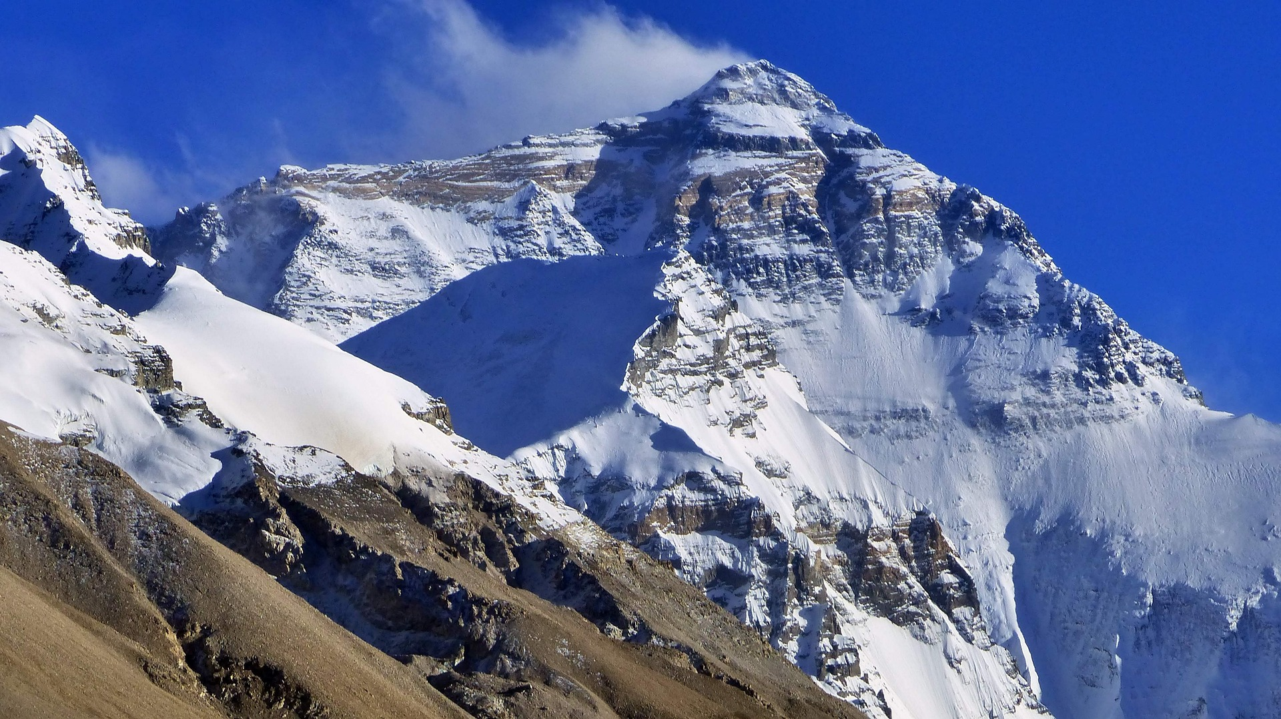
Someone told him about Jesus

Slide 3
John 1:40-42
One of the two who heard John speak and followed Jesus was Andrew, Simon Peter's brother. He first found his own brother Simon and said to him, “We have found the Messiah” (which means Christ). He brought him to Jesus. Jesus looked at him and said, “You are Simon the son of John. You shall be called Cephas” (which means Peter).

Slide 4
Total commitment
Understood sin, mercy, purpose
Someone told him about Jesus

Slide 5
Luke 5:8-11
But when Simon Peter saw it, he fell down at Jesus' knees, saying, “Depart from me, for I am a sinful man, O Lord.”
…
And Jesus said to Simon, “Do not be afraid; from now on you will be catching men.” And when they had brought their boats to land, they left everything and followed him.

Slide 6
Asking questions and learning

Slide 7
Luke 12:41
Peter said, “Lord, are you telling this parable for us or for all?”
Matthew 18:21
Then Peter came up and said to him, “Lord, how often will my brother sin against me, and I forgive him? As many as seven times?”

Slide 8
Growing in faith, doing new things

Slide 9
Matthew 14:28-29
And Peter answered him, “Lord, if it is you, command me to come to you on the water.” He said, “Come.” So Peter got out of the boat and walked on the water and came to Jesus.

Slide 10
Falling, getting back up

Slide 11
Matthew 14:30-31
But when he saw the wind, he was afraid, and beginning to sink he cried out, “Lord, save me.” Jesus immediately reached out his hand and took hold of him, saying to him, “O you of little faith, why did you doubt?”

Slide 12
Learning, understanding better

Slide 13
Matthew 16:15-16
He said to them, “But who do you say that I am?” Simon Peter replied, “You are the Christ, the Son of the living God.”

Slide 14
Falling, getting back up

Slide 15
Matthew 16:22-23
And Peter took him aside and began to rebuke him, saying, “Far be it from you, Lord! This shall never happen to you.” But he turned and said to Peter, “Get behind me, Satan! You are a hindrance to me. For you are not setting your mind on the things of God, but on the things of man.”

Slide 16
Continuing even when he doesn’t have all the answers

Slide 17
John 6:66-69
After this many of his disciples turned back and no longer walked with him.
So Jesus said to the twelve, “Do you want to go away as well?” Simon Peter answered him, “Lord, to whom shall we go? You have the words of eternal life, and we have believed, and have come to know, that you are the Holy One of God.”

Slide 18
Failing, getting back up

Slide 19
Matthew 26:73-75
After a little while the bystanders came up and said to Peter, “Certainly you too are one of them, for your accent betrays you.” Then he began to invoke a curse on himself and to swear, “I do not know the man.” And immediately the rooster crowed. And Peter remembered the saying of Jesus, “Before the rooster crows, you will deny me three times.” And he went out and wept bitterly.

Slide 20
Teaching others, leading others

Slide 21
Acts 2:14
But Peter, standing with the eleven, lifted up his voice and addressed them: “Men of Judea and all who dwell in Jerusalem, let this be known to you, and give ear to my words.

Slide 22
Still Learning

Slide 23
Acts 10:28 And he said to them, “You yourselves know how unlawful it is for a Jew to associate with or to visit anyone of another nation, but God has shown me that I should not call any person common or unclean.

Slide 24
Suffering

Slide 25
Acts 12:1-3 About that time Herod the king laid violent hands on some who belonged to the church. He killed James the brother of John with the sword, and when he saw that it pleased the Jews, he proceeded to arrest Peter also. This was during the days of Unleavened Bread.

Slide 26
Answered prayers

Slide 27
Acts 12:11 When Peter came to himself, he said, “Now I am sure that the Lord has sent his angel and rescued me from the hand of Herod and from all that the Jewish people were expecting.”

Slide 28
Failing, getting back up

Slide 29
Galatians 2:11-13
But when Cephas came to Antioch, I opposed him to his face, because he stood condemned. For before certain men came from James, he was eating with the Gentiles; but when they came he drew back and separated himself, fearing the circumcision party. And the rest of the Jews acted hypocritically along with him, so that even Barnabas was led astray by their hypocrisy.

Slide 30
Teaching, leading, suffering

Slide 31
1 Peter 5:1-2
So I exhort the elders among you, as a fellow elder and a witness of the sufferings of Christ, as well as a partaker in the glory that is going to be revealed: shepherd the flock of God that is among you, exercising oversight, not under compulsion, but willingly, as God would have you; not for shameful gain, but eagerly;

Slide 32
Looking to the end, care for those still on the journey

Slide 33
2 Peter 1:12-15
Therefore I intend always to remind you of these qualities, though you know them and are established in the truth that you have. I think it right, as long as I am in this body, to stir you up by way of reminder, since I know that the putting off of my body will be soon, as our Lord Jesus Christ made clear to me. And I will make every effort so that after my departure you may be able at any time to recall these things.

Slide 35
2 Peter 3:18
But grow in the grace and knowledge of our Lord and Savior Jesus Christ. To him be the glory both now and to the day of eternity. Amen.

