Slide 1
“End Time”
Confusion

Slide 2
Rebuilding the Temple

Slide 3
Old Testament prophecies of future Israel
Amos 9:11-15
Ezekiel 40-48

Slide 4
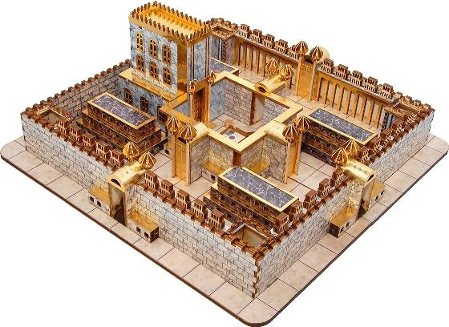

Slide 5
How did early Christians view Old Testament prophecies?
Acts 15:13-17

Slide 6
How did early Christians view the temple?
Hebrews 9:1-14
1 Peter 2:4-5

Slide 7
Lesson:
We need to read the Old Testament the way the early Christians read it.

Slide 8
The Rapture

Slide 9
How many times does Christ come?

Slide 10
Hebrews 9:27-28
And just as it is appointed for man to die once, and after that comes judgment, so Christ, having been offered once to bear the sins of many, will appear a second time, not to deal with sin but to save those who are eagerly waiting for him.

Slide 11
Primary text on the rapture:
1 Thessalonians 4:13-18

Slide 12
Problems with reading this text as the rapture:
Very well announced
Salvation AND judgment

Slide 13
But what about…
Matthew 24:40-42

Slide 14
Chapter answering two questions
When will temple be destroyed?
What will be the sign of your coming?

Slide 15
In this text, what does it mean to be “taken”?
Jesus’ coming
The flood
“Swept away”
“taken”

Slide 16
Christ’s return
is final

Slide 17
The Simpler Approach
Christ’s 2nd coming
Christ’s 1st coming
(salvation & judgment)
(sacrifice)
Former times
Last days

