Slide 1
The sermon will begin soon.

Slide 3
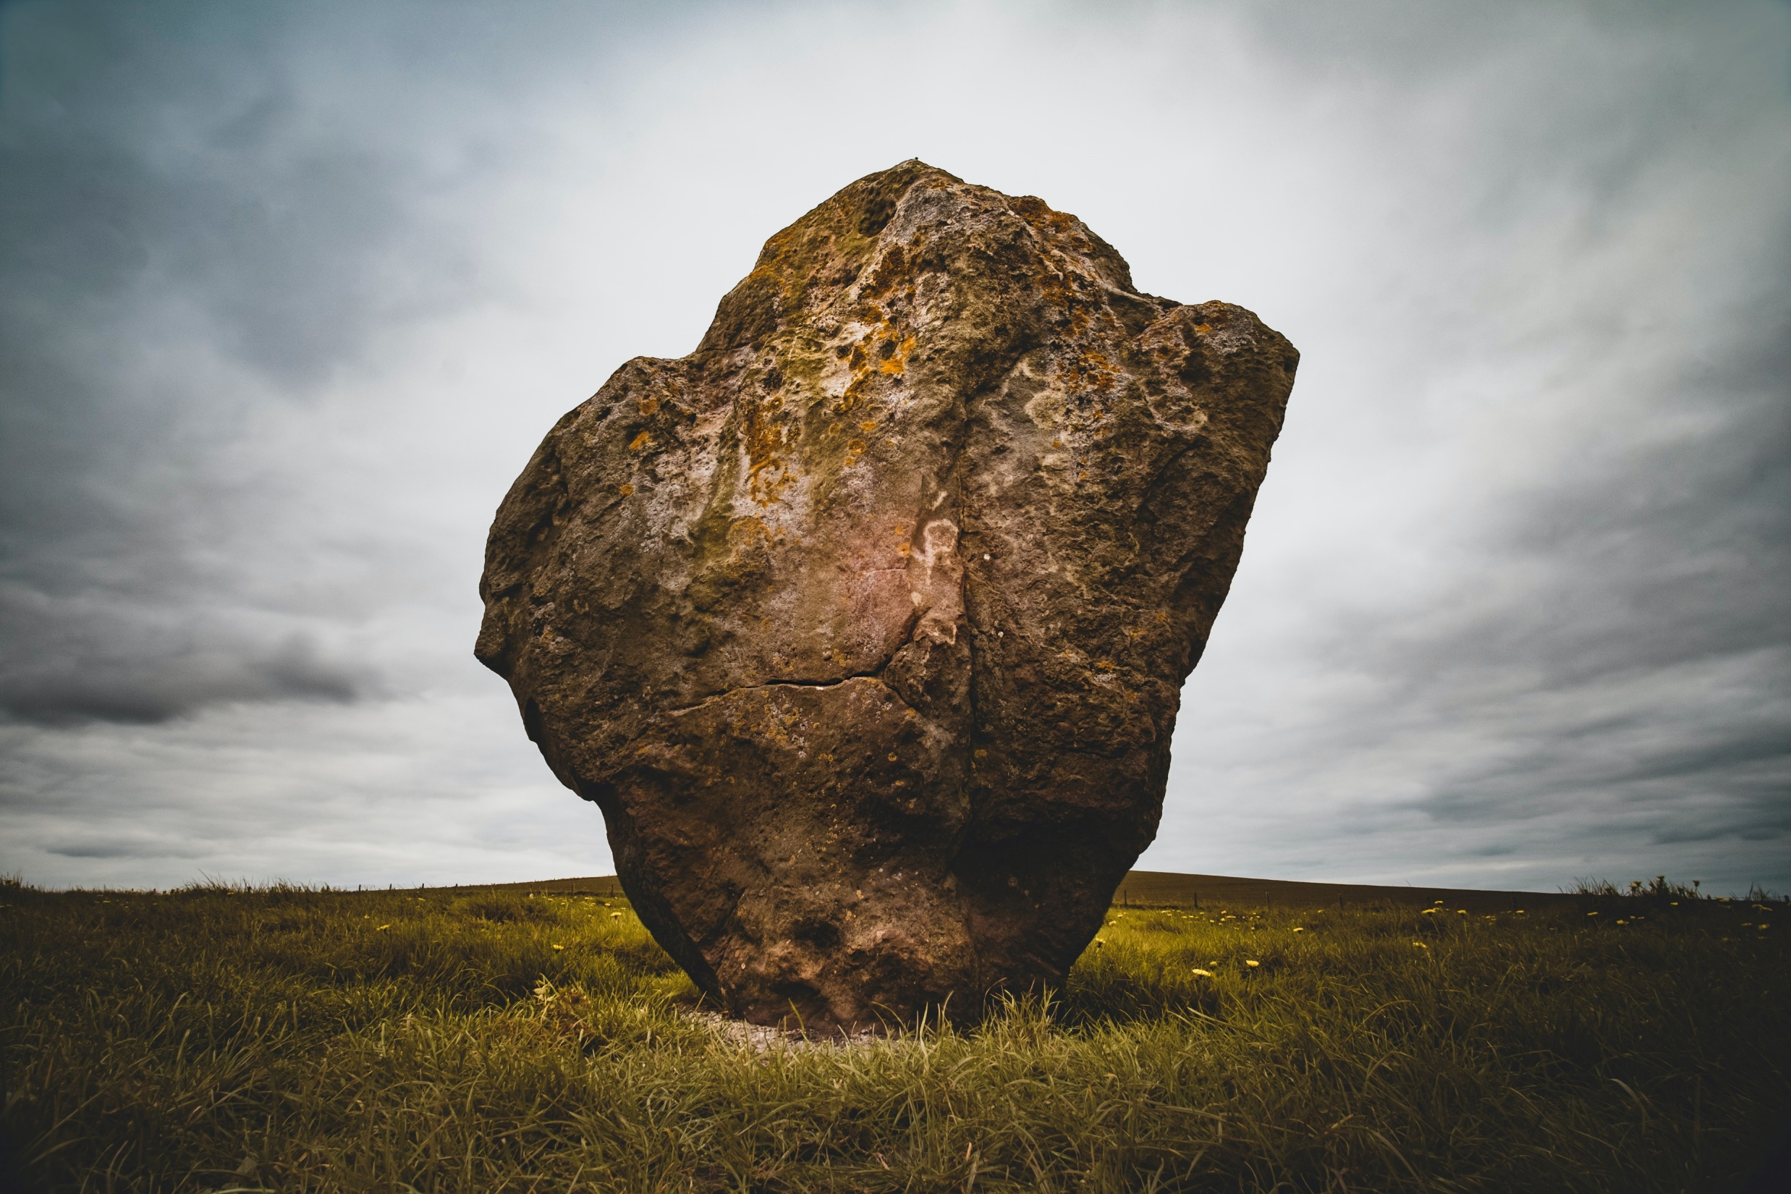
Praise God for this
Look forward to this

Slide 4
Five Reasons
Why
This is an Important Moment

Slide 5
1. Because
God’s Design
is Important

Slide 6
And he gave the apostles, the prophets, the evangelists, the shepherds and teachers, to equip the saints for the work of ministry, for building up the body of Christ,
Ephesians 4:11-12

Slide 7
2. Because
Unity
is Important

Slide 8
I therefore, a prisoner for the Lord, urge you to walk in a manner worthy of the calling to which you have been called, with all humility and gentleness, with patience, bearing with one another in love, eager to maintain the unity of the Spirit in the bond of peace. There is one body and one Spirit—just as you were called to the one hope that belongs to your call—one Lord, one faith, one baptism, one God and Father of all, who is over all and through all and in all.
Ephesians 4:1-6

Slide 9
And he gave the apostles, the prophets, the evangelists, the shepherds and teachers, to equip the saints for the work of ministry, for building up the body of Christ, until we all attain to the unity of the faith
Ephesians 4:11-13

Slide 10
3. Because
Growth
is Important

Slide 11
…the shepherds and teachers, to equip the saints for the work of ministry, for building up the body of Christ, until we all attain to the unity of the faith and of the knowledge of the Son of God, to mature manhood, to the measure of the stature of the fullness of Christ,
Ephesians 4:11-13

Slide 12
4. Because
Truth
is Important

Slide 13
…the shepherds and teachers, to equip the saints for the work of ministry, for building up the body of Christ, until we all attain to the unity of the faith and of the knowledge of the Son of God, to mature manhood, to the measure of the stature of the fullness of Christ,
Ephesians 4:11-13

Slide 14
so that we may no longer be children, tossed to and fro by the waves and carried about by every wind of doctrine, by human cunning, by craftiness in deceitful schemes.
Ephesians 4:14

Slide 15
5. Because
Love
is Important

Slide 16
Rather, speaking the truth in love, we are to grow up in every way into him who is the head, into Christ, from whom the whole body, joined and held together by every joint with which it is equipped, when each part is working properly, makes the body grow so that it builds itself up in love.
Ephesians 4:15-16

Slide 17
Let’s praise God for leading us to this point.
Let’s look to the future with boldness.

Slide 19
Thank you for watching!
Next live video:
Lesson tonight @ 6:00pm

