Slide 1
The sermon will begin soon.

Slide 3
Stewardship of Time

Slide 4
Time in the Bible

Slide 5
God created measurements
of time.

Slide 6
Blessing from God

Slide 7
Psalm 104:27-30
⁷ These all look to you, to give them their food in due season. ²⁸ When you give it to them, they gather it up; when you open your hand, they are filled with good things.²⁹ When you hide your face, they are dismayed; when you take away their breath, they die and return to their dust. ³⁰ When you send forth your Spirit, they are created, and you renew the face of the ground.

Slide 8
Isaiah 38:4-5
Then the word of the Lord came to Isaiah: “Go and say to Hezekiah, Thus says the Lord, the God of David your father: I have heard your prayer; I have seen your tears. Behold, I will add fifteen years to your life.

Slide 9
Blessing from God
?
Temptation

Slide 10
Good works
Brought up children
Shown hospitality
Washed the saints’ feet
Cared for the afflicted
Devoted to every good work
Idlers
Gossips
Busybodies
Say what they should not

Slide 11
How do we use our time effectively?

Slide 12
What did Moses say?
Psalm 90:12
So teach us to number our days that we may get a heart of wisdom.

Slide 13
What did Moses say?
See this
= Wisdom

Slide 14
What did Paul say?
See this
= Wisdom

Slide 15
What did Jesus say?
Not see this
= Foolish

Slide 16
The Ultimate Solution:
How Jesus Managed Time

Slide 17
Jesus lived with
PURPOSE

Slide 18
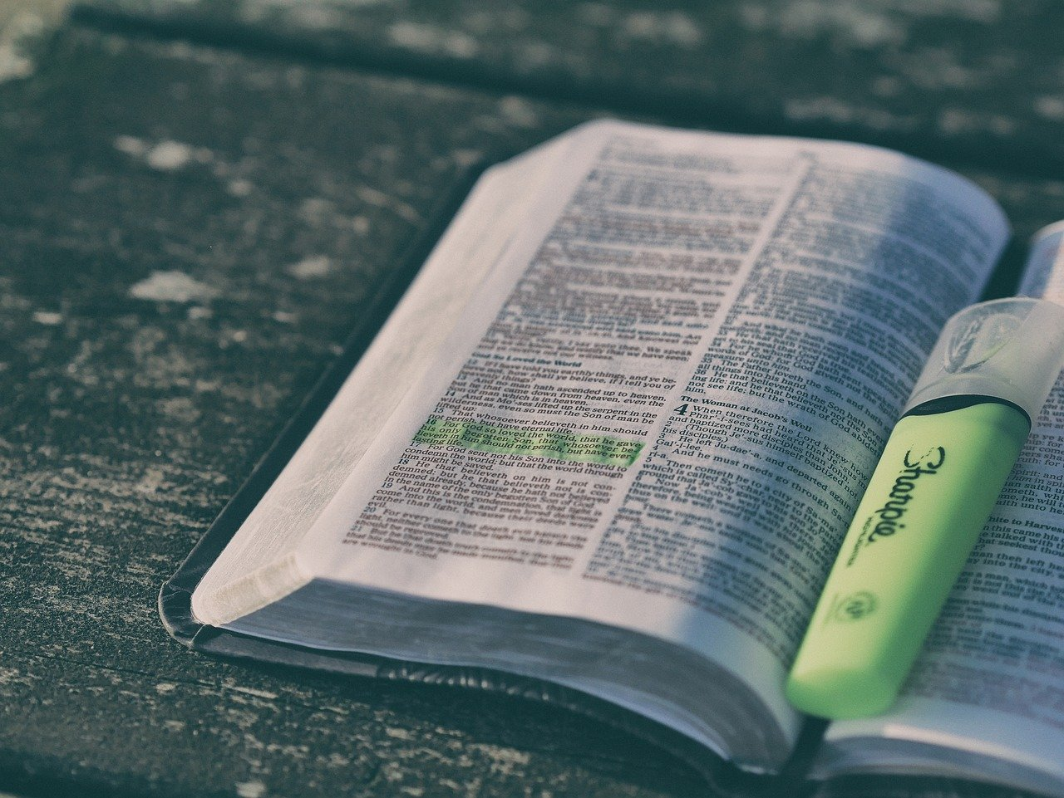
Time to Learn
“Have to be in Father’s house”

Slide 19
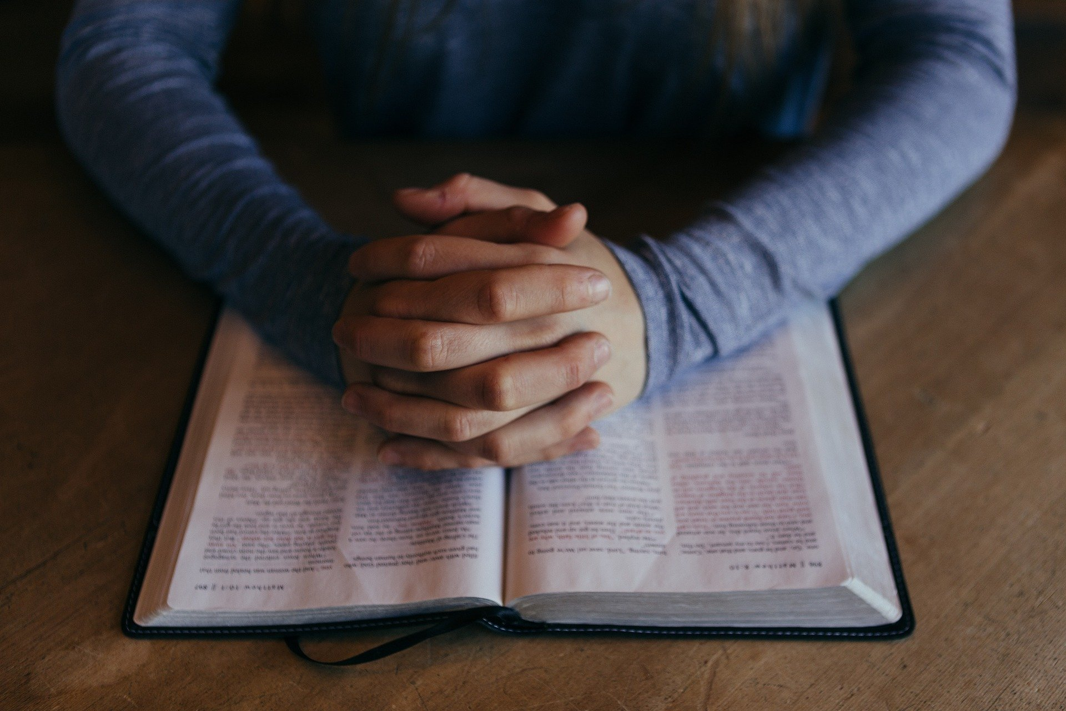
Time to Pray
“That is why I came”

Slide 20
Time to Teach
“Food to do the will of Him who sent me”

Slide 21
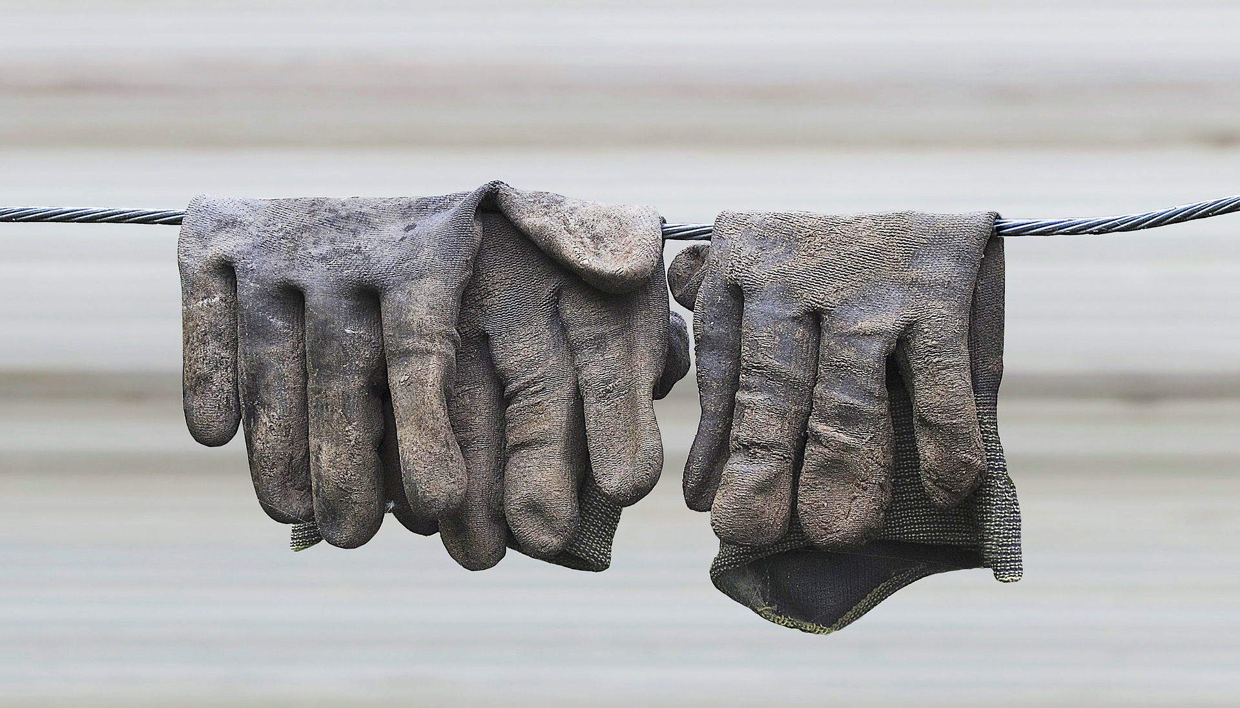
Time to Serve
“Works of Him who sent me”

Slide 22
Jesus lived with
PURPOSE

Slide 23
“As you sent me into the world, so I have sent them into the world.”
- John 17:18

Slide 24
Thank you for watching!
Next live video:
Lesson tonight @ 6:00 pm
Topic: Power in Weakness

