Slide 1
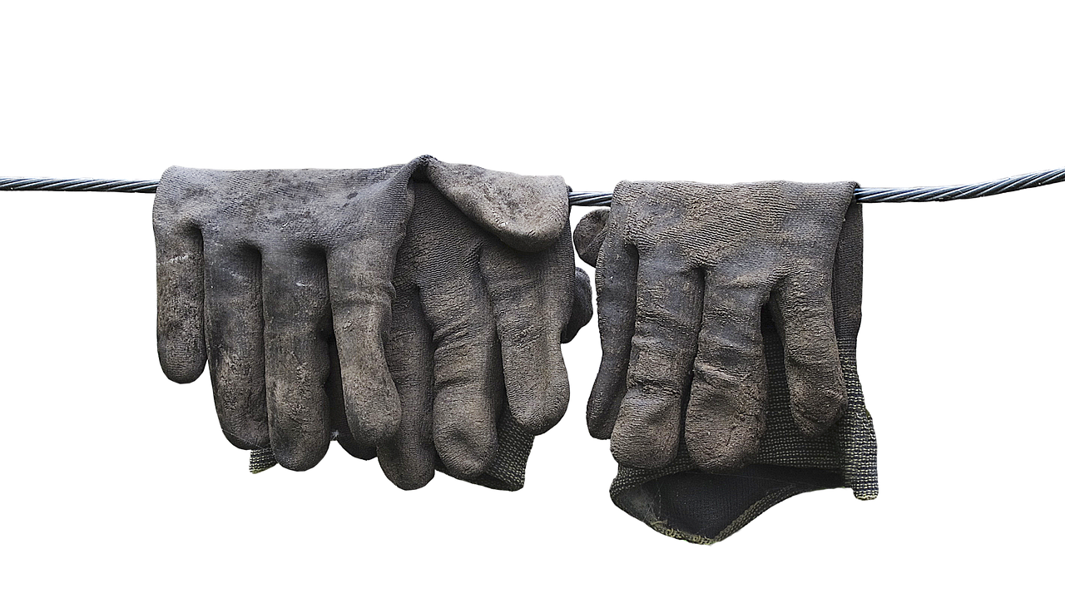
Entrusted to Serve

Slide 2
Limited Resources
Time
Money
Energy
Emotions

Slide 3
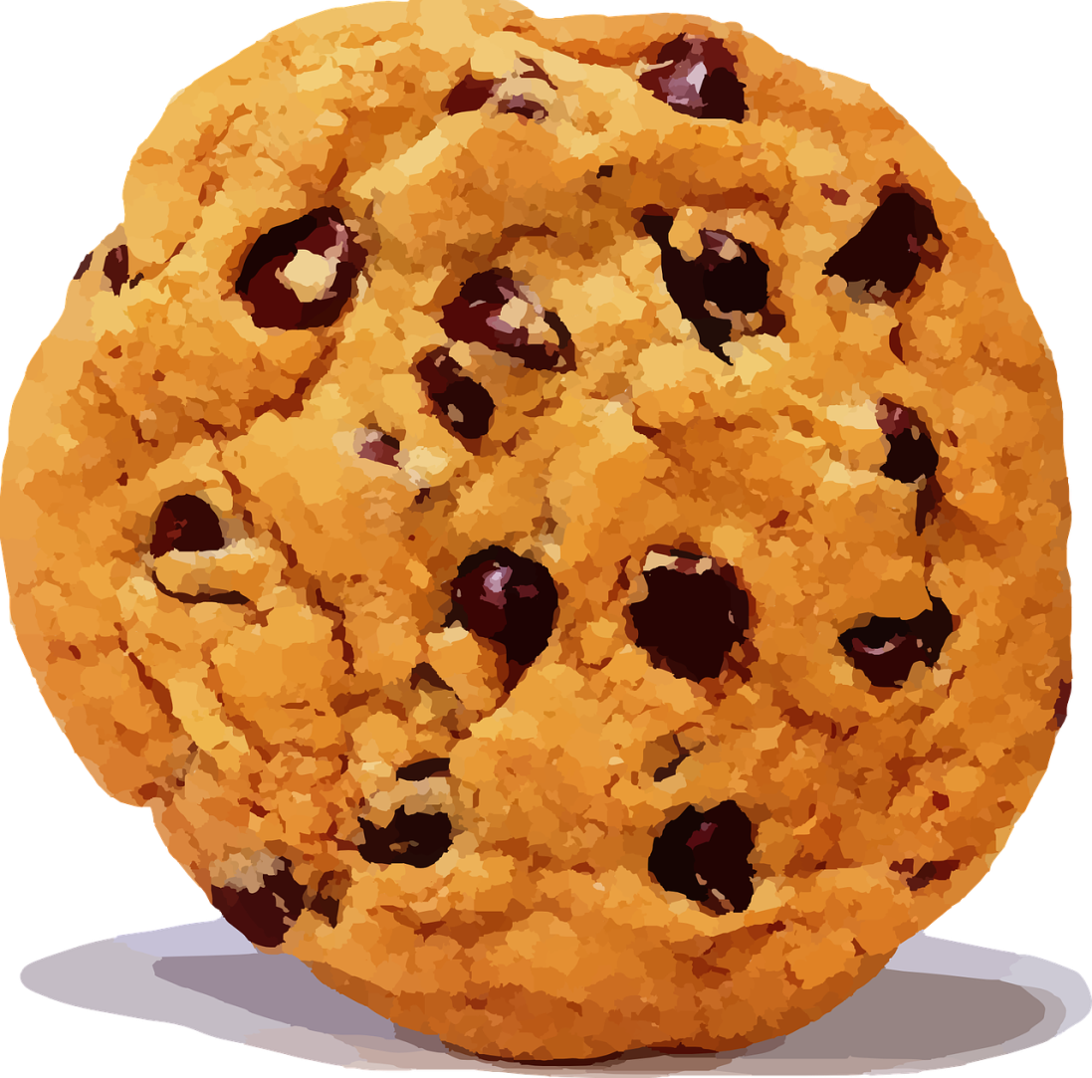
Limited Resources

Slide 4
How much should I share?
This much?

Slide 5
How much should I share?
Here you go.

Slide 6
How much should I share?
Nabal’s Thinking
My Cookie

Slide 7
How much should I share?
Nebuchadnezzar’s Thinking
My Cookie

Slide 8
How much should I share?
GIFT

Slide 9
Thinking Like a Servant

Slide 10
The Nature of a Servant

Slide 11
Master
Complete Authority
Servant

Slide 12
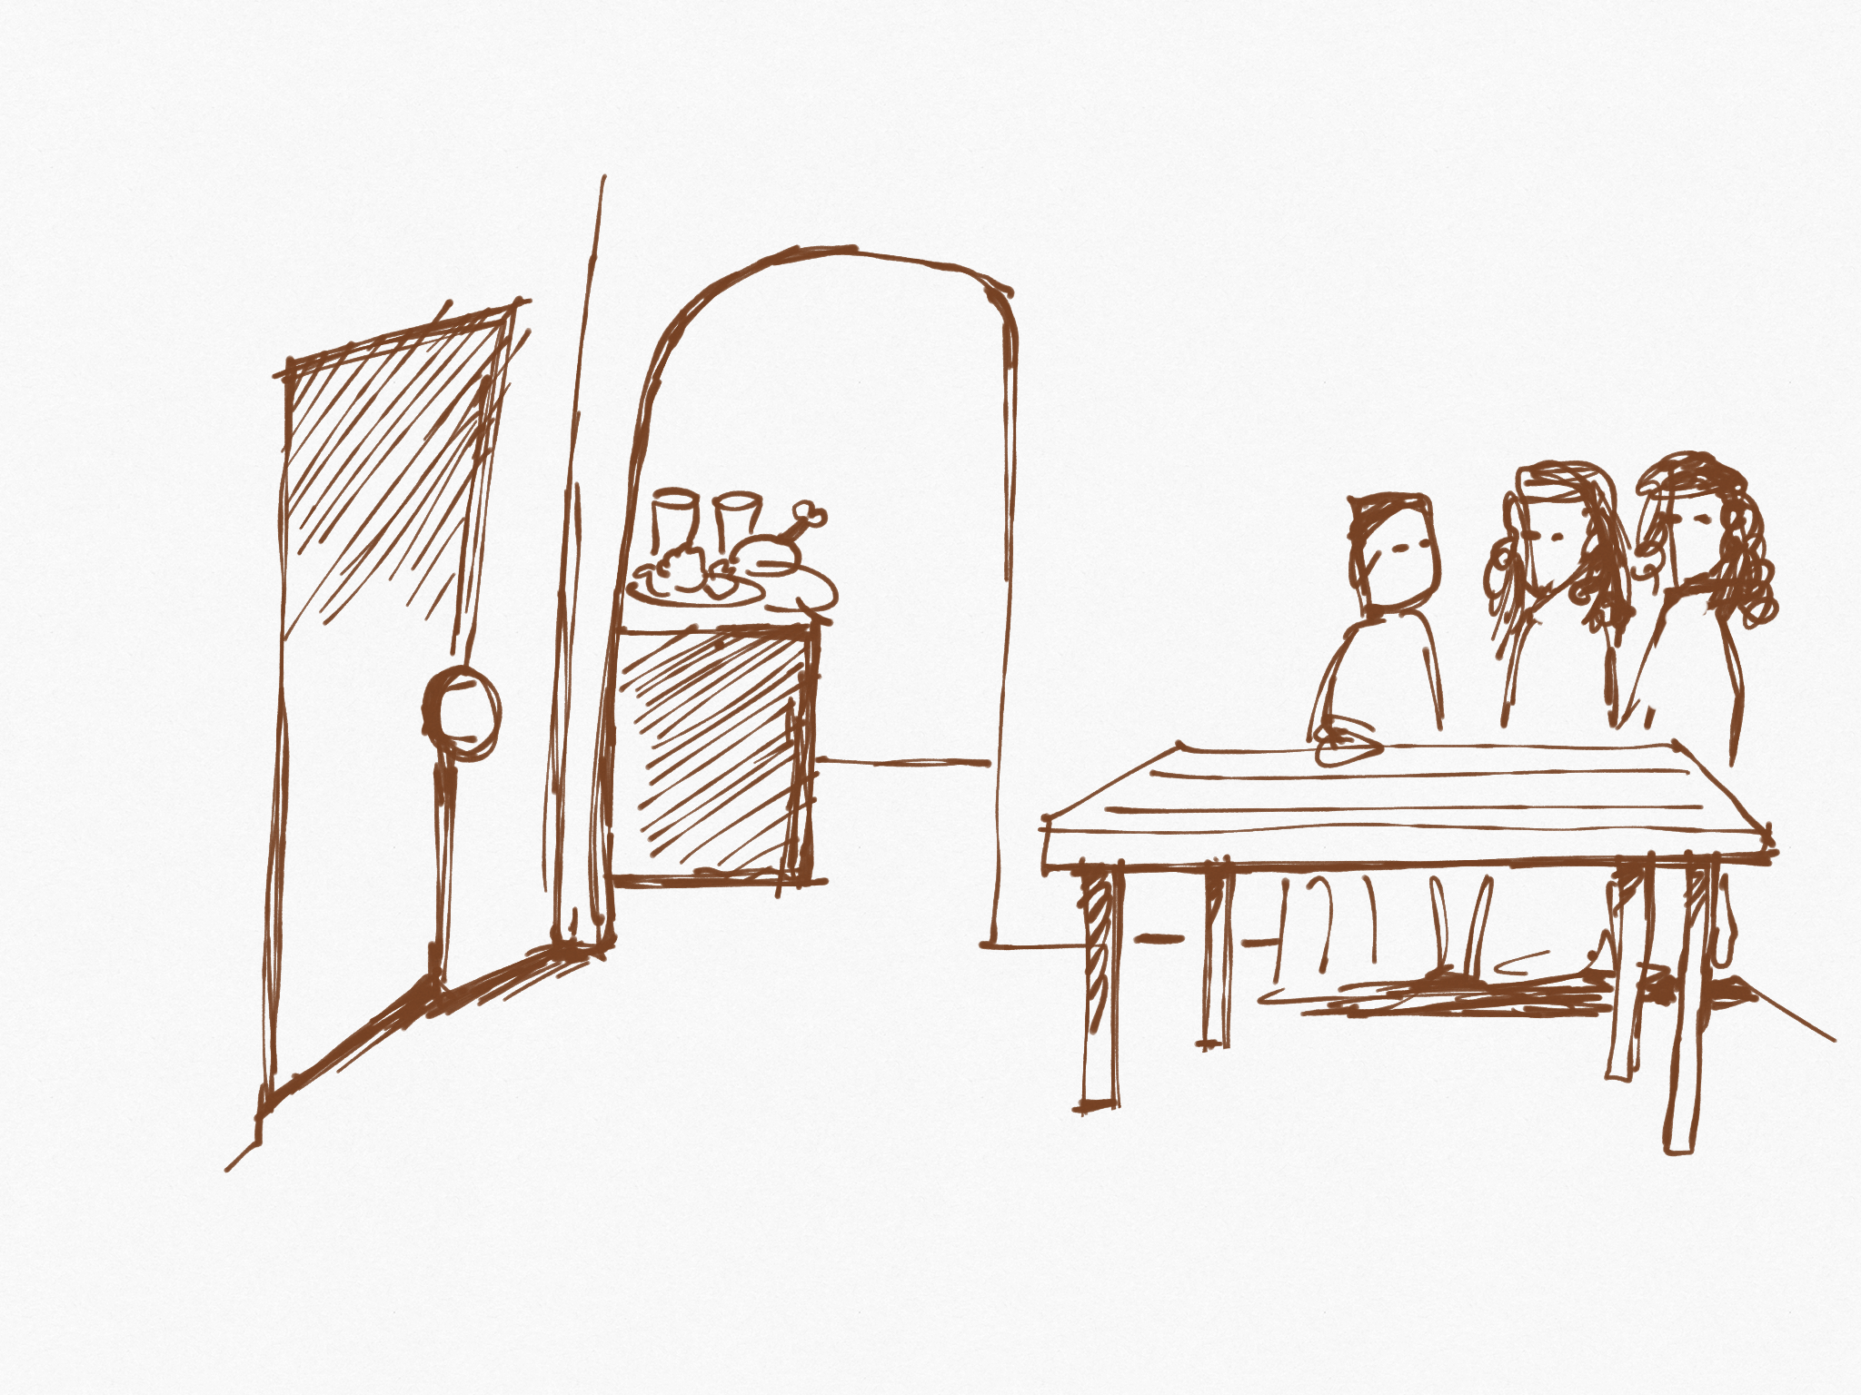
Not my food
Not my table
Not my house

Slide 13
The Duty of a Servant

Slide 14
Authority

Slide 15
Responsibility of care

Slide 16
Give it to the master’s household
Take the master’s food

Slide 17
1 Peter 4:10
As each has received a gift, use it to serve one another, as good stewards of God's varied grace.

Slide 18
Galatians 5:13-14
For you were called to freedom, brothers. Only do not use your freedom as an opportunity for the flesh, but through love serve one another. For the whole law is fulfilled in one word: “You shall love your neighbor as yourself.”

Slide 19
Matthew 20:28
Even as the Son of Man came not to be served but to serve, and to give his life as a ransom for many.”

Slide 20
When the Master Returns

Slide 21
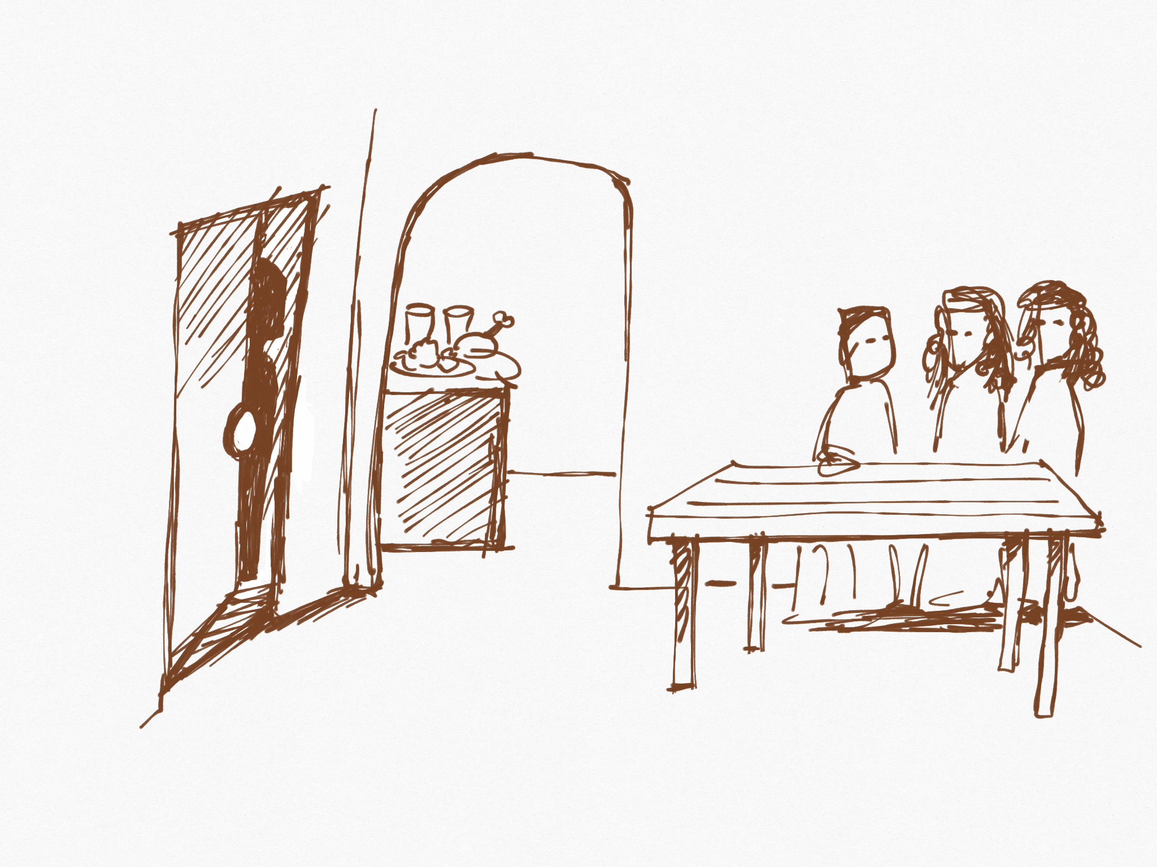
Master arrives
Given More Responsibility!

Slide 22
The Wicked Servant

Slide 24
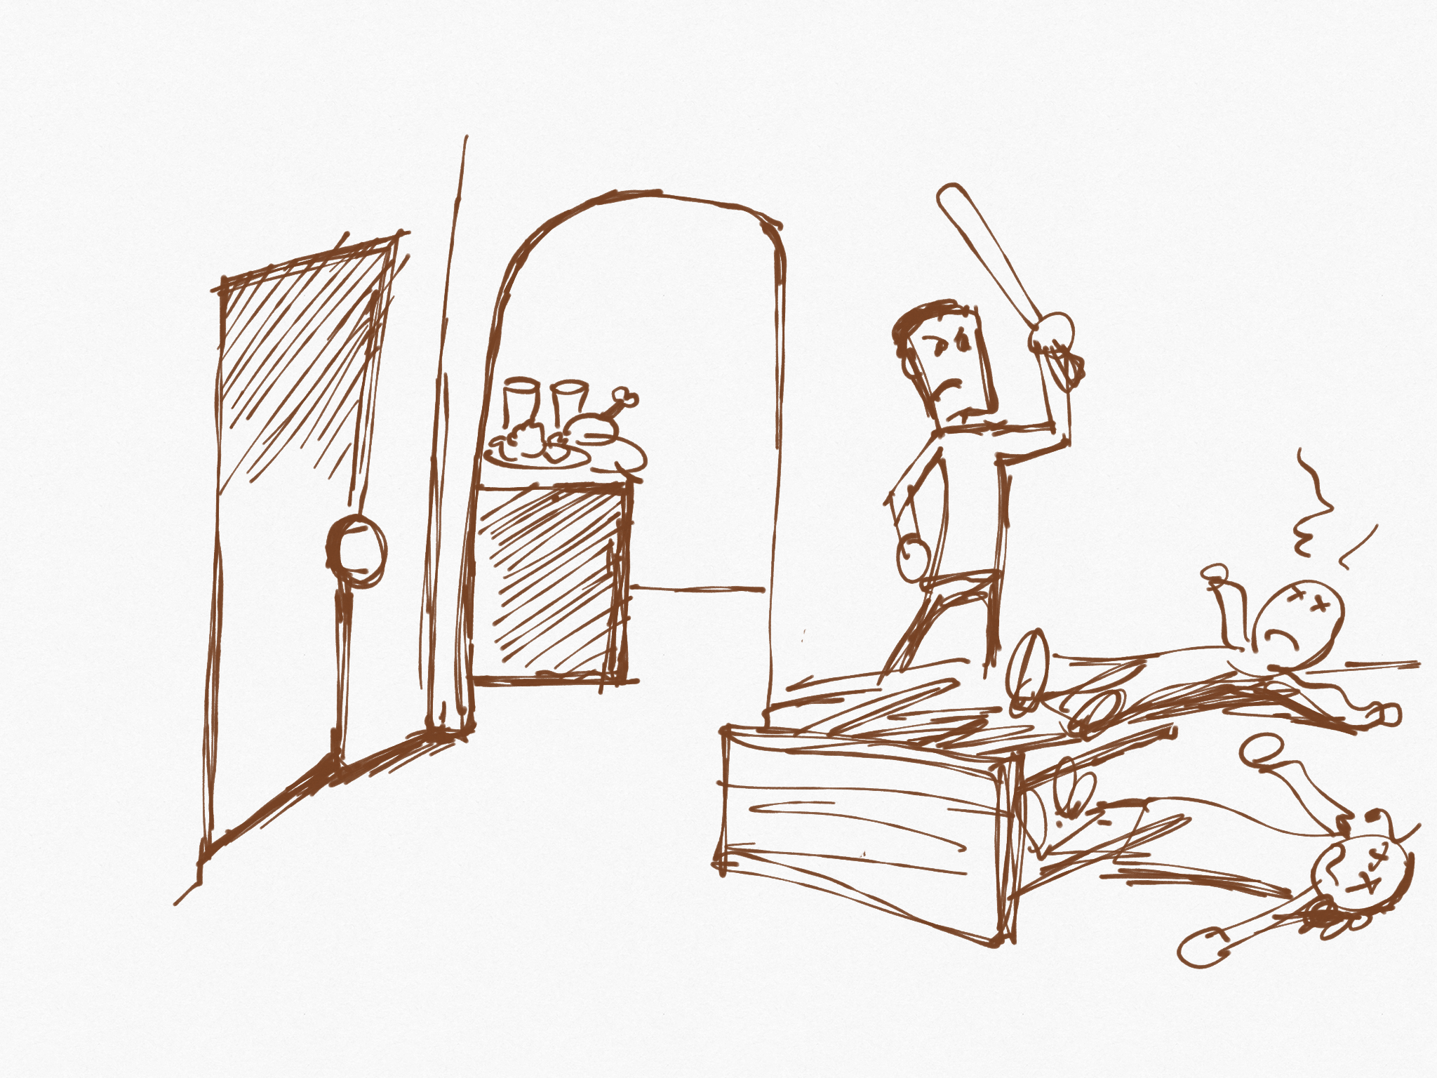
Mistreats household instead of serving

Slide 25
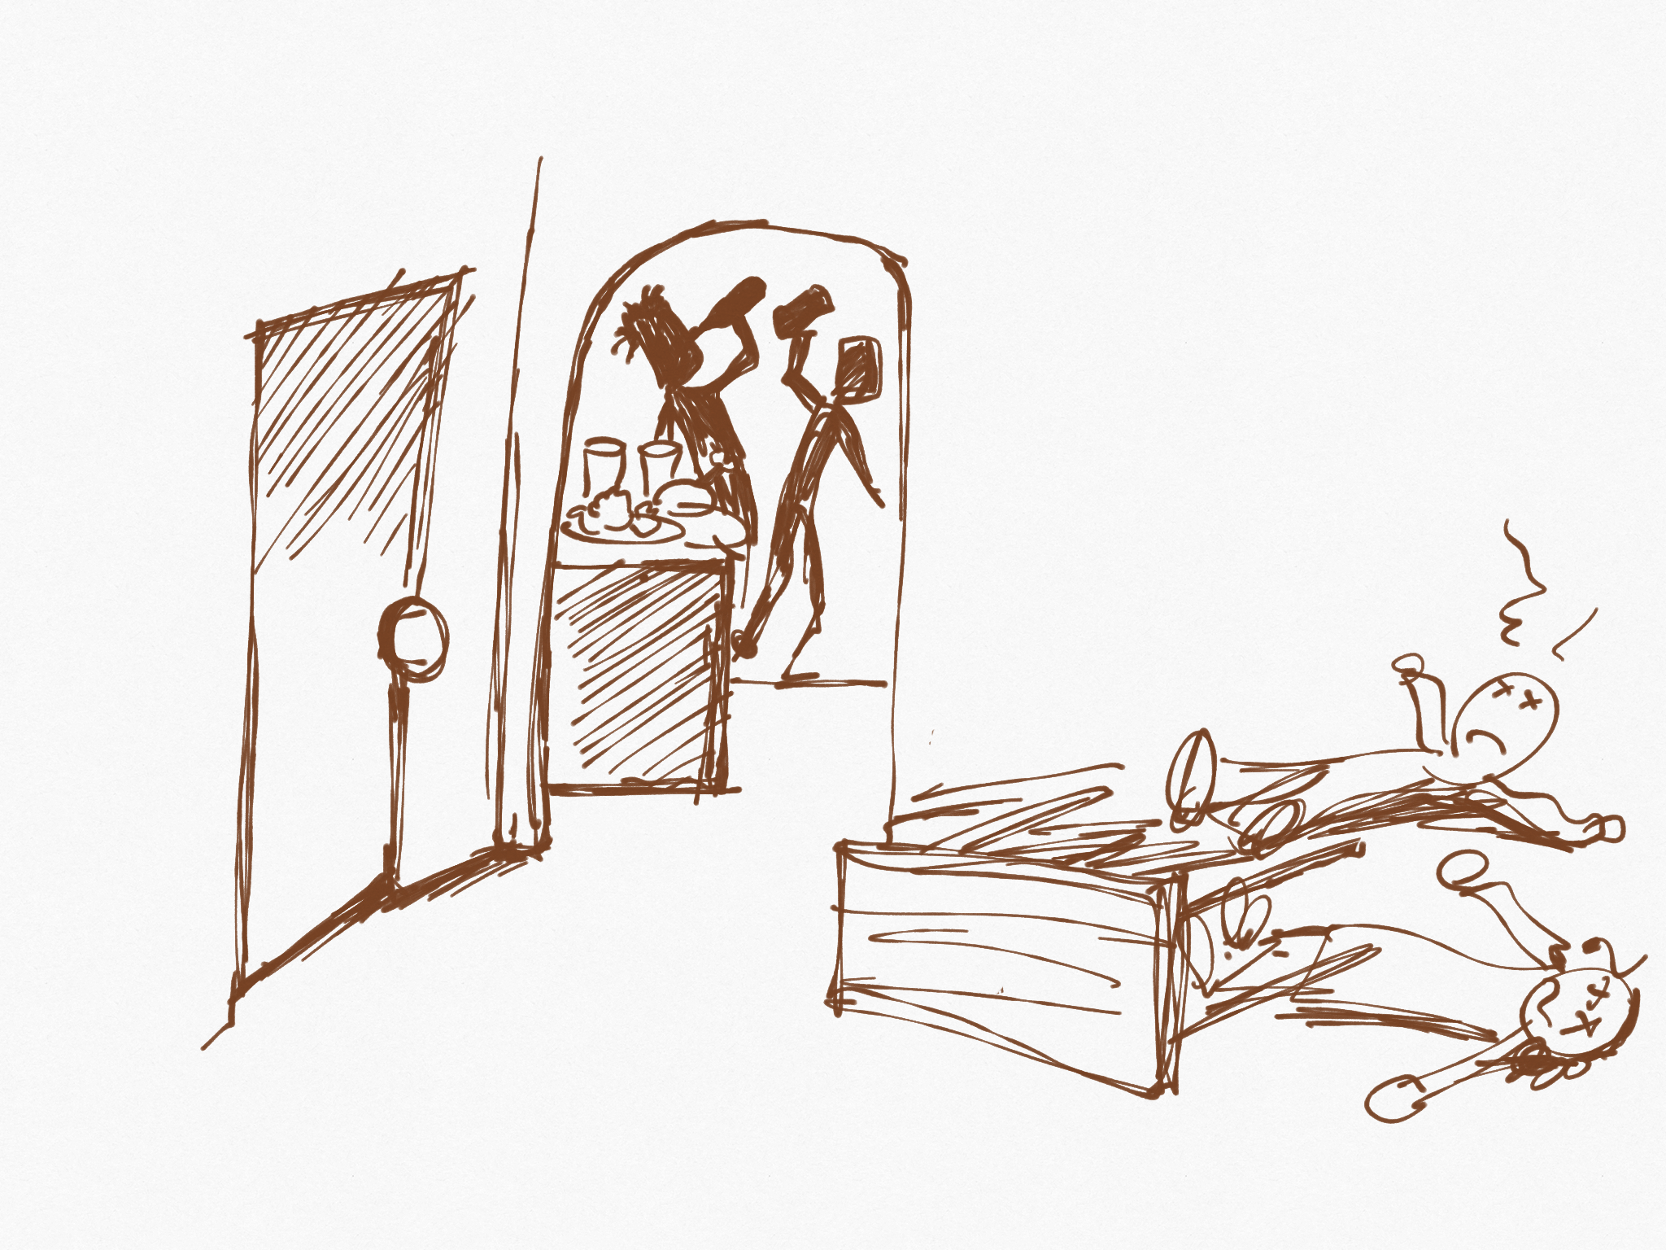
Uses master’s resources for self
How does this happen?

Slide 26
1. Lose focus on master’s return
2. Influence of others

Slide 27
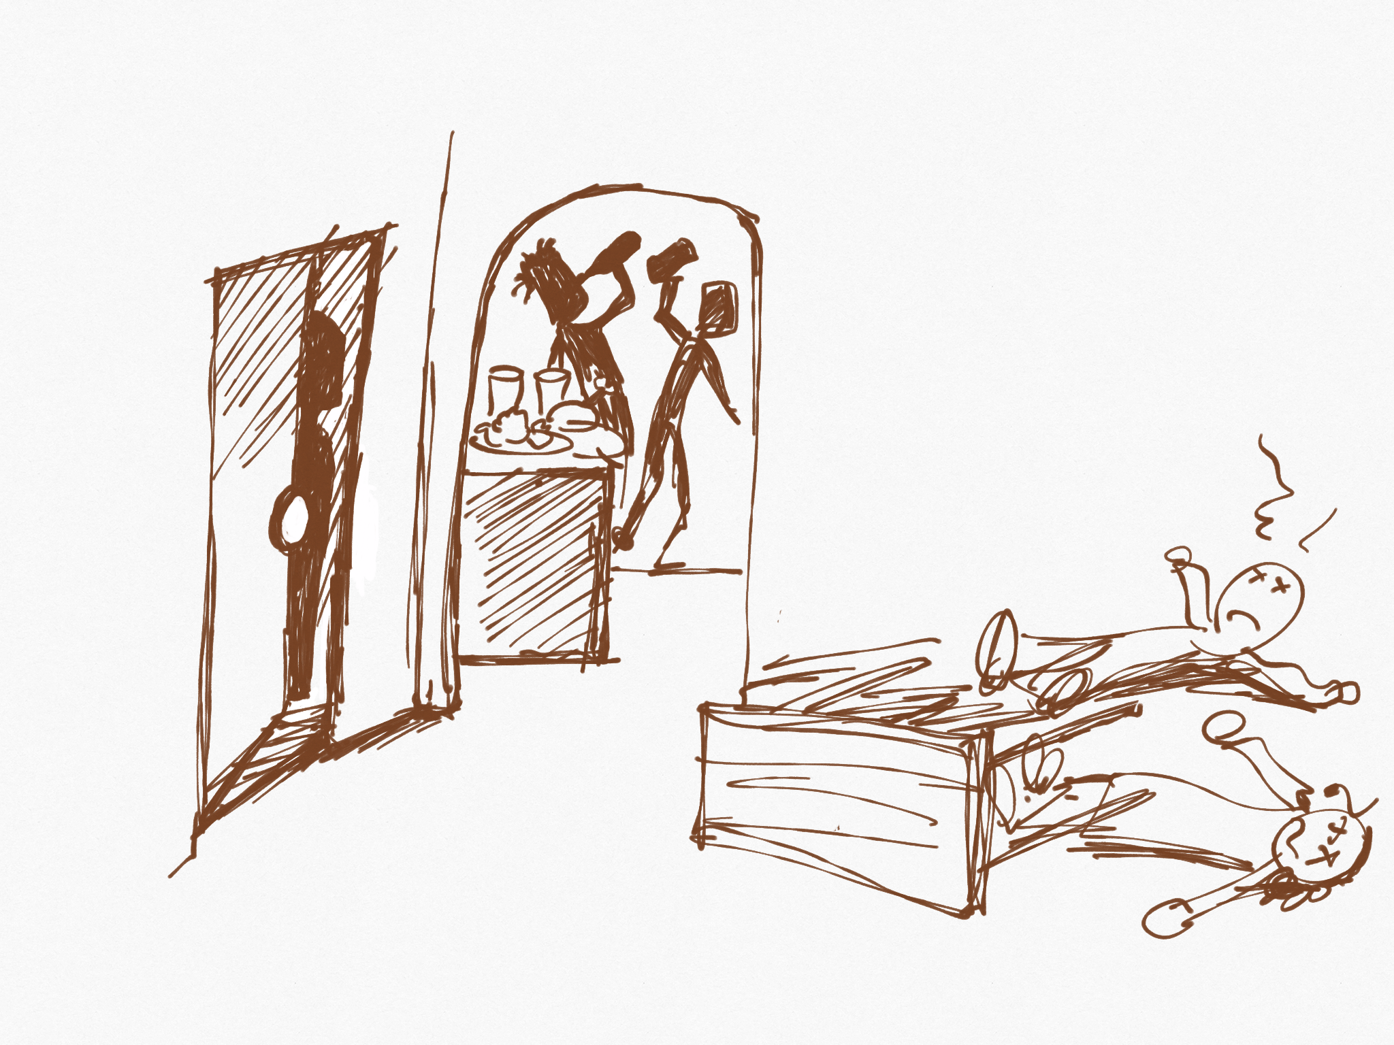
Master arrives
Punished

Slide 28
Why This Is So Important Today

Slide 29
Naturally going to drift towards this.

Slide 30
Paul’s Example

Slide 31
Let’s think like servants preparing for their master’s return.

Slide 32
The Really Strange Part of This:

Slide 33
Servant
Serves
Master

