Slide 1
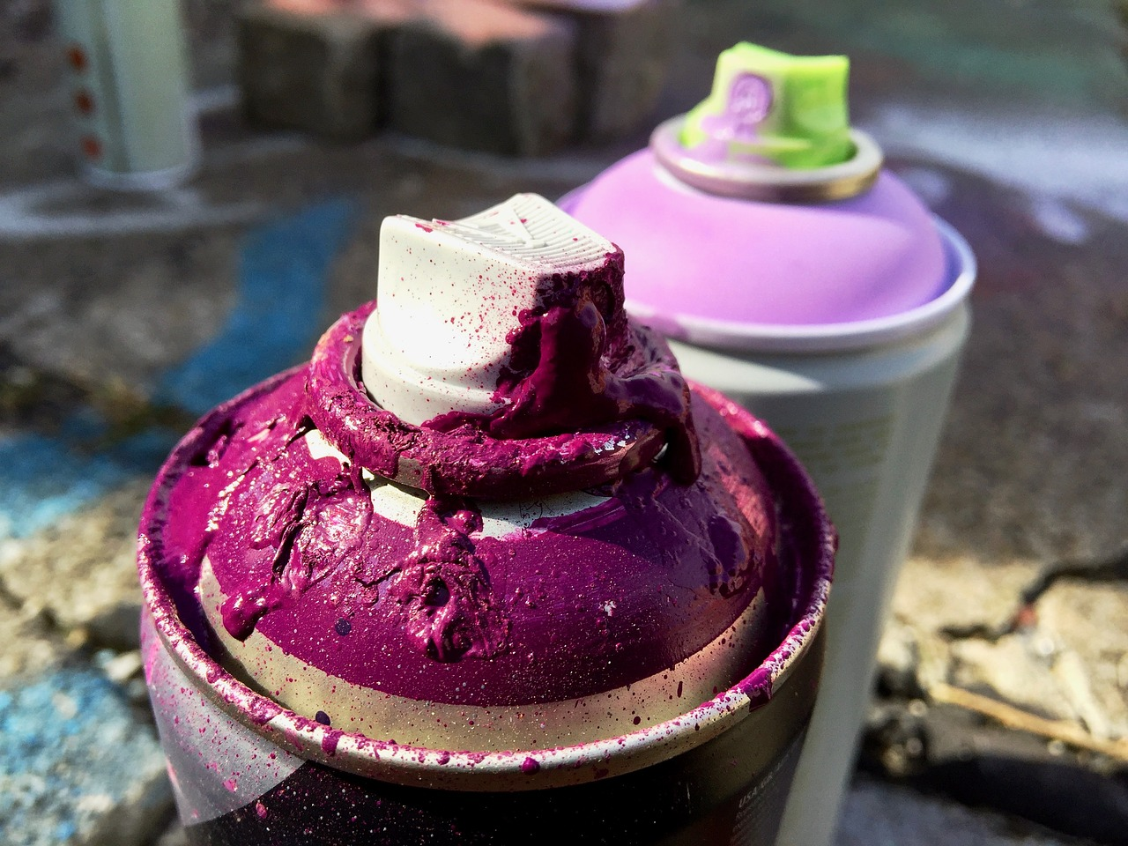
DO THINGS
WELL

Slide 2
Man with 1 bag of silver

Slide 3
How the World Sees Life
No Goal

Slide 4
How the World Sees Life
ME
When you have no goal, you become the goal.

Slide 5
How the World Sees Life

Slide 6
How Peter Sees Life
Christ’s
Return

Slide 7
Christ’s
Return
Keys this focus:
Self-control
Thinking
Praying
Being a Steward

Slide 8
How to Do Things Well

Slide 9
1
Think in terms of God’s Grace
Appreciate grace
Use grace outside of yourself.
Use grace like it’s from God

Slide 10
2
“In everything”
God deserves it
Think in terms of God’s Glory

Slide 11
1
Think in terms of God’s Grace
2
Think in terms of God’s Glory

Slide 12
Examples

Slide 13
Think in terms of God’s Grace
Think in terms of God’s Glory
Love
Earnestly

Slide 14
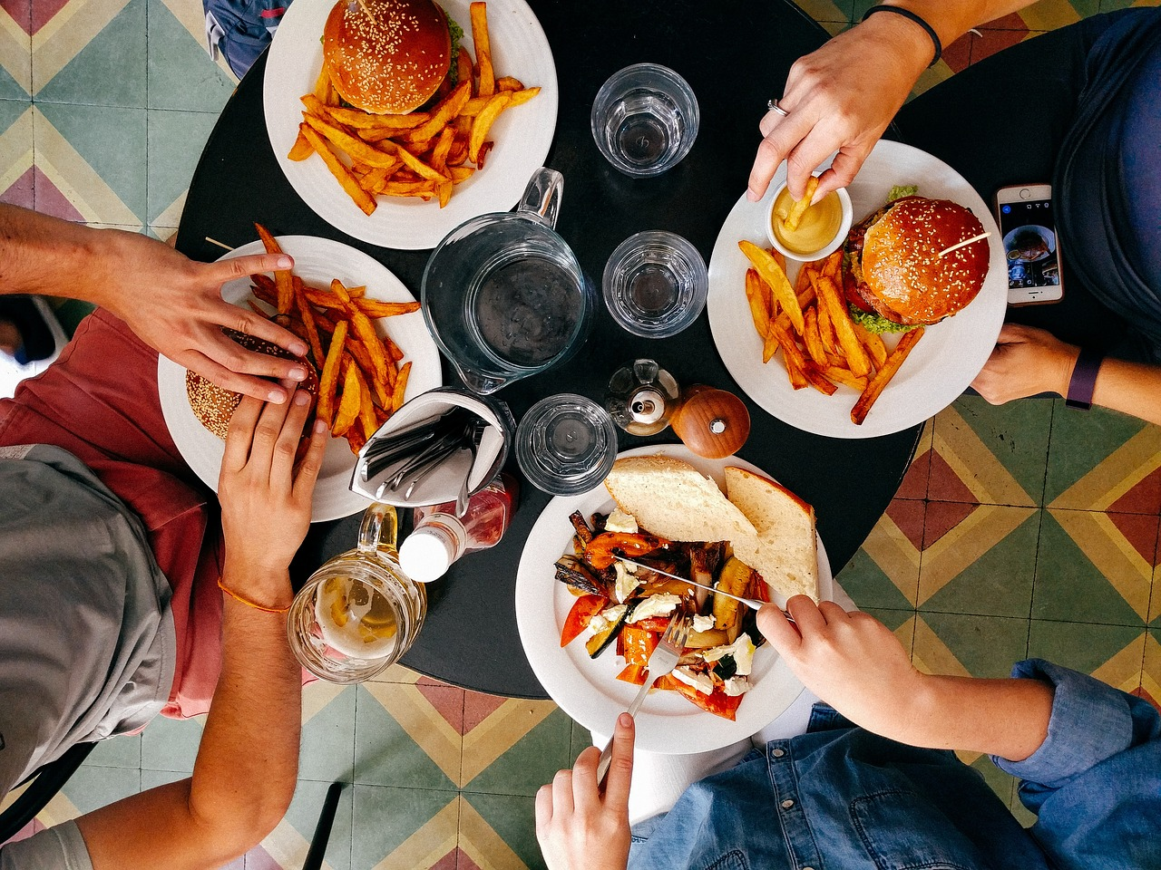
Think in terms of God’s Grace
Think in terms of God’s Glory
Hospitality
Without grumbling

Slide 15
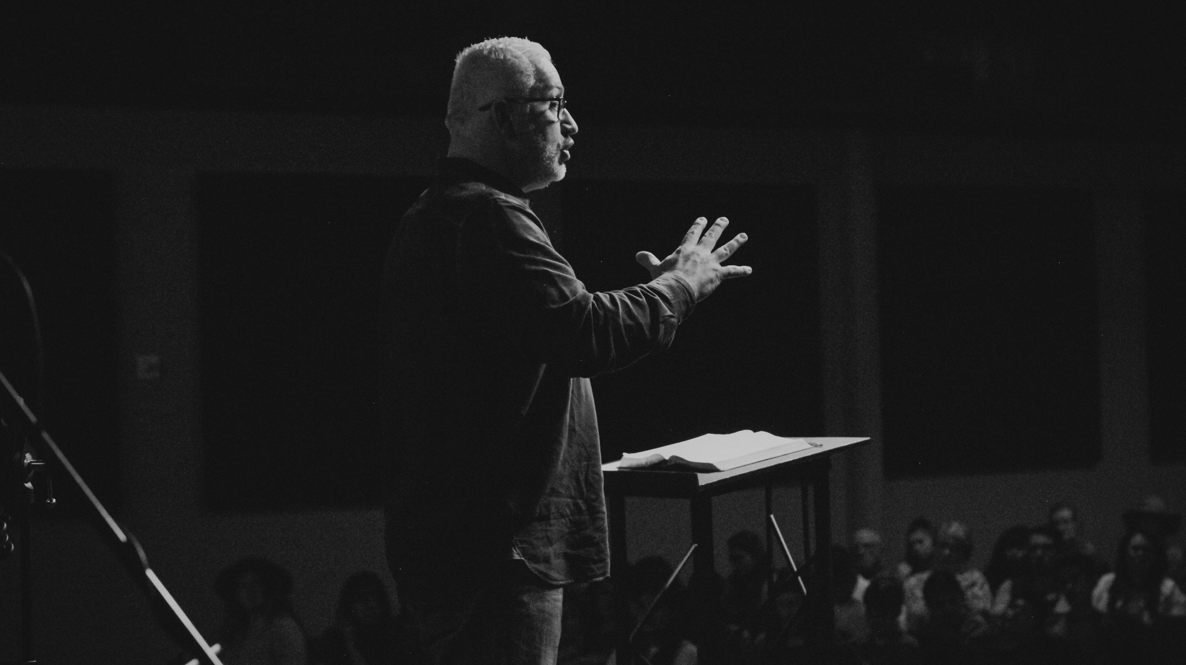
Think in terms of God’s Grace
Think in terms of God’s Glory
Speaking
As the oracles of God

Slide 16
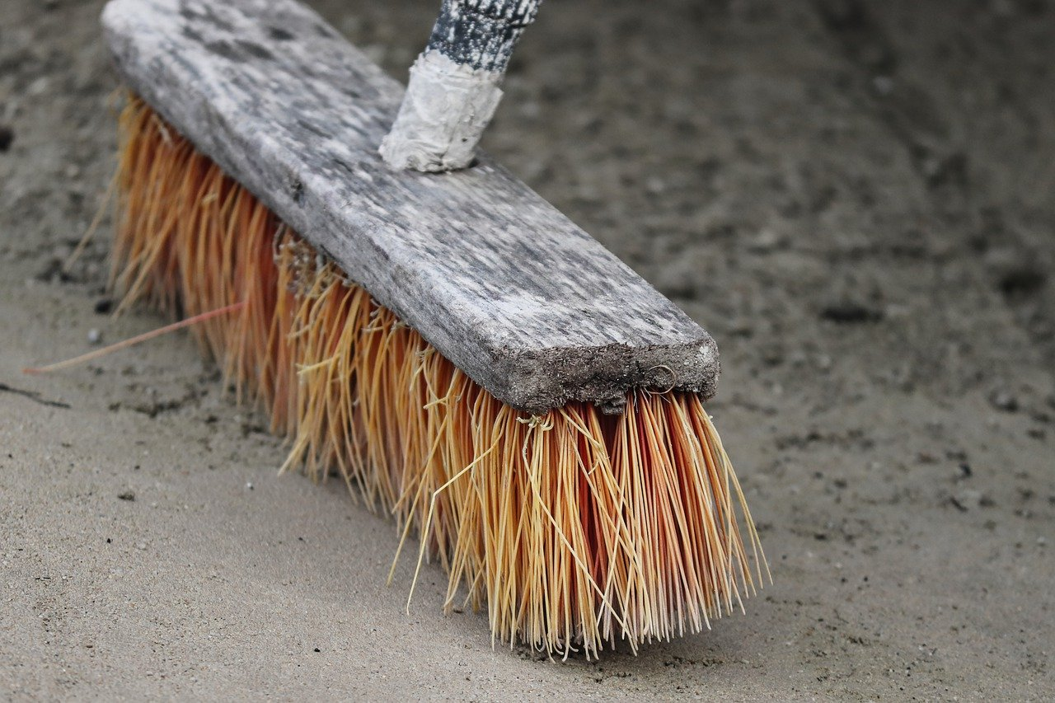
Think in terms of God’s Grace
Think in terms of God’s Glory
Serving
Strength that God supplies

Slide 17
Let’s Do Things Well

