Slide 1
Long term passion for teaching the lost

Slide 2
Long term passion for teaching the lost

Slide 3
Long term passion for teaching the lost

Slide 4
Hindrances
Apathy
Discouragement

Slide 5
Rekindling the
ZEAL
of the
PROPHETS

Slide 6
Understand Your Role

Slide 7
The Plan

Slide 8
1
2
3
Internalize Word
Share Word
Respond to Word

Slide 9
Our Responsibility
1
2
3
Internalize Word
Share Word
Respond to Word

Slide 10
Two Pictures of This

Slide 11
The Responsibility

Slide 12
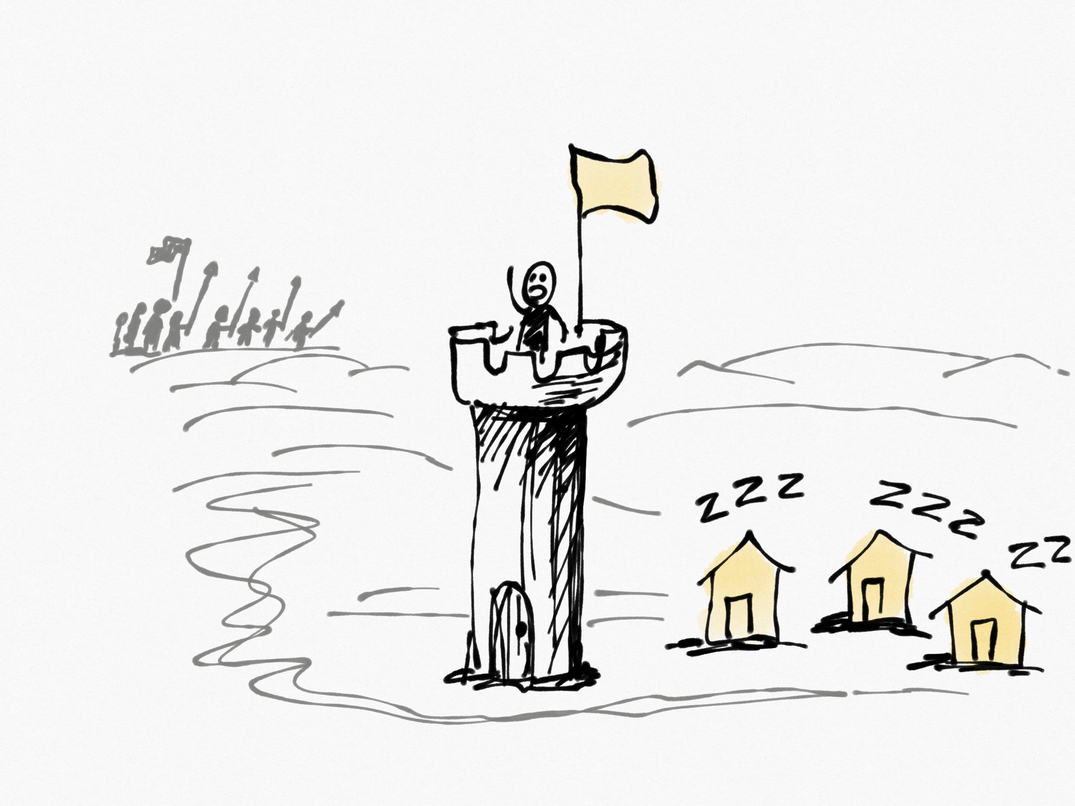

Slide 15
Responsibility
Responsibility

Slide 16
See the danger
Care about the people

Slide 17
The Power

Slide 18
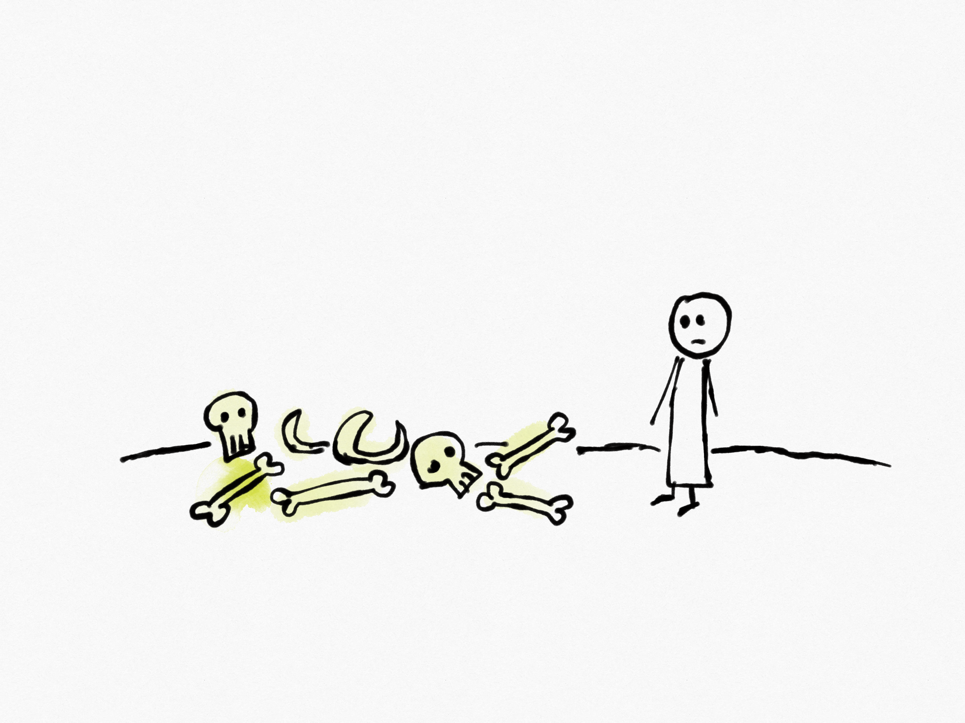
Incapable
Hopeless

Slide 19
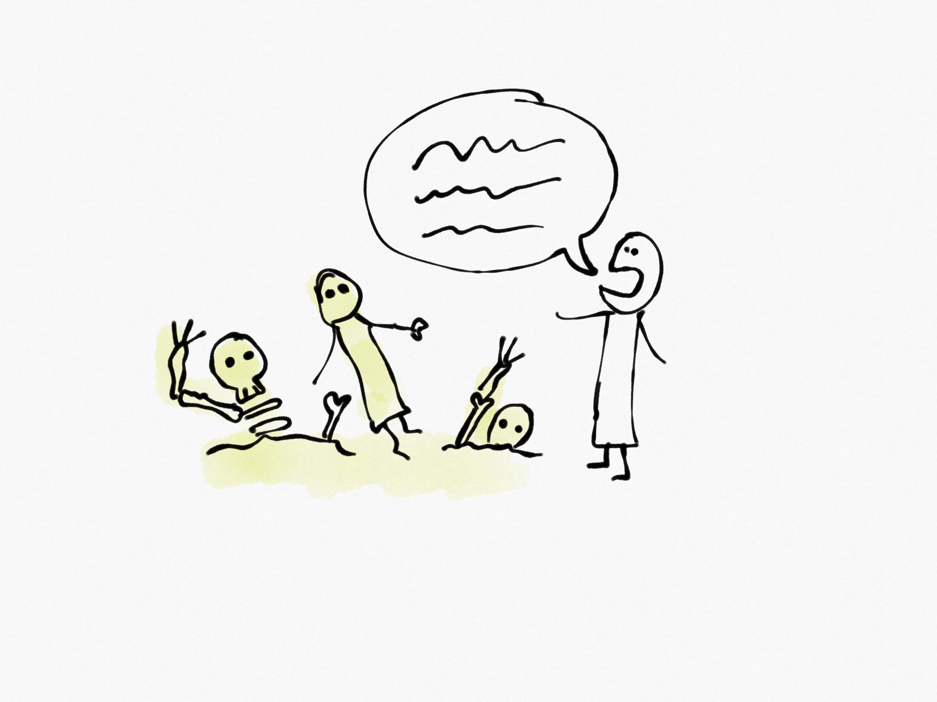
God’s power

Slide 20
Me
Not Me
Know God’s word
Share God’s word
Let God do his work
Let people make their choice

