Slide 1
1 in 5 Americans feel lonely or socially isolated.
Loneliness can be as dangerous as smoking 15 cigarettes a day

Slide 2
We were made for relationships
But relationships limit our freedom

Slide 3
Learning to Belong to God

Slide 4
With God again
With God
We left God

Slide 5
The Exile’s Story

Slide 6
With God again
With God
Exiles in Babylon

Slide 7
We are His because He made us
Blessing
Responsibility

Slide 8
The Priest’s Story

Slide 9
With God again
With God
Slaves in Egypt

Slide 10
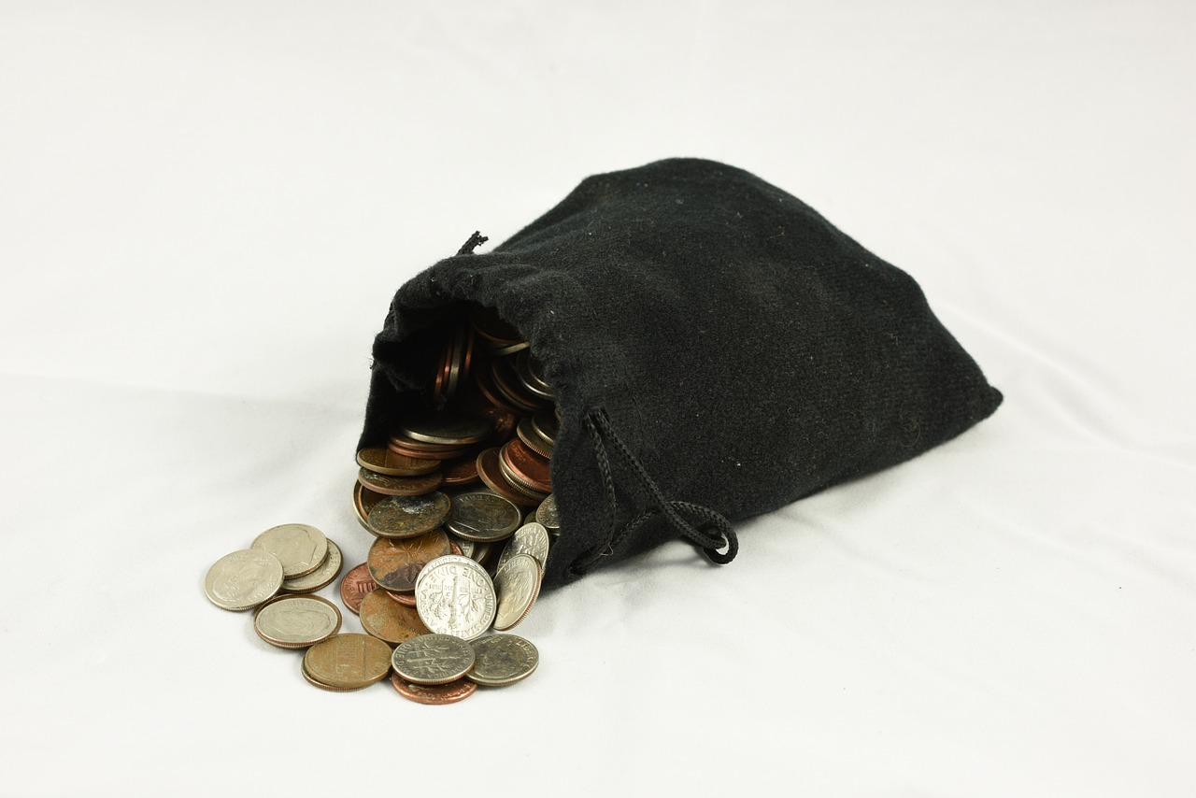
Blessing
Responsibility
We are his because he redeemed us

Slide 11
The Unfaithful Spouse’s Story

Slide 12
With God again
With God
Unfaithful to God

Slide 13
Blessing
Responsibility
We are his because he’s merciful

Slide 14
The Result

Slide 15
“Beloved”

Slide 16
We don’t belong anywhere else

Slide 17
You are not your own, for you were bought with a price. So glorify God in your body.
- 1 Corinthians 6:19-20

