Slide 1
“Ponder the path of your feet.”
- Proverbs 4:26

Slide 2
Think

Slide 3
The
“what went wrong?”
moment

Slide 4
Why do we get off the path?

Slide 5
Other People & Other Messages
Greed
Lust

Slide 6
Me

Slide 7
So how do I determine the right path?

Slide 8
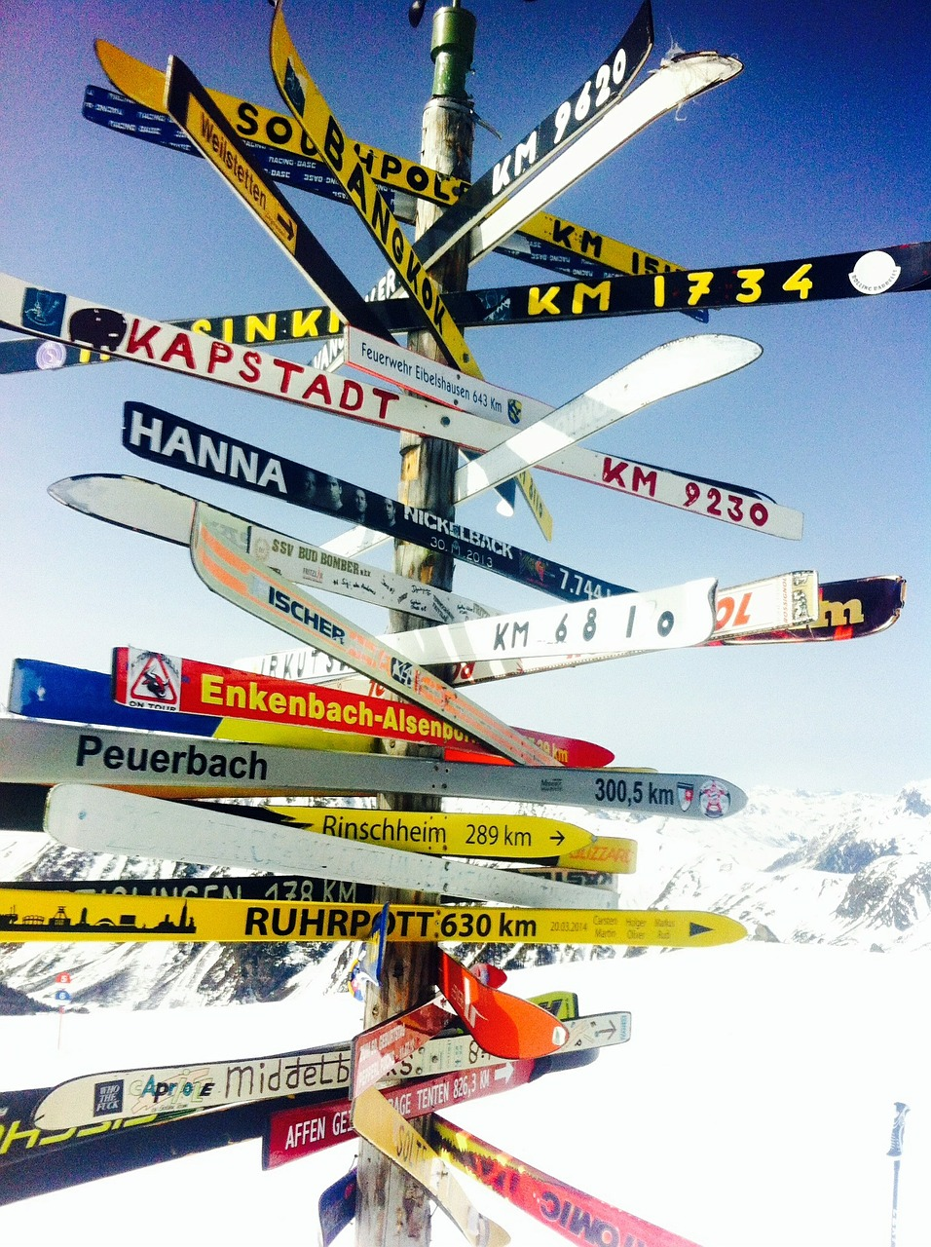

Slide 9
Wisdom

Slide 10
Her origin

Slide 11
How do we find her?

Slide 12
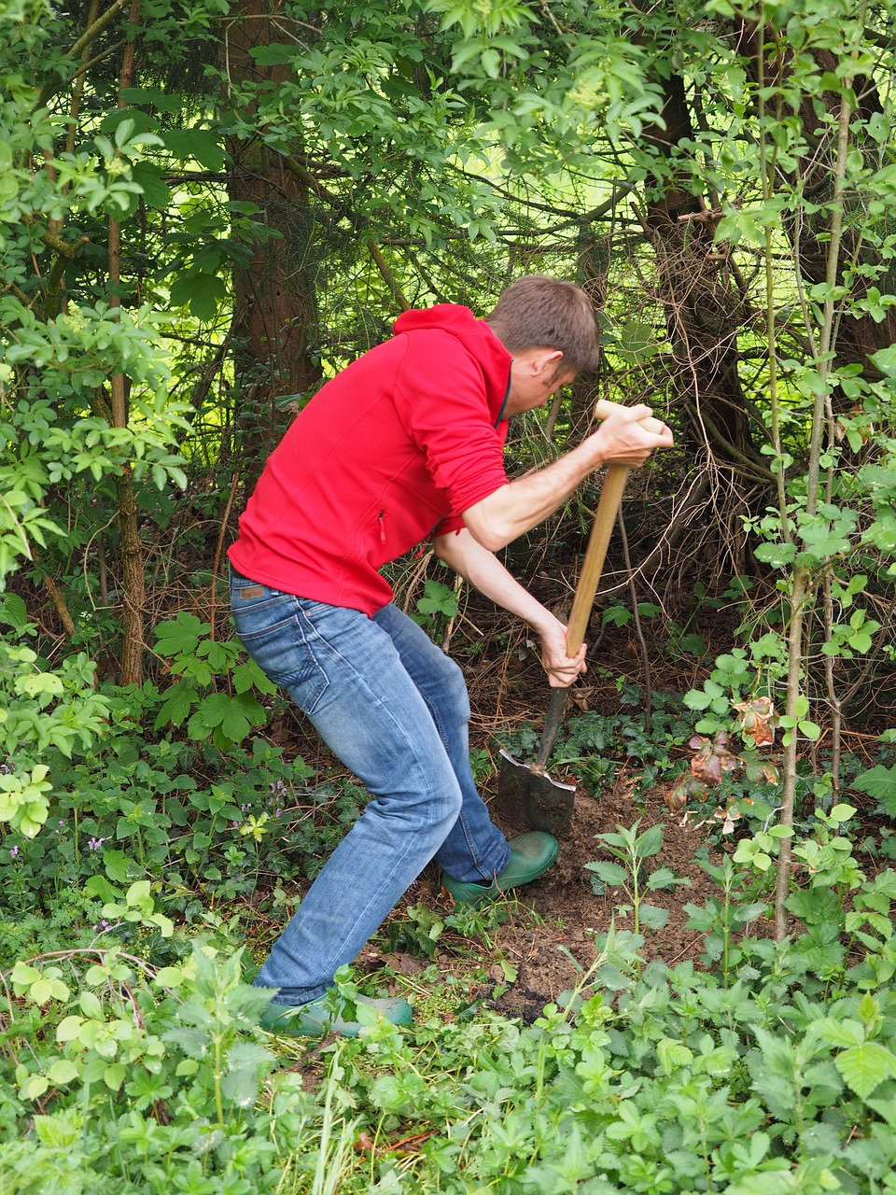
We have to work at it.

Slide 13
Treasure up
Attentive
Incline heart
Call out
Raise voice for
Seek
Search

Slide 14
We find it in God

Slide 15
Think

Slide 16
Two ways to live:

Slide 17
Deep Darkness

Slide 18
Deep Darkness
Sunrise

Slide 19
Ponder the path of your feet.
then all your ways will be sure.

