Slide 1
How it all started
Different
Slightly different
Slightly different
Different
Different
Different

Slide 2
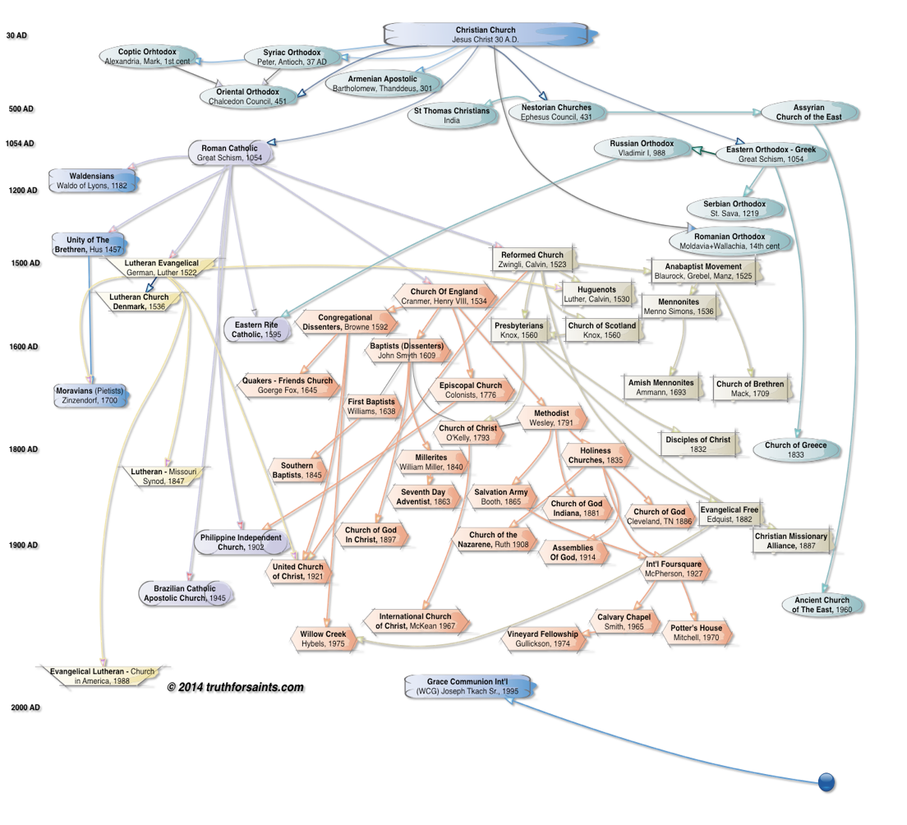

Slide 3
“that they may all be one”
- Jesus

Slide 4
What Gets Us Off Track?

Slide 5
God’s Covenant
At Sinai

Slide 6
God’s Covenant
At Sinai
Micah
Did whatever he personally felt was right.

Slide 7
God’s Covenant
At Sinai
Micah
Solomon
Pressure from the world

Slide 8
God’s Covenant
At Sinai
Micah
Solomon
Jeroboam
Wanted to pull in the crowds

Slide 9
God’s Covenant
At Sinai
Micah
Solomon
How does he do it?
Sets his heart to seek God
Changes what he can change
Goes back to God’s word
Leads others to change
Jeroboam
?????

Slide 10
Be a Josiah

