Slide 1
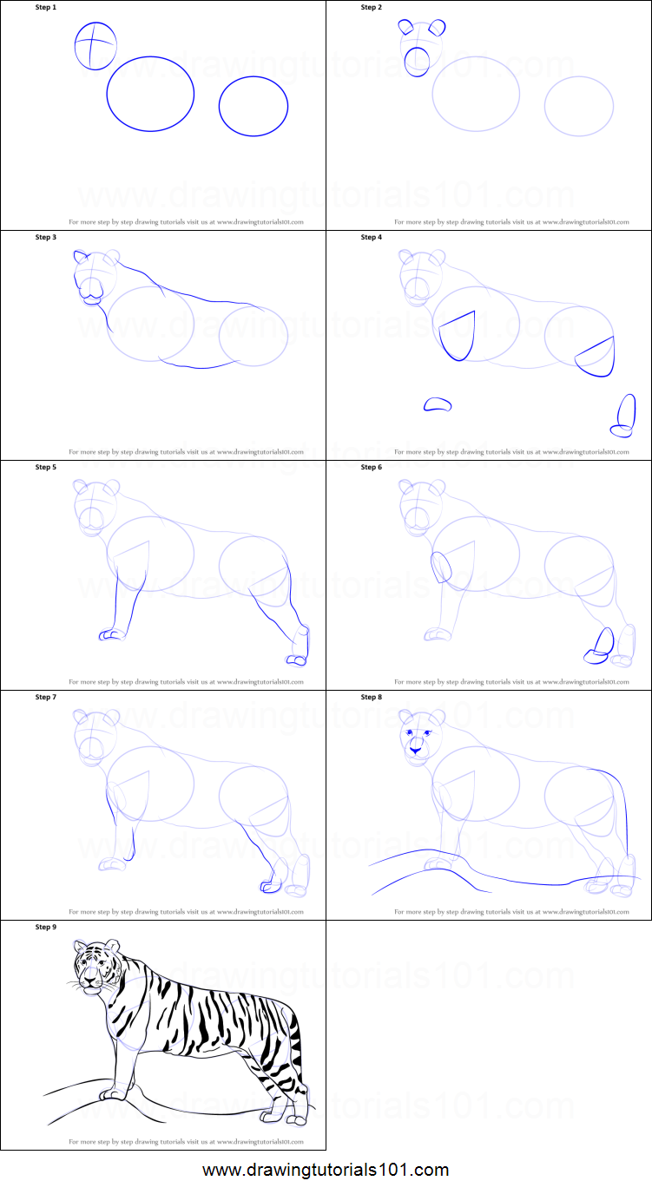

Slide 2
Is Jesus Your
HERO
Or Is Jesus Your LIFE?

Slide 3
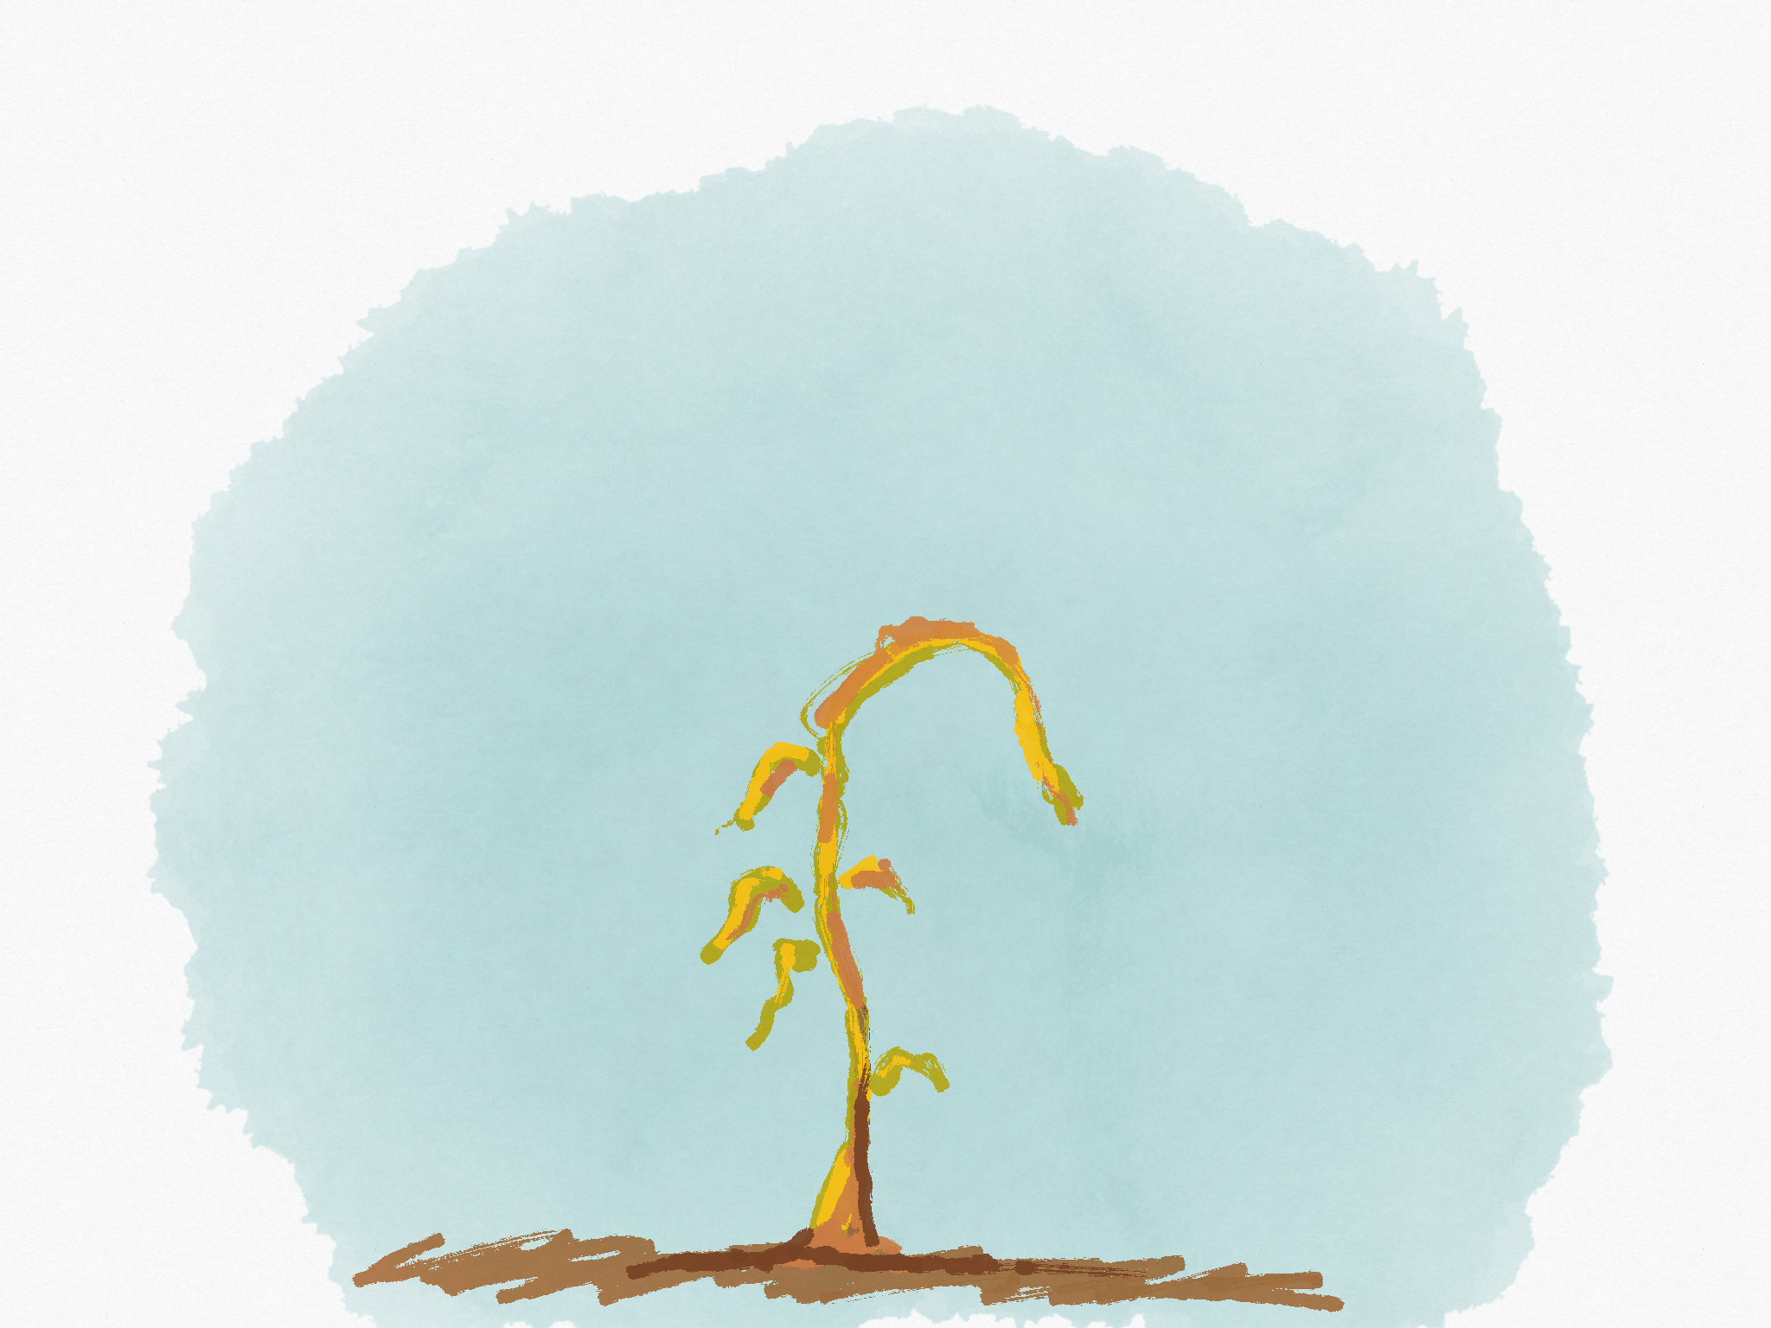
Israel

Slide 4
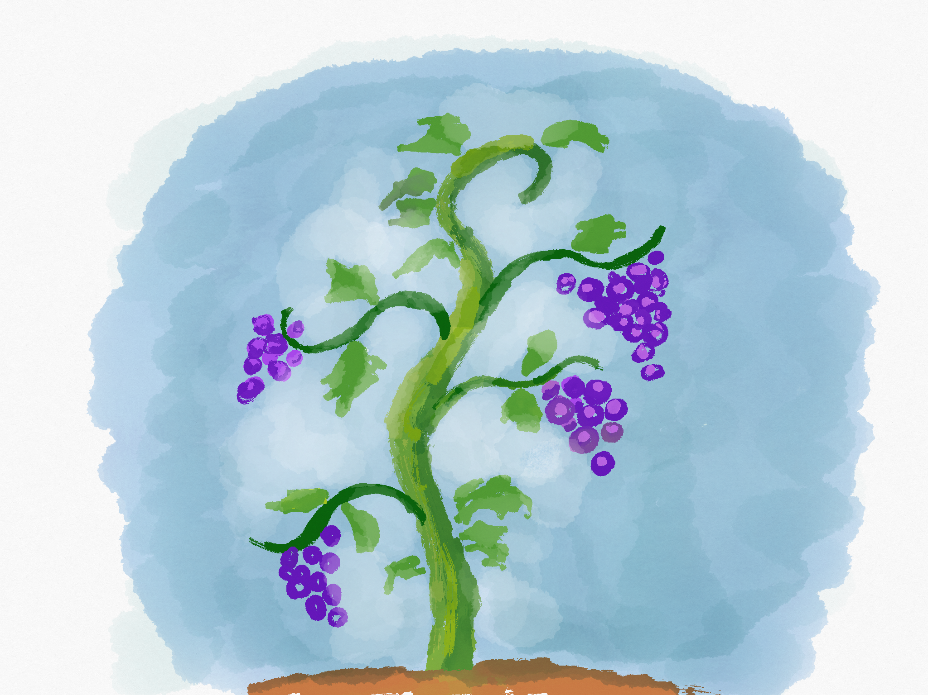
Shadow

Slide 5
Jesus

Slide 6
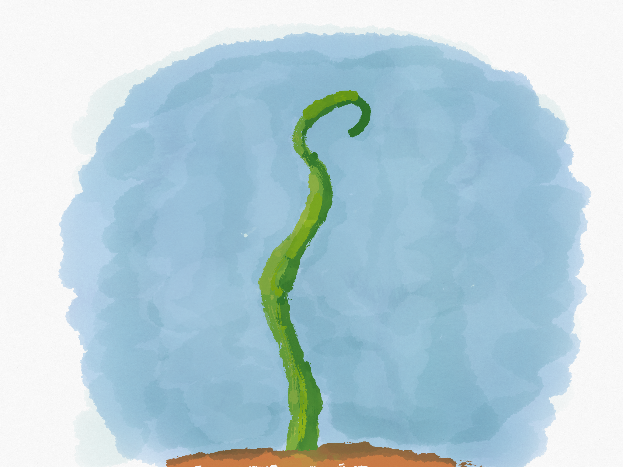
Jesus

Slide 7
Jesus
Us

Slide 8
The Father’s Role

Slide 9
Removes

Slide 10
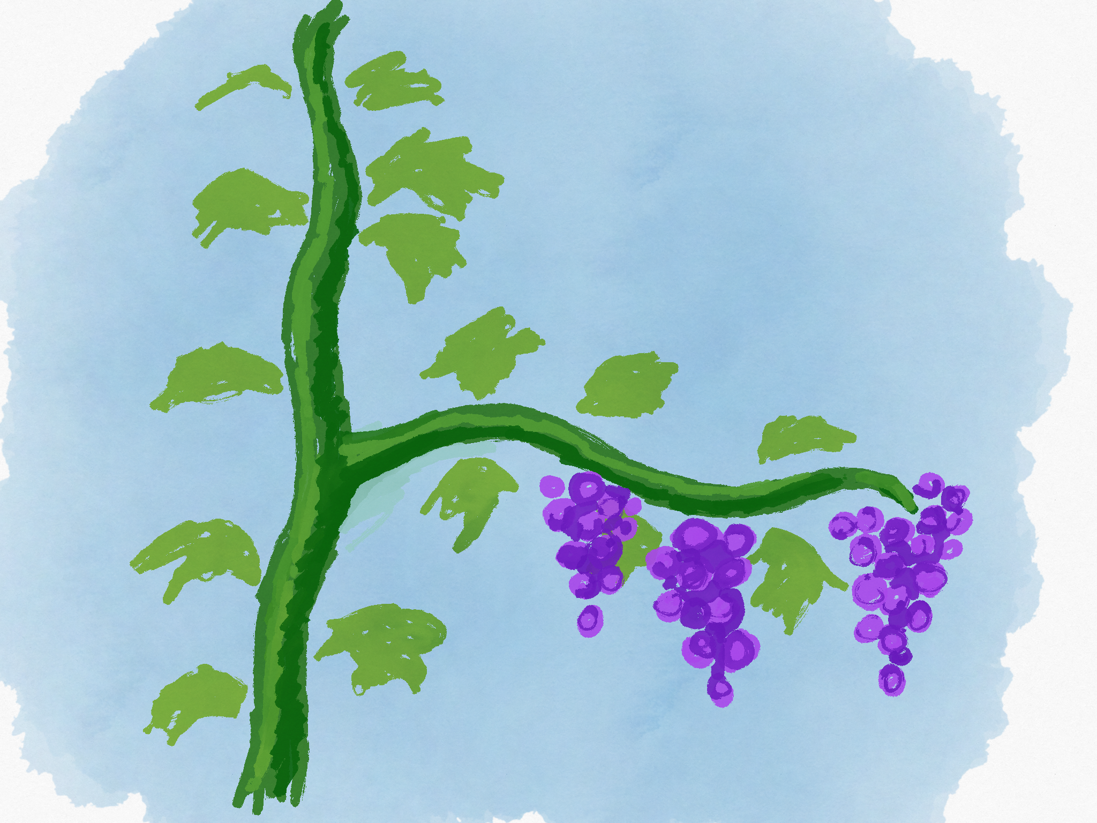
Prunes

Slide 11
Our Relationship to Jesus

Slide 12
Begins with Jesus’ word

Slide 13
So how do we grow fruit?

Slide 14
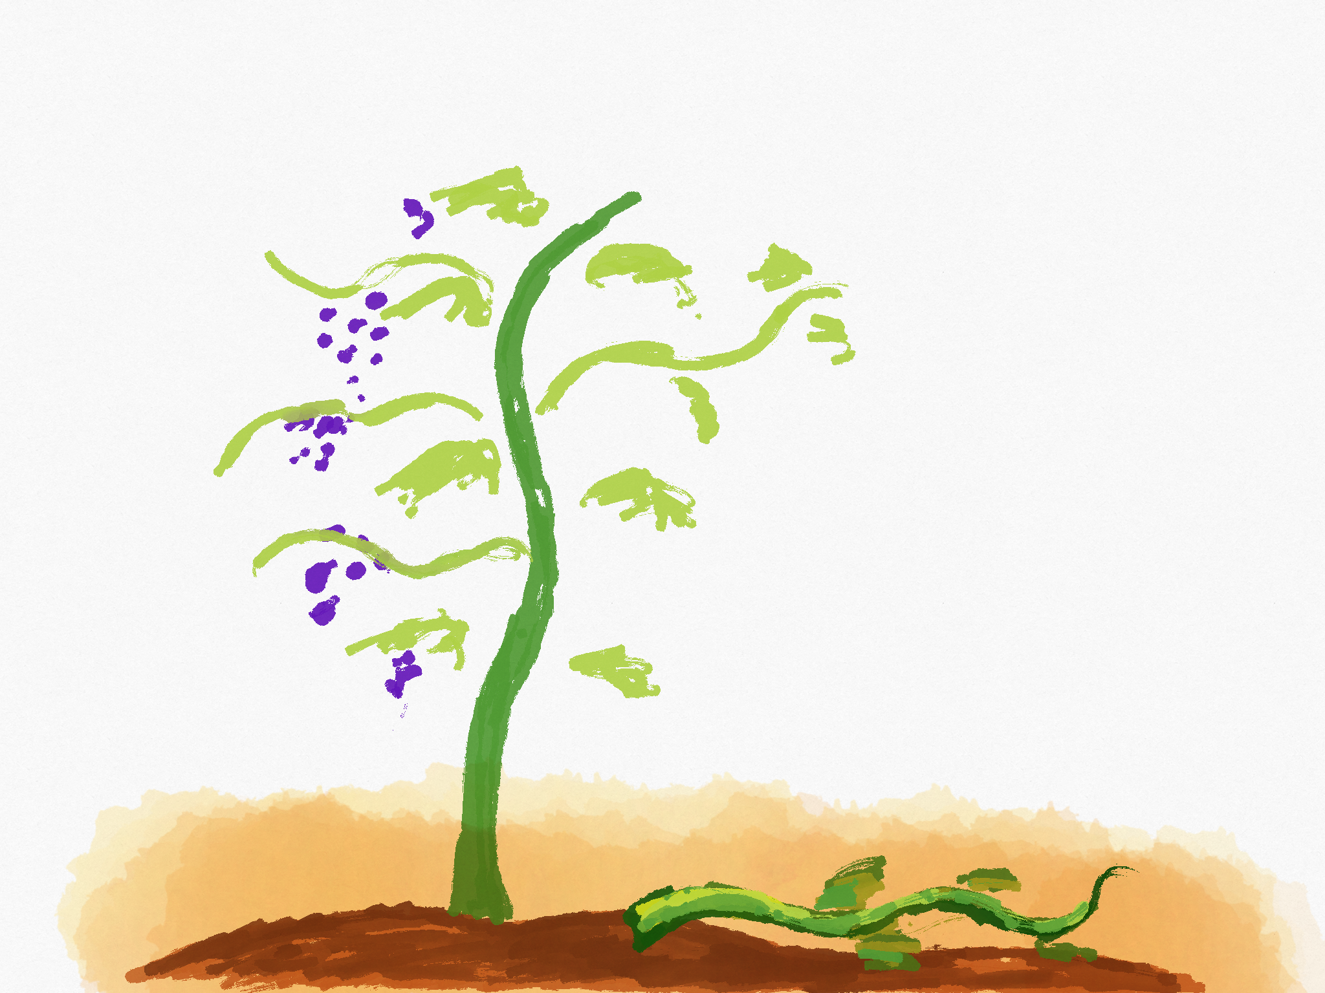
Not like this.

Slide 15
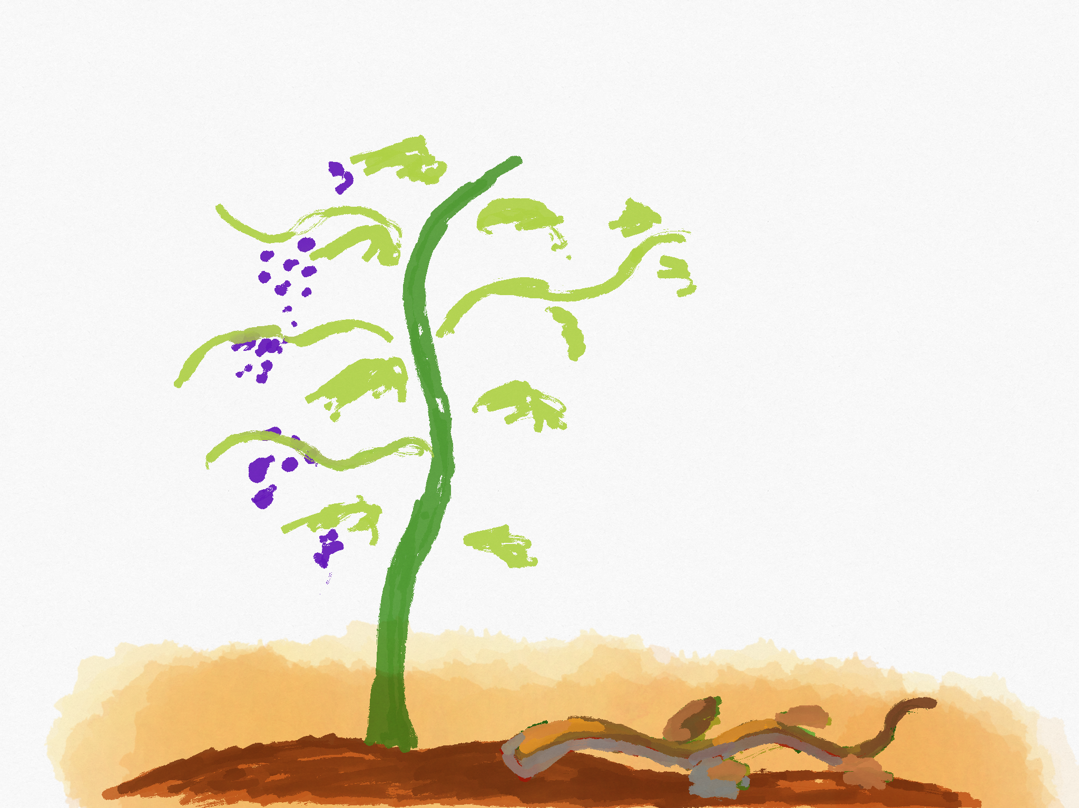
Not like this.

Slide 16
This is the key!
It comes from our relationship with Jesus

Slide 17
So what does it look like to abide in Jesus?

Slide 18
Word
Answered Prayer

Slide 19
Joy
Prove we are Jesus’ Disciples
Purpose
Word
Love
Answered Prayer
Friendship
Love to others
Glorifies Father
Joy
Obedience

Slide 20
Is Jesus Your
HERO
Or Is Jesus Your LIFE?

