Slide 1
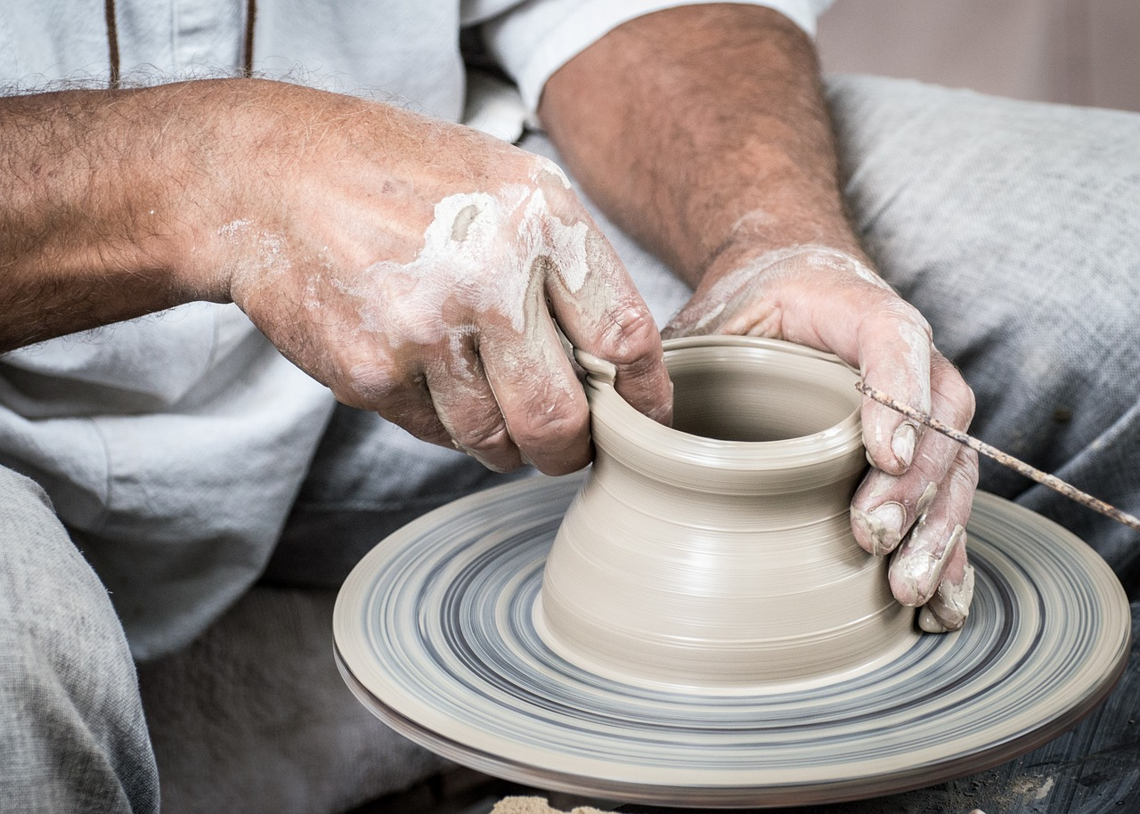
Molded Like Clay

Slide 2
For by him all things were created, in heaven and on earth, visible and invisible, whether thrones or dominions or rulers or authorities—all things were created through him and for him.
Colossians 1:16

Slide 3
Thinking Like Clay

Slide 4
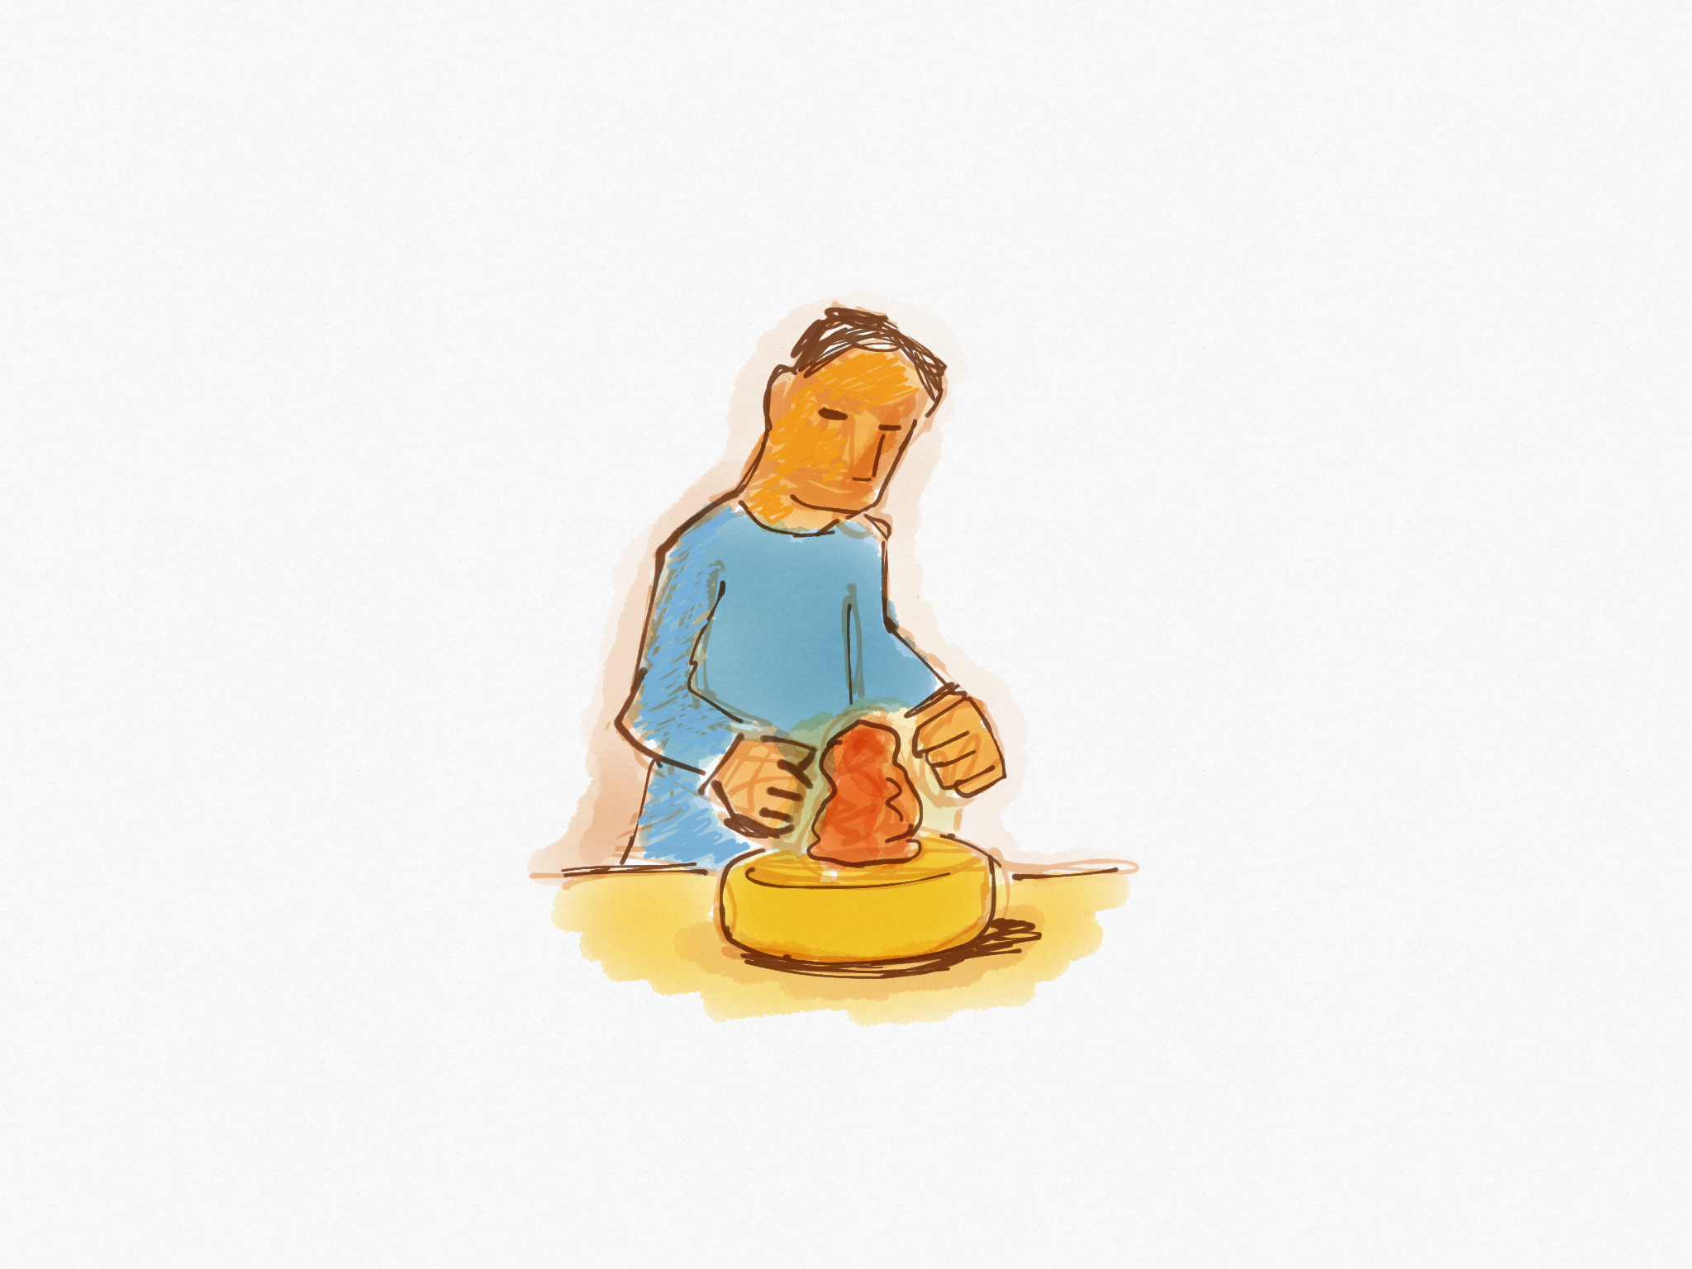
Why did you make me like this?
God is creator

Slide 5
But We Have a Choice

Slide 6
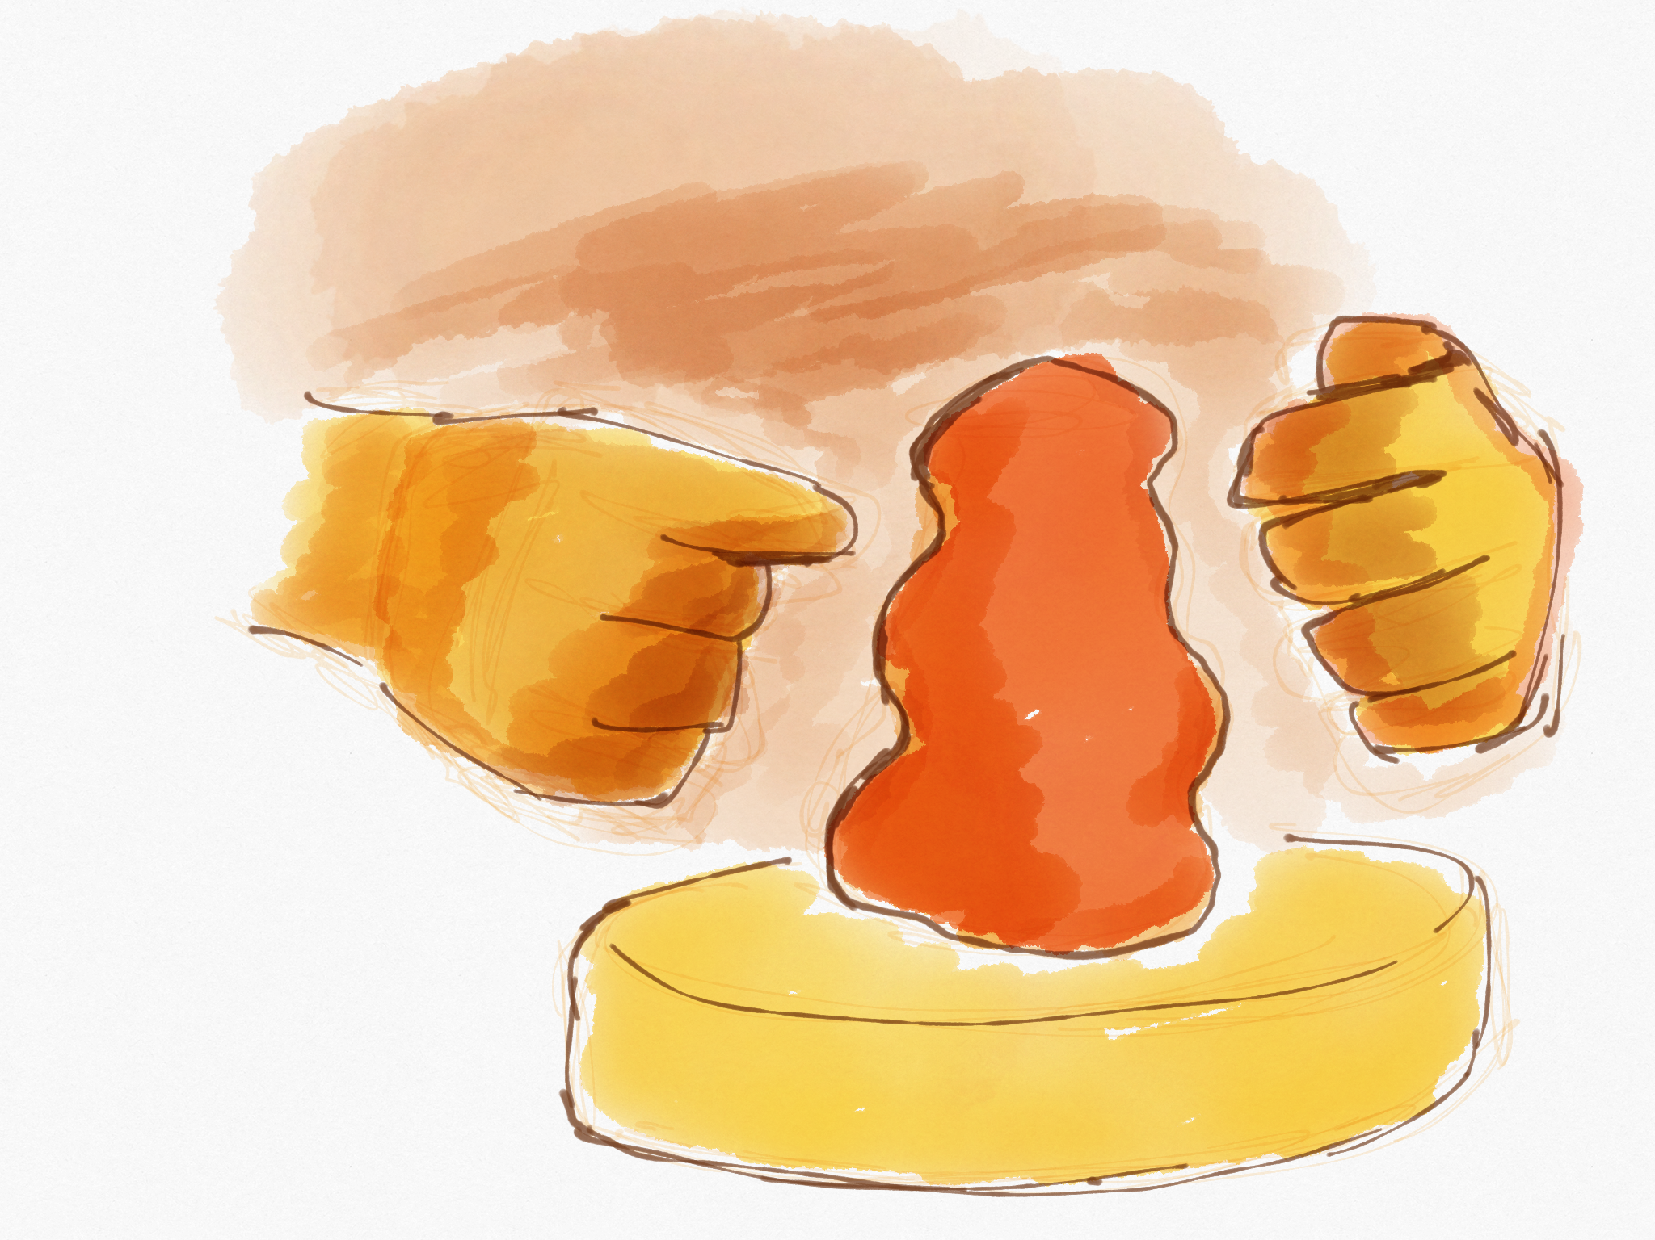

Slide 7
Plan A
Plan B

Slide 8
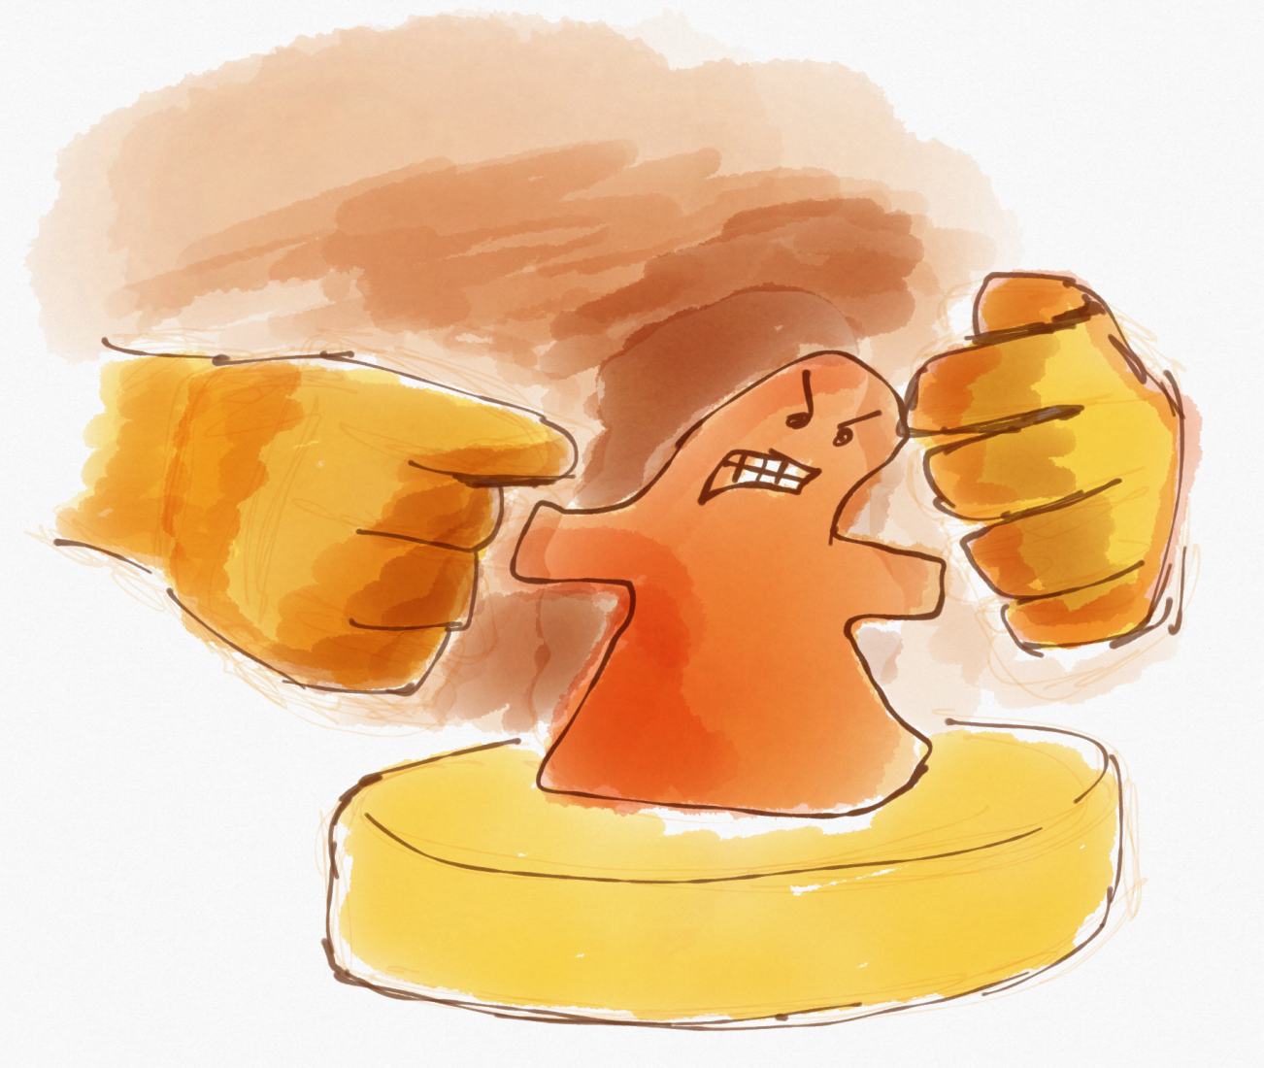
Stubbornness of their own heart

Slide 9
God Has a Purpose for His Creations

Slide 10
A Negative Example

Slide 11
Baptism By John
Critical of God

Slide 12
A Positive Example

Slide 13
A weapon against God

Slide 14
A tool in God’s hand
A weapon against God

Slide 15
My Life

Slide 16
Faith
Love
Peace
Kind
Teach
Patient
Gentle
Passions
Ignorant controversies
Arguing

