Slide 2
How Did Jesus Make a Difference?

Slide 3
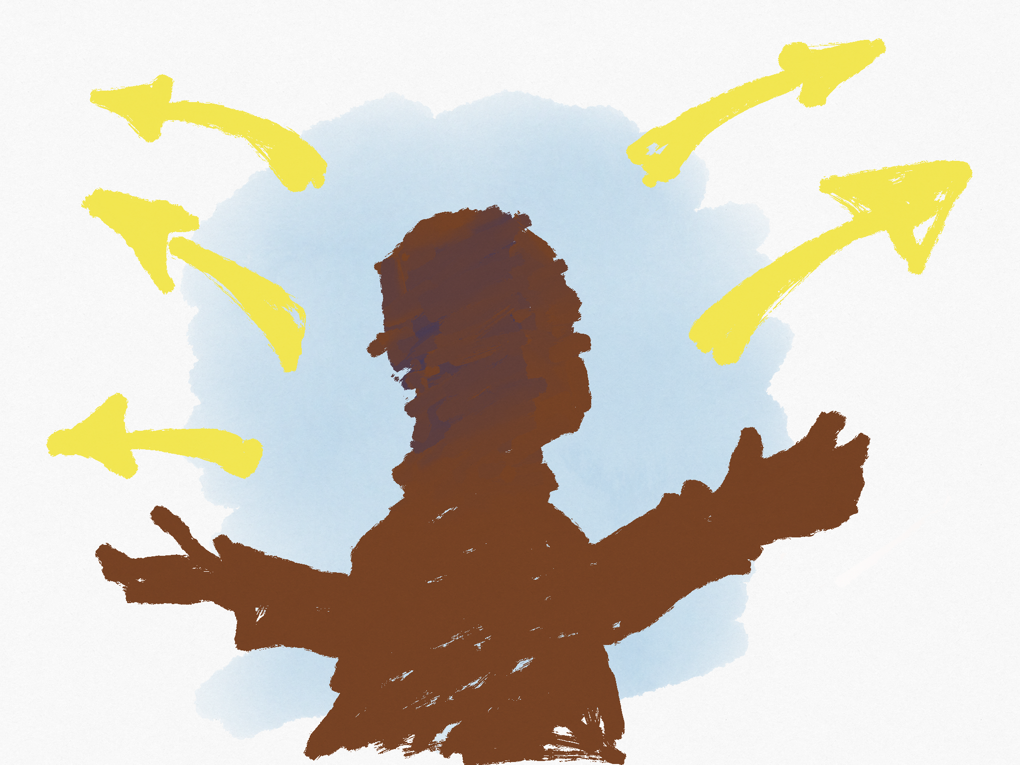

Slide 4
Compassion
Even when it was inconvenient.
Even when he didn’t know them.

Slide 5
Love
For those physically hurting.
For those spiritually hurting.

Slide 6
Anger
Over mistreatment of others.
Over mistreatment of God.

Slide 7
Sorrow

Slide 8
Passion
To obey God.

Slide 9
Do you care?

