Slide 1
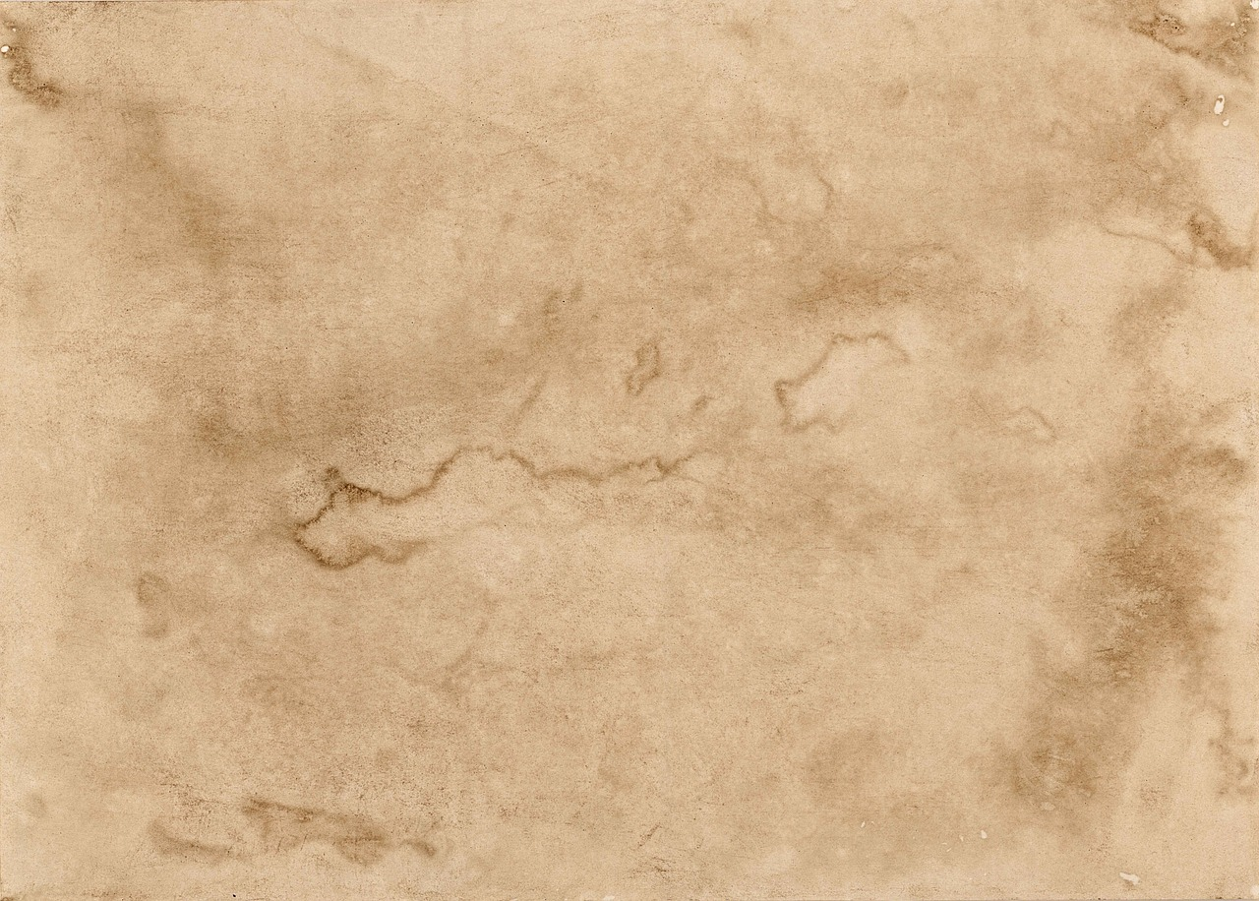
Is My Bible Accurate?

Slide 2
Old Testament
2500 years!
Genesis
Malachi
1600 B.C.
450 B.C.
AD 2019

Slide 3
New Testament
NT written
Almost 2000 years!
AD 1
A.D. 100
AD 2019

Slide 4
Old Testament Manuscripts

Slide 5
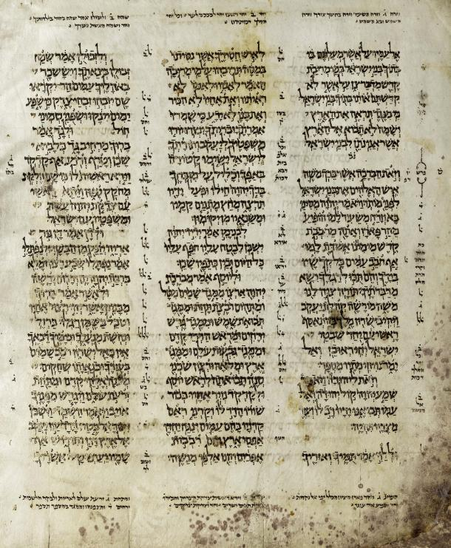
Masoretic Text

Slide 6
Masoretic Text
1000 A.D.
Genesis
Malachi
0
1600 B.C.
450 B.C.
AD 2019

Slide 7
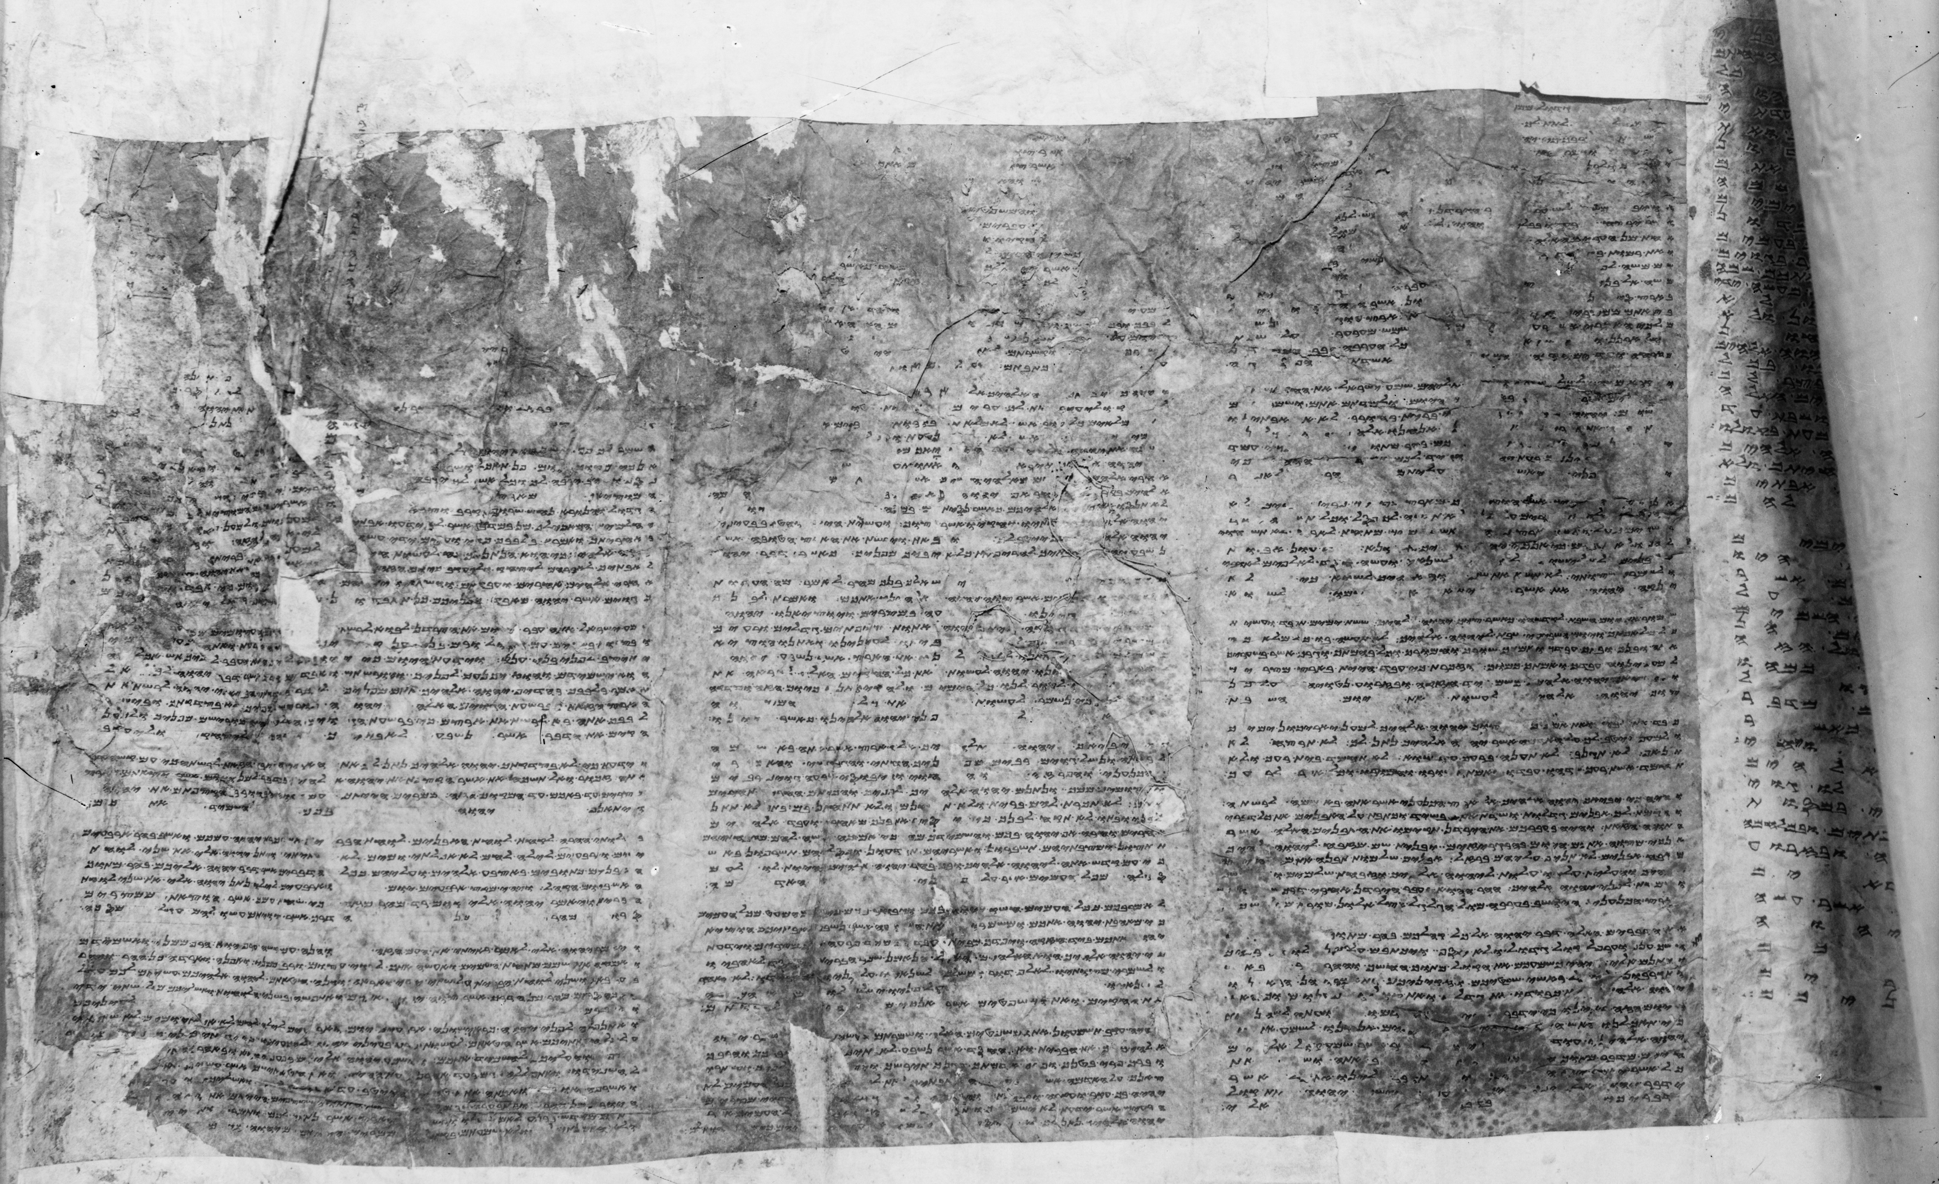
Samaritan Pentateuch

Slide 8
Samaritan Pentateuch
A.D. 100
Mas.
Genesis
Malachi
0
1600 B.C.
450 B.C.
AD 2019

Slide 9
Samaritan Pentateuch

Slide 10
Samaritan Pentateuch
Sam
Sep
300-200
Mas.
Genesis
Malachi
0
100
300
1000
1600 B.C.
450 B.C.
AD 2019

Slide 11
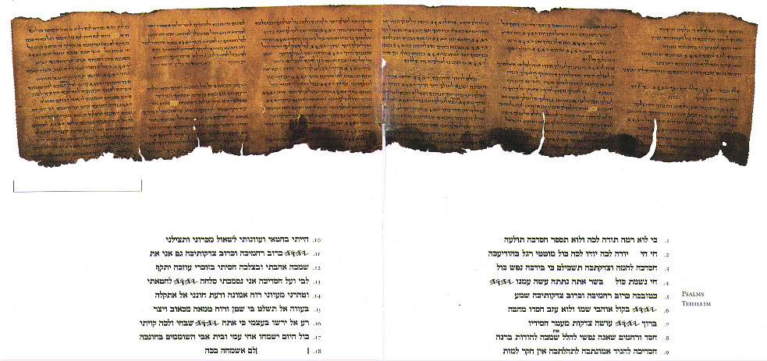
Dead Sea Scrolls

Slide 12
Dead Sea Scrolls
Dead Sea
Sam
Sep
Mas.
Genesis
Malachi
0
100
300
1000
1600 B.C.
300BC – AD50
AD 2019
450 B.C.

Slide 13
New Testament Manuscripts

Slide 14
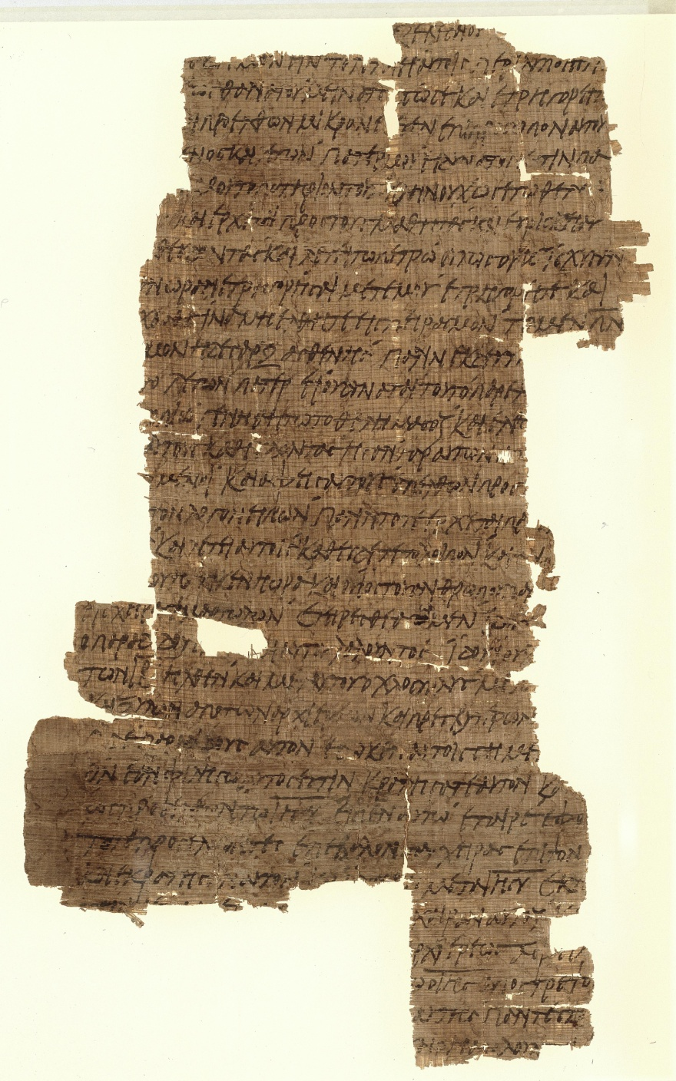
Papyrus Manuscripts

Slide 15
Papyrus Manuscripts
AD 1
120 – 300
100
AD 2019

Slide 16
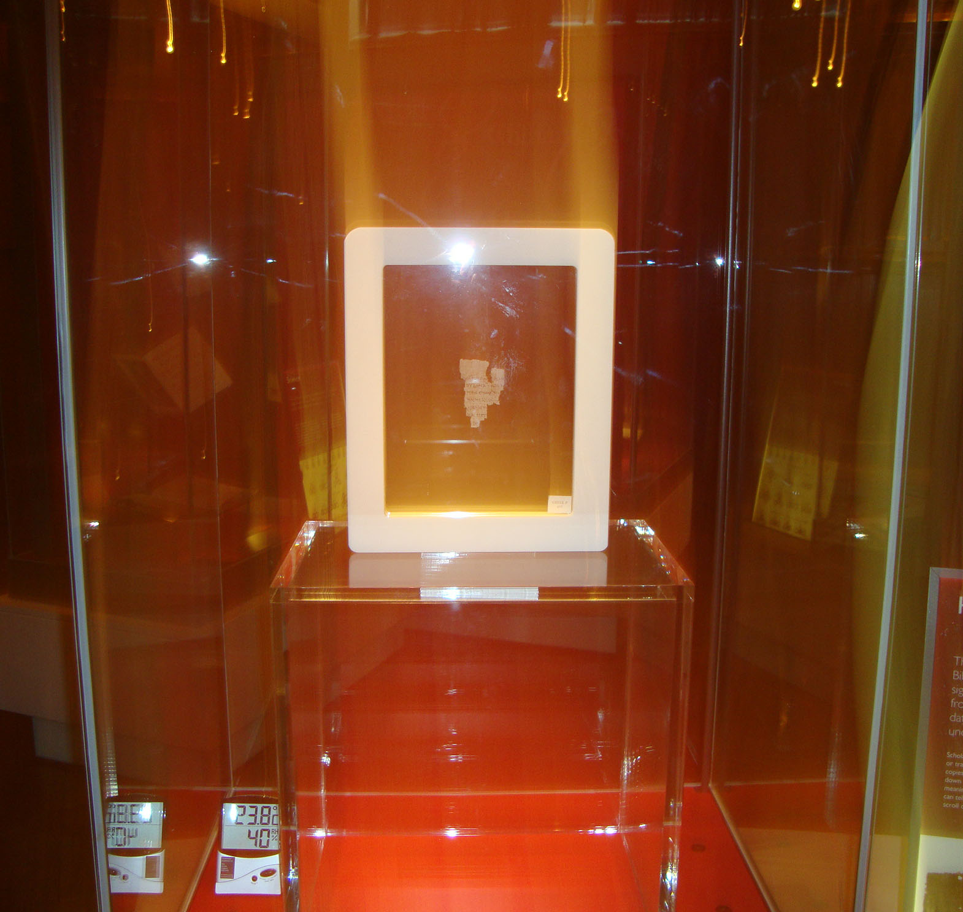
John Fragment

Slide 17
John Fragment
AD 1
~120
100
AD 2019

Slide 18
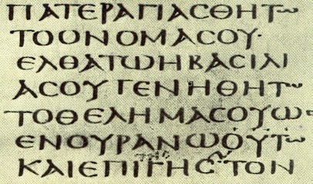
Uncial Manuscripts

Slide 19
Uncial Manuscripts
AD 1
~120
300-800
100
AD 2019

Slide 20
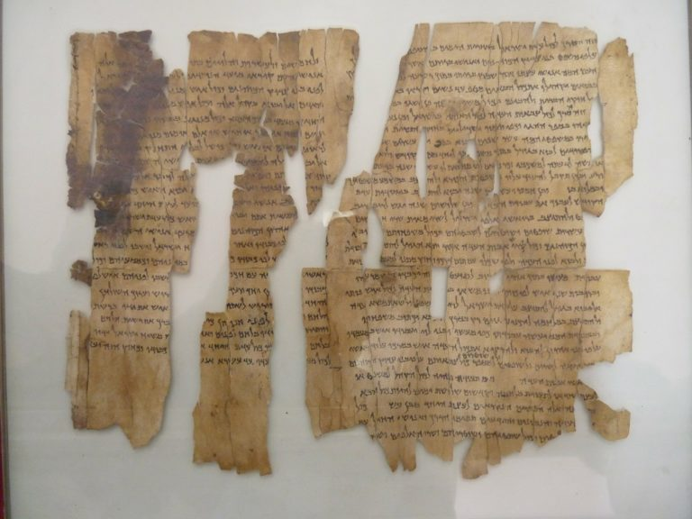
References

Slide 21
References
AD 1
~120
300-800
100
AD 2019
100-300

Slide 22
Lectionaries

Slide 23
Lectionaries
AD 1
~120
300-800
100
600-1100
AD 2019
100-300

Slide 24
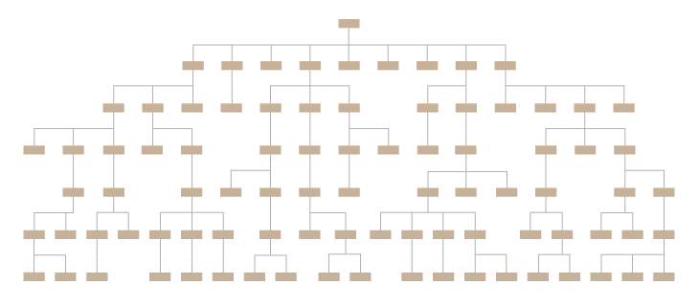
Lectionaries

Slide 25
Lectionaries
Book
Date written
Gap
# copies
1 partial & 19 copies
Livy’s History of Rome
59 BC
1,350 years
Caesar’s Gaelic Wars
100-44BC
1,000 years
10
Plato
400 BC
1,300 years
7
114 Fragment
200 Books
250 Most of NT
325 Complete
5800
NT
AD 50-100

