Slide 1
Angels

Slide 3
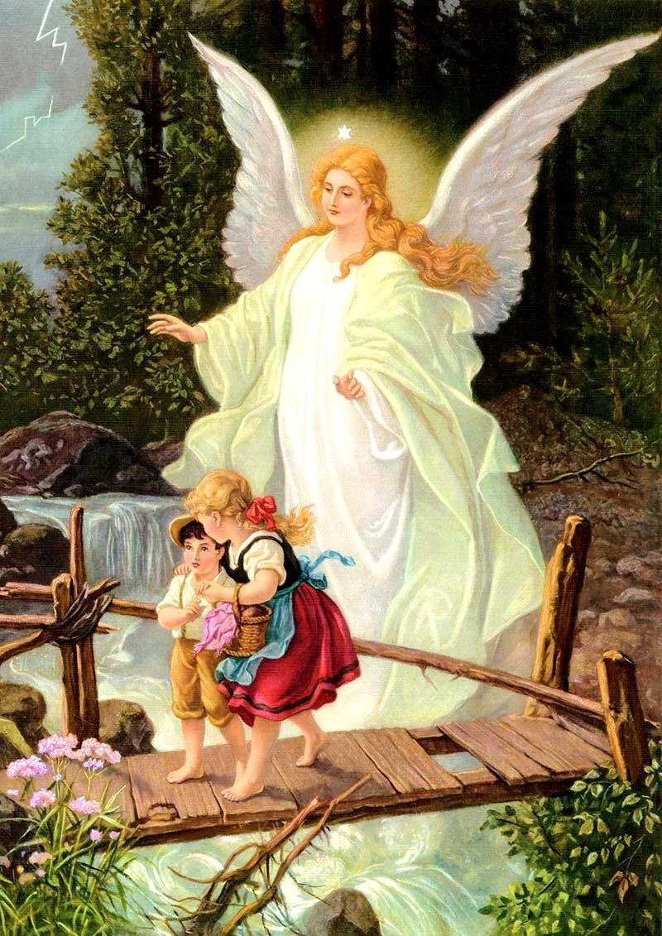

Slide 4
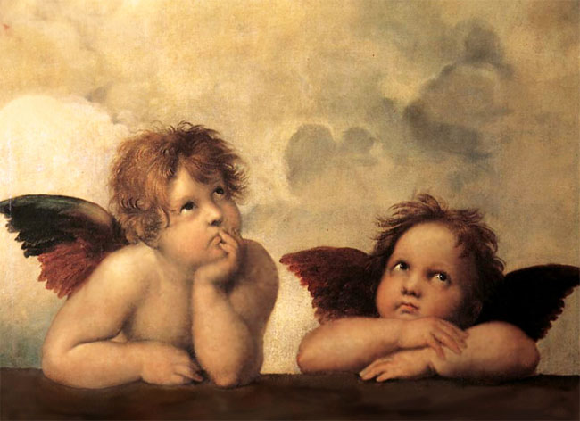

Slide 5
1 Timothy 1:4
…nor to devote themselves to myths and endless genealogies, which promote speculations rather than the stewardship from God that is by faith.

Slide 6
Unseen reality
God
Angels
Satan
Physical Reality

Slide 7
Where did angels come from?
Colossians 1:16
For by him all things were created, in heaven and on earth, visible and invisible, whether thrones or dominions or rulers or authorities—all things were created through him and for him.

Slide 8
What are angels?
Psalm 8:5
You made him a little lower than the angels; You crowned him with glory and honor.

Slide 9
What are angels?
Jude 1:6
6 And the angels who did not stay within their own position of authority, but left their proper dwelling, he has kept in eternal chains under gloomy darkness until the judgment of the great day—

Slide 10
What are angels?
Matthew 25:41
“Then he will say to those on his left, ‘Depart from me, you cursed, into the eternal fire prepared for the devil and his angels.

Slide 11
How powerful are they?
2 Kings 19:35
And that night the angel of the LORD went out and struck down 185,000 in the camp of the Assyrians. And when people arose early in the morning, behold, these were all dead bodies.

Slide 12
How powerful are they?
2 Samuel 14:20
But my lord has wisdom like the wisdom of the angel of God to know all things that are on the earth.”

Slide 13
How many are there?
Revelation 5:11-12
Then I looked and heard the voice of many angels, numbering thousands upon thousands, and ten thousand times ten thousand. They encircled the throne and the living creatures and the elders.

Slide 14
What do they look like?
Often just like humans
Sometimes not:
Matt 28:3
His appearance was like lightning, and his clothing white as snow.

Slide 15
What do they look like?
Ezekiel 1:10-11
The four had the face of a lion on the right side, the four had the face of an ox on the left side, and the four had the face of an eagle. Such were their faces. And their wings were spread out above. Each creature had two wings, each of which touched the wing of another, while two covered their bodies.

Slide 16
What do they do and how involved are they in our lives today?
1. Worship God

Slide 17
Hebrews 1:14
Are they not all ministering spirits sent out to serve for the sake of those who are to inherit salvation?

Slide 18
What do they do and how involved are they in our lives today?
2. Reveal God’s message

Slide 19
What do they do and how involved are they in our lives today?
1 Peter 1:12
It was revealed to them that they were serving not themselves but you, in the things that have now been announced to you through those who preached the good news to you by the Holy Spirit sent from heaven, things into which angels long to look.
5. Very interested in God’s plan

Slide 20
What do they do and how involved are they in our lives today?
Luke 15:10
Just so, I tell you, there is joy before the angels of God over one sinner who repents.”
6. Very interested in our lives

Slide 21
What do they do and how involved are they in our lives today?
Daniel 10:10-14
7. Oversee/Interact with the nations?

Slide 22
What do they do and how involved are they in our lives today?
2 Kings 6:17
Then Elisha prayed and said, “O LORD, please open his eyes that he may see.” So the LORD opened the eyes of the young man, and he saw, and behold, the mountain was full of horses and chariots of fire all around Elisha.

Slide 23
What do they do and how involved are they in our lives today?
Psalm 34:7
The angel of the Lord encamps
around those who fear him, and delivers them.
8. Protect God’s people?

Slide 24
What do they do and how involved are they in our lives today?
Matt 18:10
“See that you do not despise one of these little ones. For I tell you that in heaven their angels always see the face of my Father who is in heaven.
8. Assigned to individuals?

Slide 25
What do they do and how involved are they in our lives today?
Rev 2:1
“To the angel of the church in Ephesus write: ‘The words of him who holds the seven stars in his right hand, who walks among the seven golden lampstands.
9. Assigned to churches?

Slide 26
What do they do and how involved are they in our lives today?
Eph 6:12
For we do not wrestle against flesh and blood, but against the rulers, against the authorities, against the cosmic powers over this present darkness, against the spiritual forces of evil in the heavenly places.
10. Part of our spiritual battle

Slide 27
What should we do with this?
Colossians 2:18
Let no one disqualify you, insisting on asceticism and worship of angels, going on in detail about visions, puffed up without reason by his sensuous mind,

Slide 28
Unseen reality
God
Angels
Satan
Physical Reality

Slide 29
What should we do with this?
Saving a soul is much more important than we understand.
God is overseeing the nations much more than we understand.
God is watching over us more than we understand
The importance of every soul is much more than we understand

Slide 30
What should we do with this?
The importance of each church is much greater than we understand
The moral choices we make are much more significant than we understand.

