Slide 1
Do you
enjoy serving
God?

Slide 2
Does your relationship with God give you joy?

Slide 3
The Request

Slide 4
Preserve Me

Slide 5
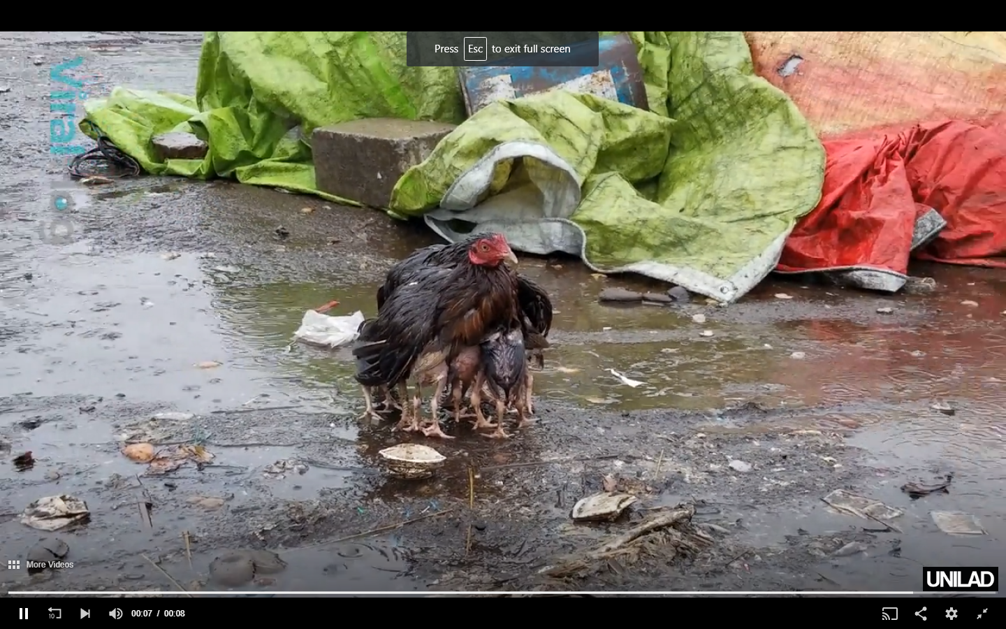
You are My Refuge

Slide 6
Creating that kind of Relationship
My attitude towards God

Slide 7
Respect for God

Slide 8
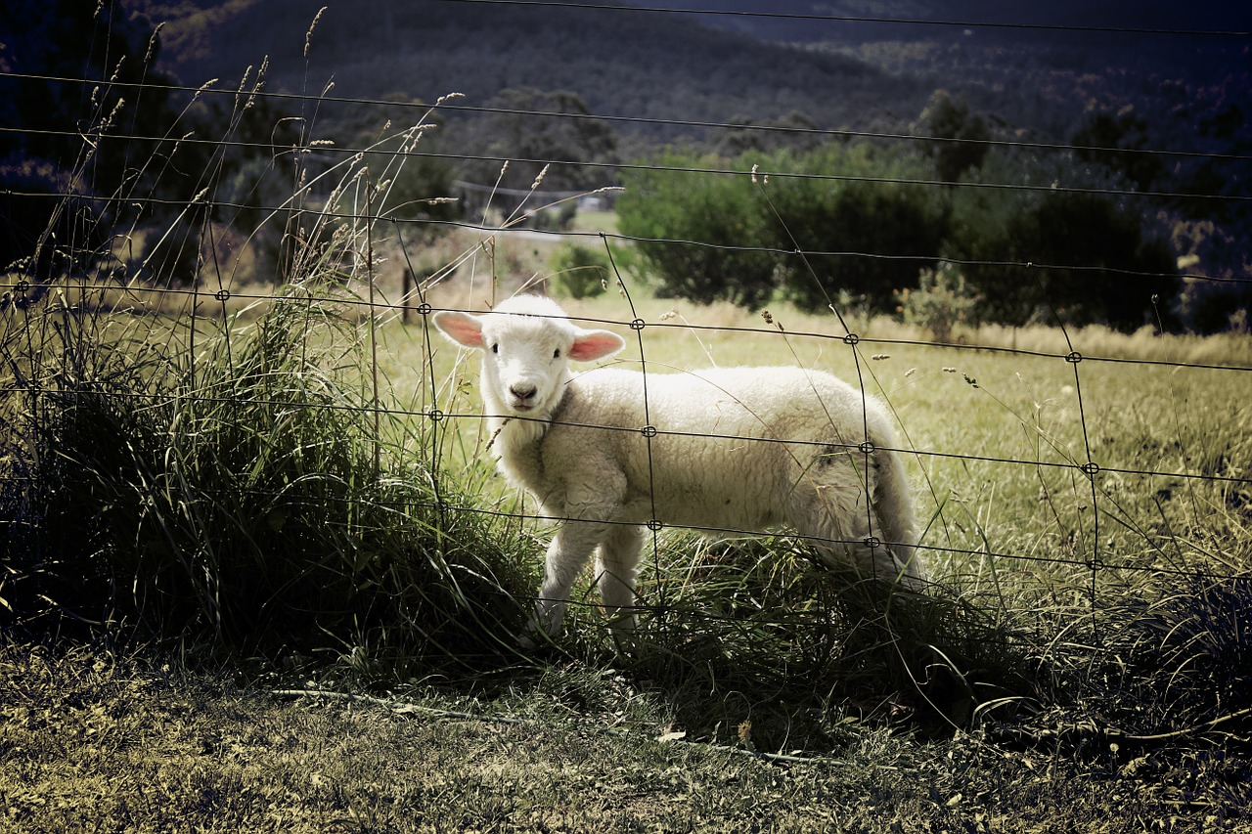

Slide 9
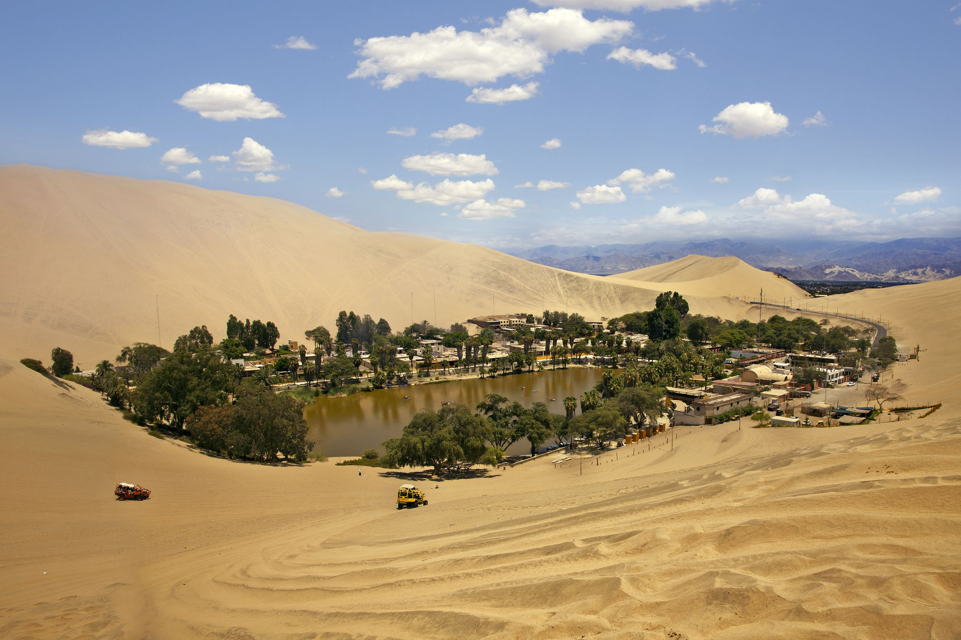
Need for God
God
Nothing good

Slide 10
Creating that kind of Relationship
My attitude towards God
My attitude towards others

Slide 11
Delight in God’s People

Slide 12
Those who go after other Gods…

Slide 13
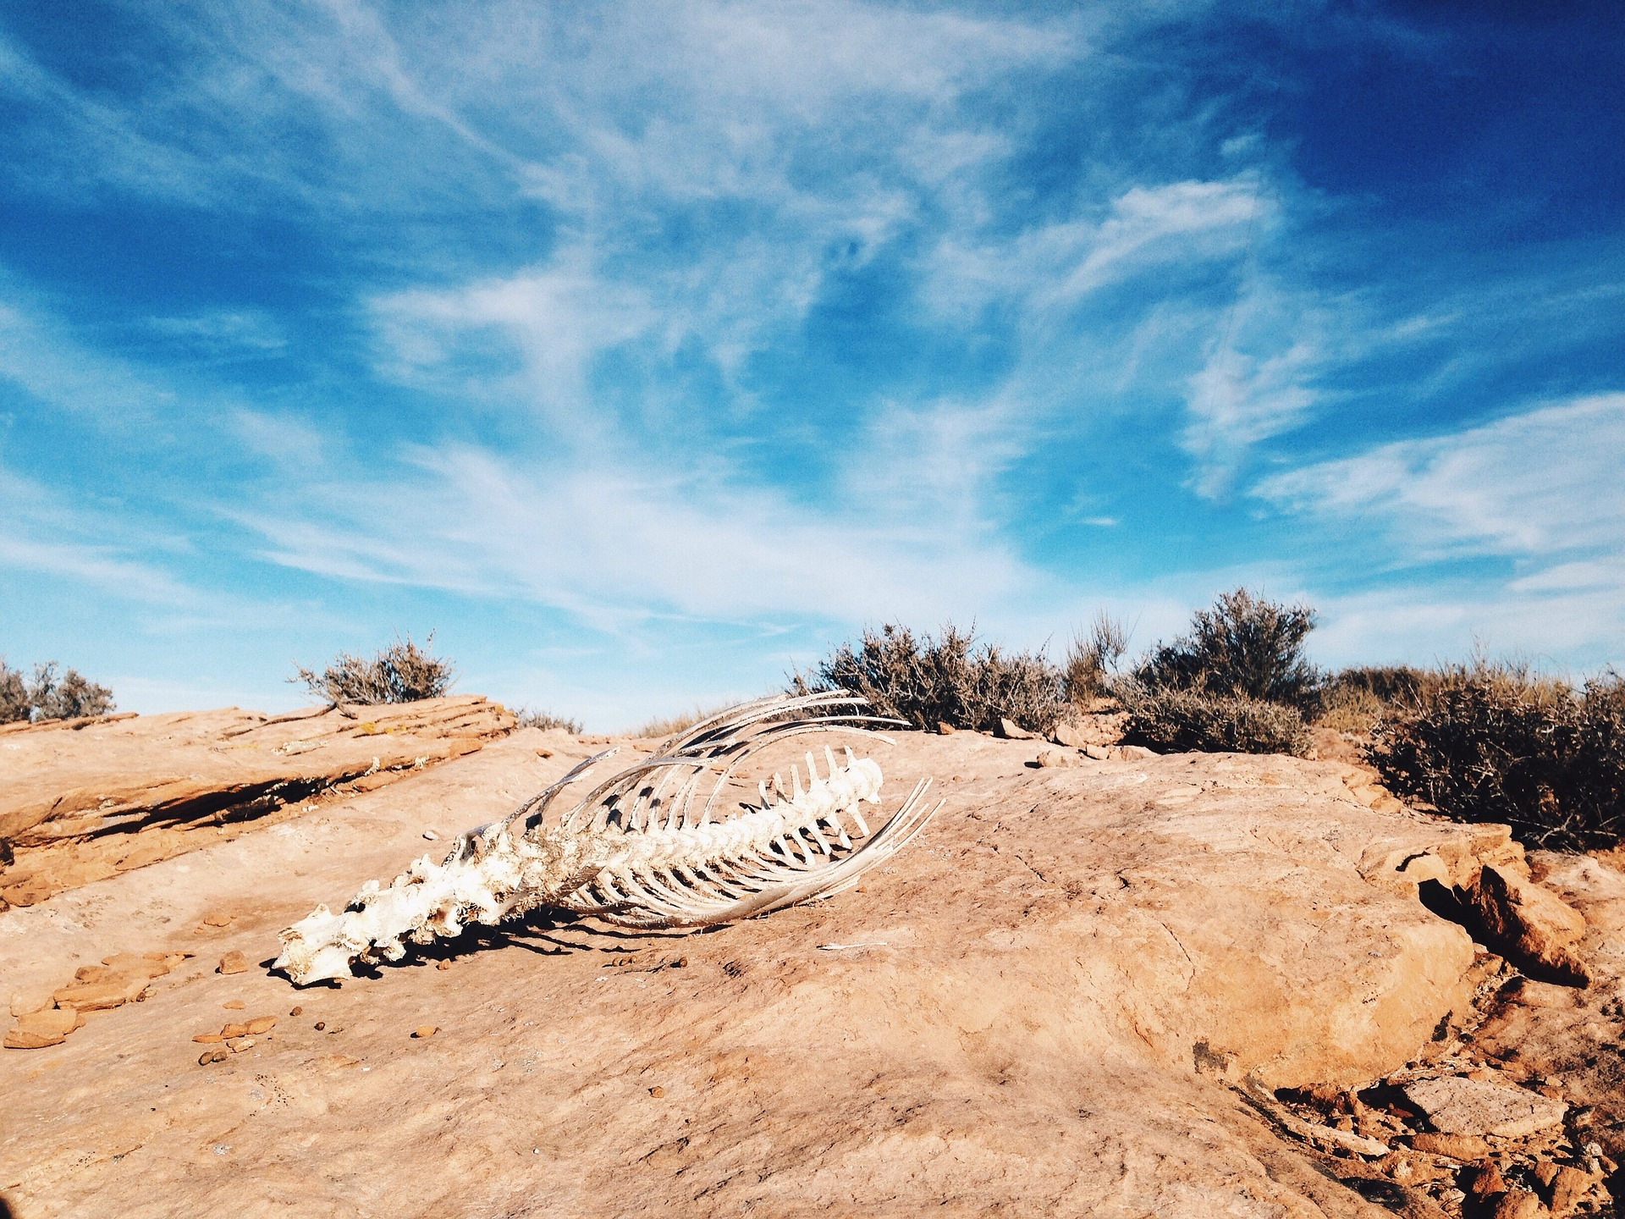
David doesn’t want to get near it.
Multiply sorrows

Slide 14
Thriving in that Relationship
Appreciating God’s blessings

Slide 15
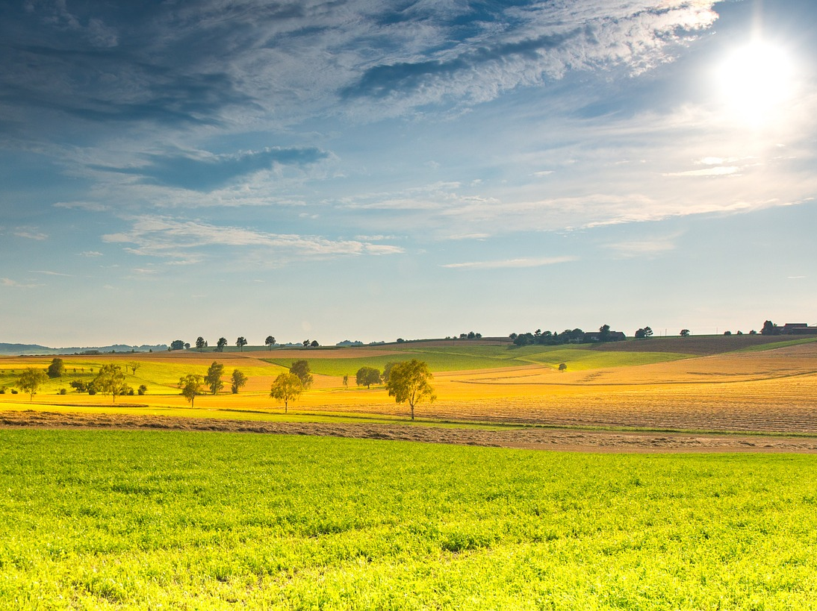
Enjoying the Blessing

Slide 16
God
God is the blessing

Slide 17
Thriving in that Relationship
Appreciating God’s blessings
Seeking God’s guidance

Slide 18
God’s Counsel

Slide 19
Dependence on God

Slide 20
The Result of the Relationship
Security

Slide 21
God Holds Him Securely

Slide 22
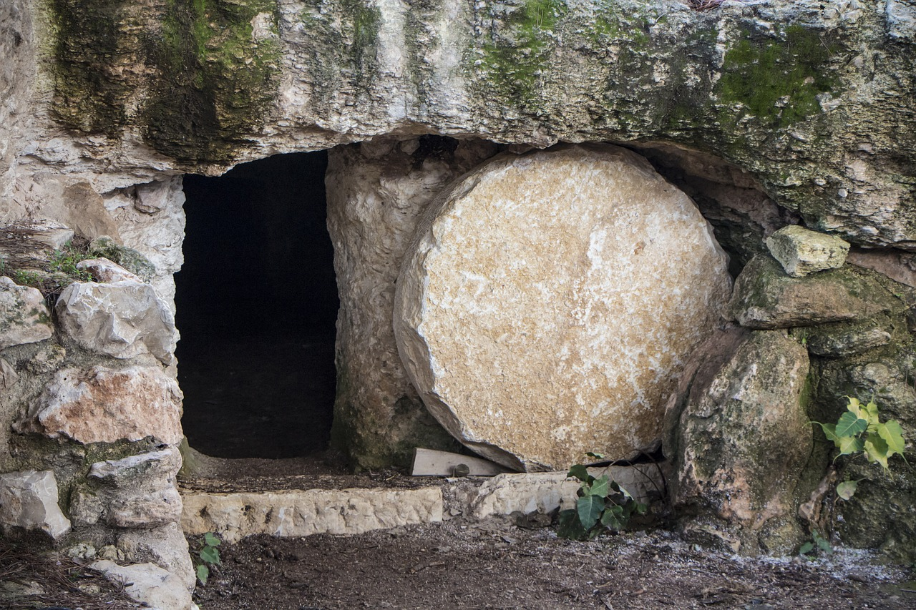
This is Why We Are Secure

Slide 23
The Result of the Relationship
Security
Joy

Slide 24
You make known to me the path of life;
in your presence there is fullness of joy;
at your right hand are pleasures forevermore.

Slide 28
God

Slide 31
That should give us joy.

