Slide 1
If in Christ we have hope in this life only, we are of all people most to be pitied.
– 1 Corinthians 15:19

Slide 2
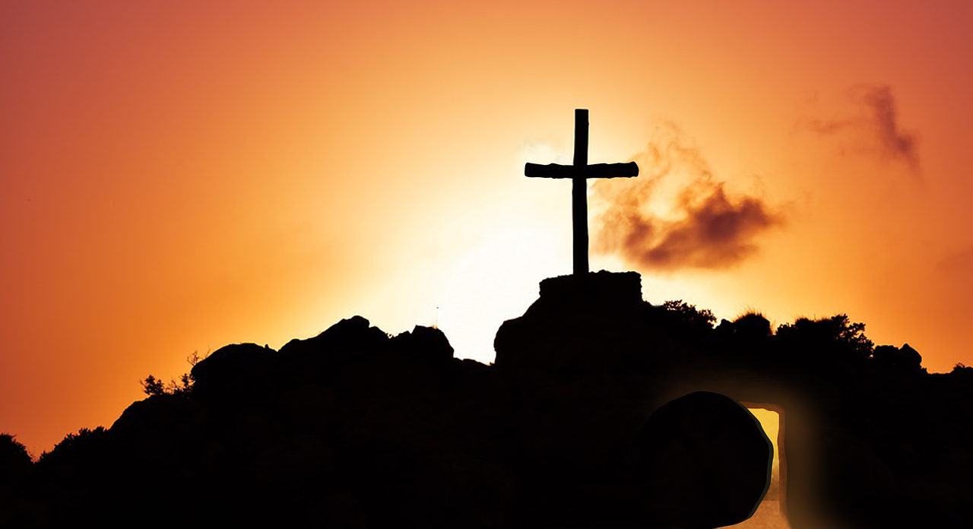
Do You Live
Like Jesus was
Raised?

Slide 3
Why Truth is So Critical

Slide 4
The Gospel is Our
Foundation
GOSPEL

Slide 5
The Gospel is Based on an Event
GOSPEL

Slide 6
The Gospel is Based on an Event
Raised
Buried
Died

Slide 7
The Event Has Evidence
Paul
500
James
Peter
12
Others
Buried
Died

Slide 8
Other Teaching is Based on this Foundation
Teaching
Raised
Buried
Died

Slide 9
Our Resurrection
Raised
Buried
Died

Slide 10
So what happens when…

Slide 11
Our Resurrection
Raised
Buried
Died

Slide 12
Our Resurrection
Raised
Buried
Died

Slide 13
Everything Falls Apart

Slide 14
Truth Needs to Change our Perspective

Slide 15
Birth
Death
Life

Slide 16
Christ’s Resurrection
My Resurrection
Life

Slide 17
Christ’s Resurrection
My Resurrection
Life

Slide 18
Christ’s Resurrection
My Resurrection
Life

Slide 19
Life

Slide 20
Life

Slide 21
Which one is my life?

Slide 22
If in Christ we have hope in this life only, we are of all people most to be pitied.
– 1 Corinthians 15:19

