Slide 1
As for what was sown on rocky ground, this is the one who hears the word and immediately receives it with joy, yet he has no root in himself, but endures for a while, and when tribulation or persecution arises on account of the word, immediately he falls away.
- Matthew 13:20-21

Slide 5
Dealing with
Moral Dilemmas
At Work

Slide 6
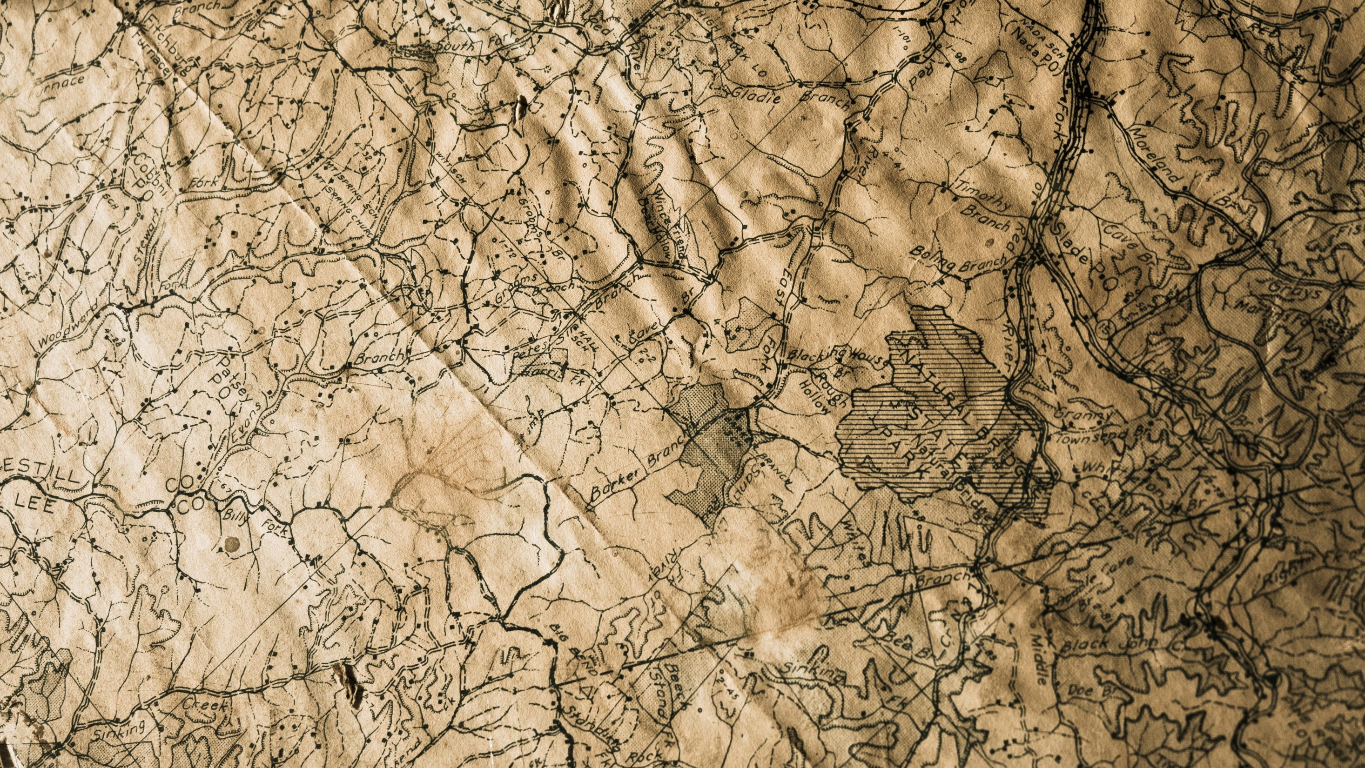
Not this.
This.

Slide 7
Israel
Exile

Slide 8
Exile
1 Peter 2:11

Slide 9
But look forward to this.
Live here

Slide 10
What happens when the environment pushes the exiles towards sin?

Slide 11
Daniel Not Eating the Food

Slide 12
Shadrach, Meshach, & Abednego not worshiping the statue

Slide 13
Daniel Praying to God When It Was Against the Law

Slide 14
Nehemiah Choosing to Go to Jerusalem

Slide 15
What can we learn from these?

Slide 16
Resolved
Respectful
Suggested alternatives
Daniel Not Eating the Food

Slide 17
4. Willing to face the consequences
Shadrach, Meshach, & Abednego not worshiping the statue

Slide 18
5. Already had a godly reputation
Daniel Praying to God When It Was Against the Law

Slide 19
6. Prayed about it ahead of time
Nehemiah Choosing to Go to Jerusalem

Slide 20
7. Complete trust in God.

Slide 21
The Real Reason They Were So Strong

Slide 23
Deep Roots

