Slide 1
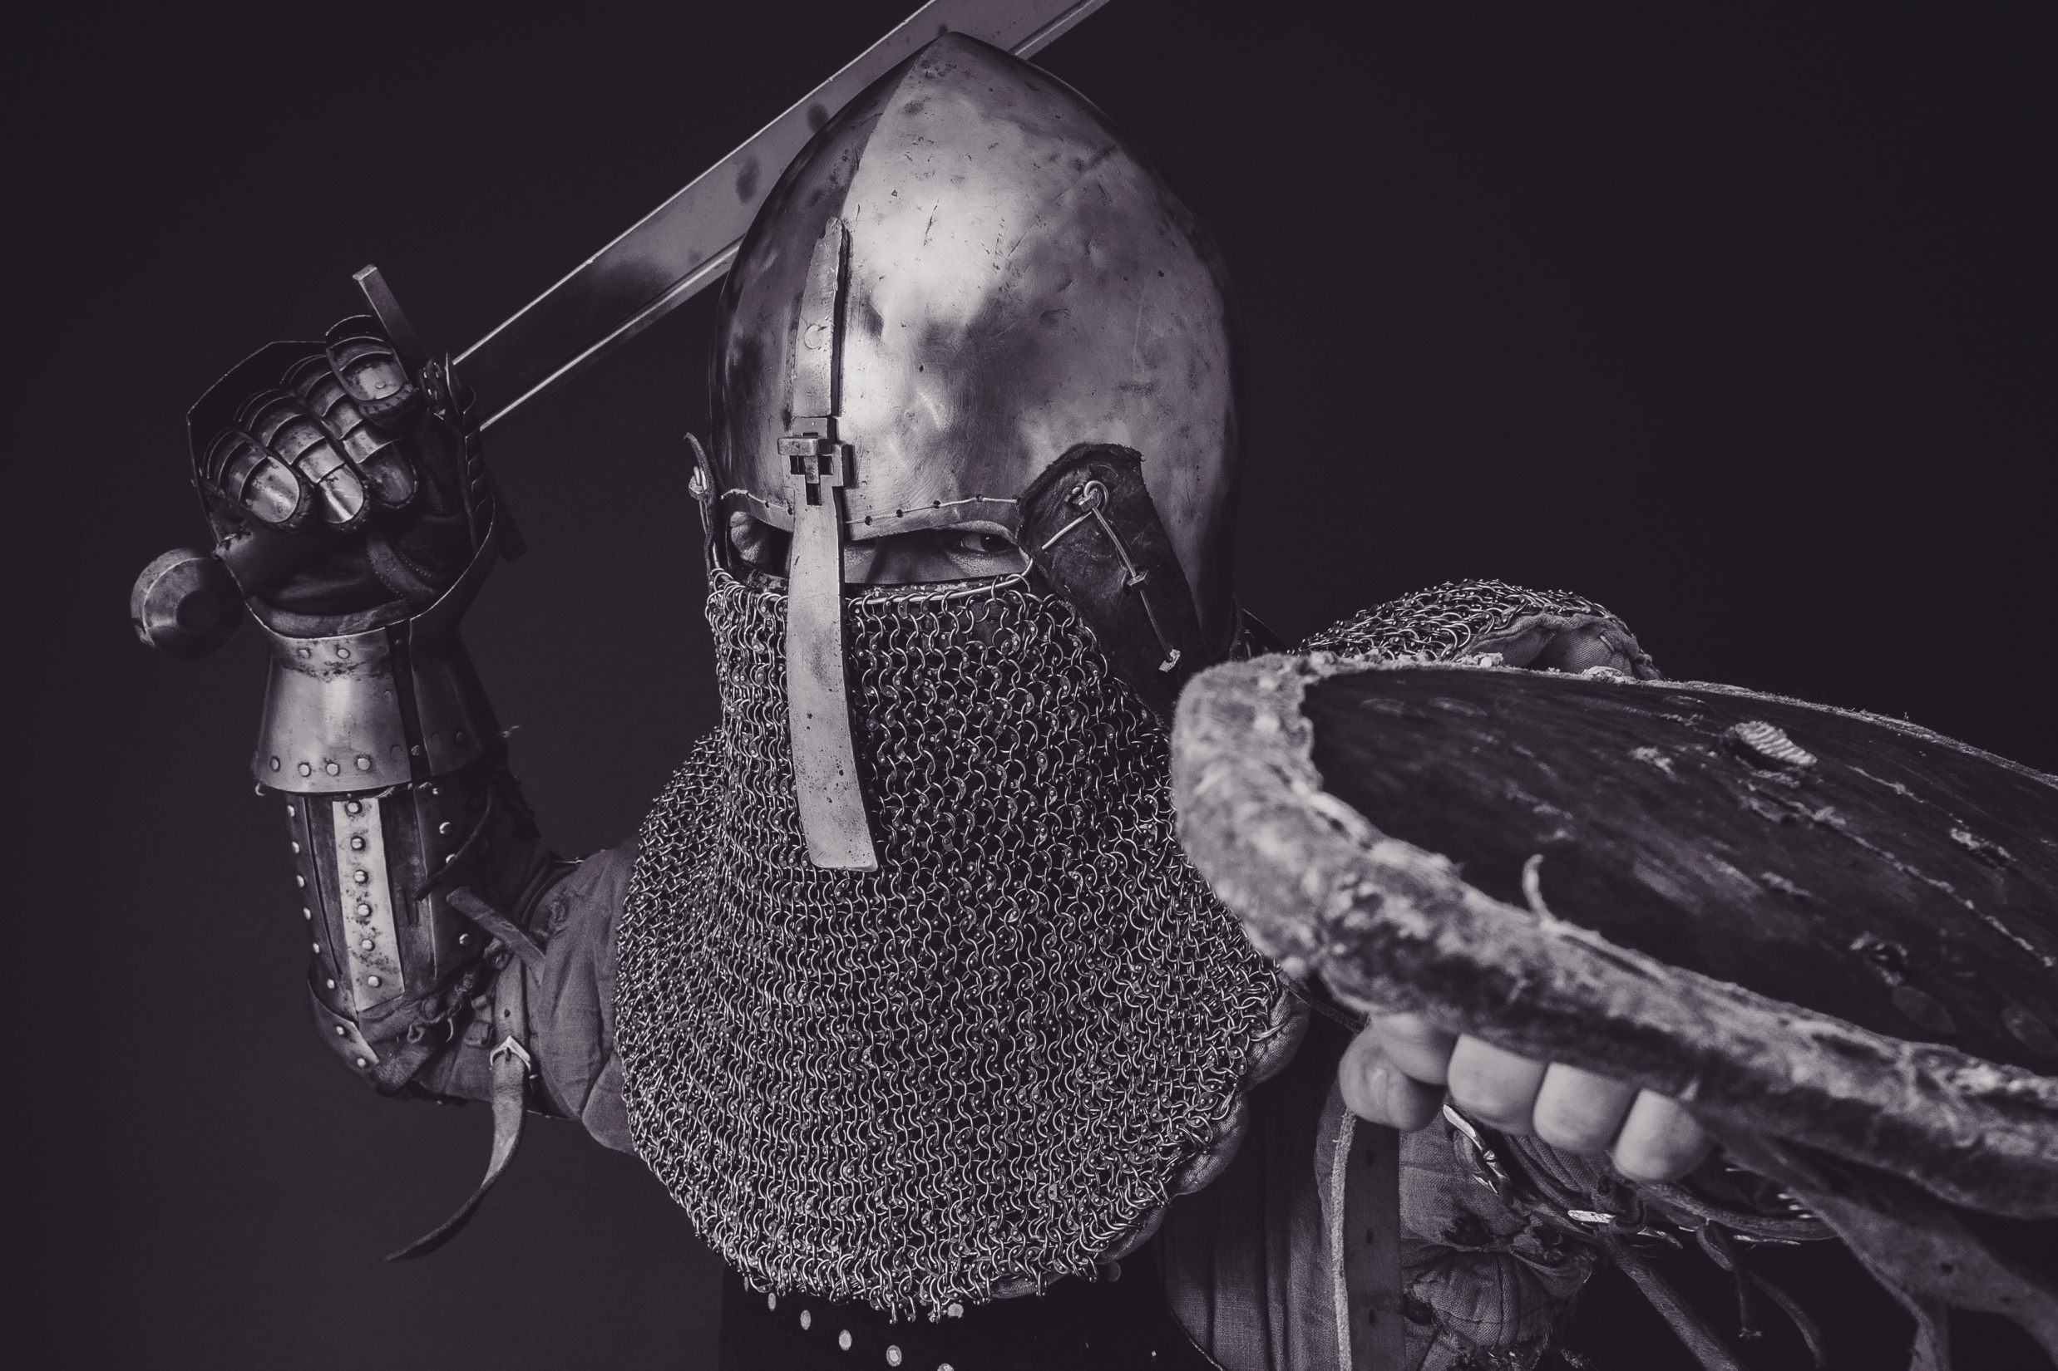
Conquering with
Purity

Slide 2
COVETOUSNESS

Slide 3
No other gods
No images
No name in vain
Keep Sabbath
Honor parents
Not murder
Not commit adultery
Not steal
No false testimony
Not covet

Slide 4
Me
You

Slide 5
Covetousness
Me
You

Slide 6
No other gods
No images
No name in vain
Keep Sabbath
Honor parents
Not murder
Not commit adultery
Not steal
No false testimony
Not covet
Internal
A form of Idolatry
Leads to the others

Slide 7
When is it coveting?
Me

Slide 8
Let’s Look at a Real World Example

Slide 9
Not fair.
Jesus says:
“I’m not the judge.”
Man
Brother

Slide 10
“Be careful not to covet.”
Not fair.
Man
Brother

Slide 11
“Because...”
It’s not about this.

Slide 12
“Here’s what I mean…”
Not fair.
He won!!!

Slide 13
Then God said,
“You won the wrong contest.”

Slide 14
God doesn’t want me to be like this:

Slide 15
God wants:

Slide 16
God

Slide 17
God
Where’s your focus?

