Slide 1
The Story
of the Bible

Slide 2
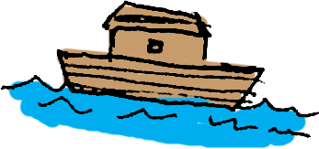
Noah
Walked with God
GOD
Humans
Flood
LIFE
DEATH
Disobeyed
GOD
Humans
Eden
LIFE
DEATH
Blessings!
GOD
Humans
Creation
LIFE

Slide 3
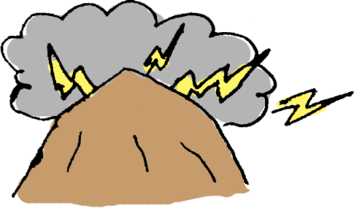
Sacrifice
Israelites
GOD
Obedience
Law
LIFE
DEATH
Sacrifice
Israelites
GOD
Egyptians
Exodus
LIFE
DEATH
Blessings!
Life of Faith
GOD
Abraham
Abraham
LIFE
DEATH
LIFE
DEATH

Slide 4
Blessings!
David
GOD
Promises!
David
LIFE
DEATH
Israel
Repentance
GOD
Go after other things
Judges
LIFE
DEATH
Blessings!
Faith & Obedience
GOD
Israel
Joshua
LIFE
DEATH
LIFE
DEATH

Slide 5
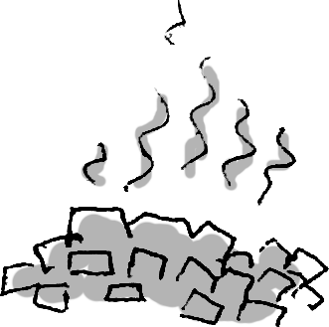
Repentance
Israel
GOD
Restored
LIFE
DEATH
GOD
Disobedience
Israel
Captivity
LIFE
DEATH
Creation
LIFE
DEATH

Slide 6
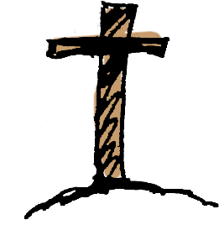
Christ
God
Humans
Raised
Christ
LIFE
DEATH

Slide 7
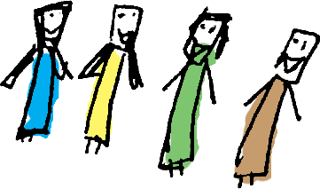
Blessings!
GOD
Humans
Eternity
LIFE
DEATH
Walking with God
Christ
Humans
Letters
LIFE
DEATH
Faith
Repentance
Christ
Baptism
Humans
Sacrifice
Acts
LIFE
DEATH

