Slide 2
1 KINGS 17

Slide 4
1 Kings 17:1 ESV
“Now Elijah the Tishbite, of Tishbe in Gilead, said to Ahab, ‘As the LORD, the God of Israel, lives, before whom I stand, there shall be neither dew nor rain these years, except by my word.’”

Slide 5
I. Elijah Was A Common Man

Slide 6
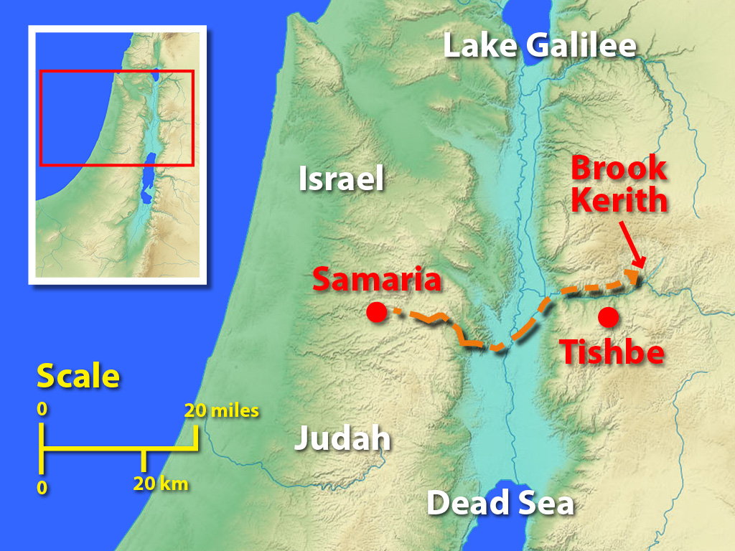
A) His Home

Slide 7
B) His Humanity
James 5:17-18 ESV
“Elijah was a man with a nature like ours, and he prayed fervently that it might not rain, and for three years and six months it did not rain on the earth.
(18) Then he prayed again, and heaven gave rain, and the earth bore its fruit.”

Slide 8
II. Elijah Was A Courageous Man

Slide 9
1 Kings 17:1 ESV
“Now Elijah the Tishbite, of Tishbe in Gilead, said to Ahab, ‘As the LORD, the God of Israel, lives, before whom I stand, there shall be neither dew nor rain these years, except by my word.’”

Slide 10
A) Defied
A Foolish Ruler
1 Kings 16:30, 33
1 Kings 16:31
1 Kings 16:32
1 Kings 16:34 (ff. Joshua 6:26)

Slide 11
B) Denounced
A False Religion

Slide 12
III. Elijah Was A Committed Man

Slide 13
A) His Designation
Elijah
means
“My God is Jehovah”

Slide 14
Hebrews 11:1 ESV
(1) Now faith is the assurance of things hoped for, the conviction of things not seen.

Slide 15
B) His Dependence
Hebrews 11:6 ESV
(6) And without faith it is impossible to please him, for whoever would draw near to God must believe that he exists and that he rewards those who seek him.

Slide 16
C) His Devotion
1 Kings 17:1 ESV
“Now Elijah the Tishbite, of Tishbe in Gilead, said to Ahab, ‘As the LORD, the God of Israel, lives, before whom I stand, there shall be neither dew nor rain these years, except by my word.’”

Slide 17
IV. Elijah Was A Confident Man

Slide 18
Confident in:
A) Person of God
1 Kings 17:1 ESV
“Now Elijah the Tishbite, of Tishbe in Gilead, said to Ahab, ‘As the LORD, the God of Israel, lives, before whom I stand, there shall be neither dew nor rain these years, except by my word.’”

Slide 19
Confident in:
B) Power of God
James 5:17-18 ESV
“Elijah was a man with a nature like ours, and he prayed fervently that it might not rain, and for three years and six months it did not rain on the earth.
(18) Then he prayed again, and heaven gave rain, and the earth bore its fruit.”

Slide 20
Confident in:
B) Power of God
Job 42:1-2 ESV
(1) Then Job answered the LORD and said:
(2) “I know that you can do all things, and that no purpose of yours can be thwarted.”

Slide 21
Confident in:
B) Power of God
Luke 1:37 ESV
“For nothing will be impossible with God."

Slide 22
Confident in:
B) Power of God
Ephesians 3:20-21 ESV
“Now to him who is able to do far more abundantly than all that we ask or think, according to the power at work within us,
(21) to him be glory in the church and in Christ Jesus throughout all generations, forever and ever. Amen.”

Slide 23
Confident in:
C) Promise of God
Romans 4:20-21 ESV
(20) No unbelief made him waver concerning the promise of God, but he grew strong in his faith as he gave glory to God,
(21) fully convinced that God was able to do what he had promised.

