Slide 2
“Therefore, my brothers, whom I love and long for, my joy and crown, stand firm thus in the Lord, my beloved. I entreat Euodia and I entreat Syntyche to agree in the Lord. Yes, I ask you also, true companion, help these women, who have labored side by side with me in the gospel together with Clement and the rest of my fellow workers, whose names are in the book of life.”

Slide 3
“Rejoice in the Lord always; again I will say, rejoice. Let your reasonableness be known to everyone. The Lord is at hand; do not be anxious about anything, but in everything by prayer and supplication with thanksgiving let your requests be made known to God. And the peace of God, which surpasses all understanding, will guard your hearts and your minds in Christ Jesus.”

Slide 4
“Finally, brothers, whatever is true, whatever is honorable, whatever is just, whatever is pure, whatever is lovely, whatever is commendable, if there is any excellence, if there is anything worthy of praise, think about these things. What you have learned and received and heard and seen in me—practice these things, and the God of peace will be with you.”
(Philippians 4:1-9 ESV)

Slide 6
^{I. How To Walk (verse 1)}
^{A) “Stand firm”}
^{B) 1 Corinthians 16:13}
^{C) Romans 5:2-6}

Slide 7
“Through him we have also obtained access by faith into this grace in which we stand, and we rejoice in hope of the glory of God. Not only that, but we rejoice in our sufferings, knowing that suffering produces endurance, and endurance produces character, and character produces hope, and hope does not put us to shame, because God's love has been poured into our hearts through the Holy Spirit who has been given to us. For while we were still weak, at the right time Christ died for the ungodly.”
(Romans 5:2-6 ESV)

Slide 8
^{I. How To Walk (verse 1)}
^{A) “Stand firm”}
^{B) 1 Corinthians 16:13}
^{C) Romans 5:2-6}
^{D) “In the Lord”}

Slide 9
“Finally, be strong in the Lord and in the strength of his might. Put on the whole armor of God, that you may be able to stand against the schemes of the devil. For we do not wrestle against flesh and blood, but against the rulers, against the authorities, against the cosmic powers over this present darkness, against the spiritual forces of evil in the heavenly places. Therefore take up the whole armor of God, that you may be able to withstand in the evil day, and having done all, to stand firm.”
(Ephesians 6:10-13 ESV)

Slide 10
^{II. How To Be Whole (v. 2-3)}
^{A) Philippians 2:1-2}
^{B) Ladies’ names}
C) Agreement to walk together must be made in order for a prosperous journey to take place.
^{D) “Help these women”}

Slide 11
III. How To Overcome Worry (verses 4-7)
^{A) Praise (v. 4)}
^{1. “Rejoice”}
^{2. “Always”}
^{B) Practice (v. 5)}
^{C) Prayer (v. 6)}
^{1. Trust God}
^{2. Ask God}
^{3. Thank God}
^{4. Entreat God}
^{D) Peace (v. 7)}

Slide 12
^{IV. How To Win (verses 8-9)}
^{A) Begins with} ^{Positive Thinking}

Slide 13
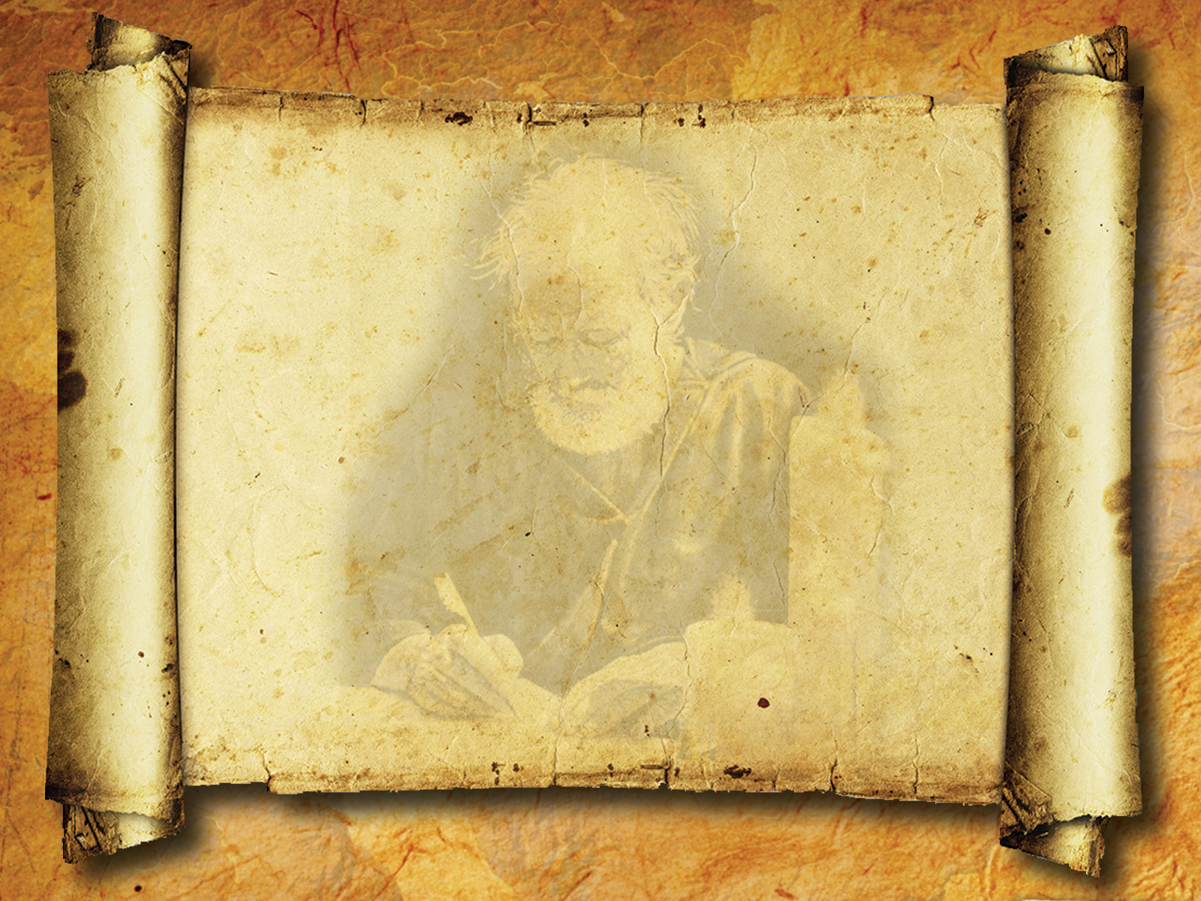
“Therefore I urge you, brethren, by the mercies of God, to present your bodies a living and holy sacrifice, acceptable to God, which is your spiritual service of worship. And do not be conformed to this world, but be transformed by the renewing of your mind, so that you may prove what the will of God is, that which is good and acceptable and perfect.”
(Romans 12:1-2 NASB)

Slide 14
^{IV. How To Win (verses 8-9)}
^{A) Begins with} ^{Positive Thinking}
^{B) Results in} ^{Personal Victory!.}
^{C) Key to each is found} ^{in one phrase} ^{“IN THE LORD”} ^{(1; 2; 4; 7)}

