Slide 2
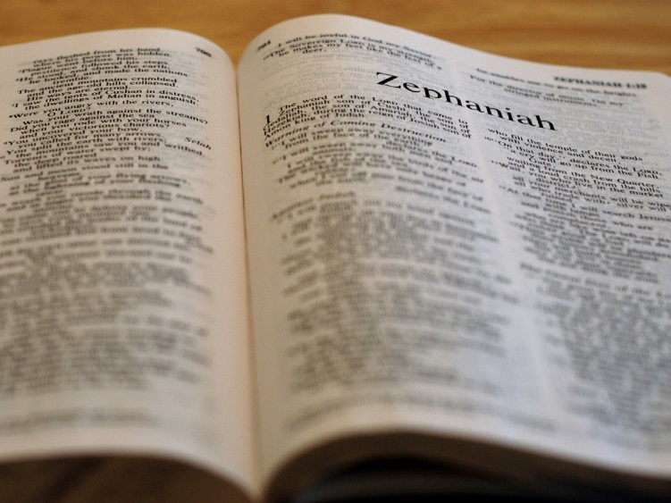

Slide 3
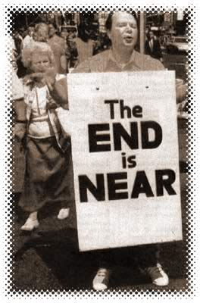
I will utterly sweep away everything from the face of the earth. . .
1:2

Slide 4
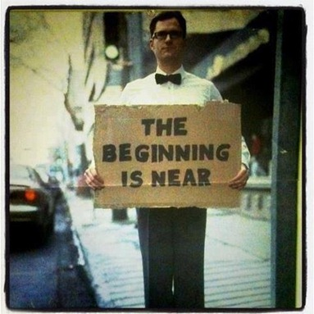
I will bring you home
3:20

Slide 5
Zephaniah
Jehovah hides

Slide 7
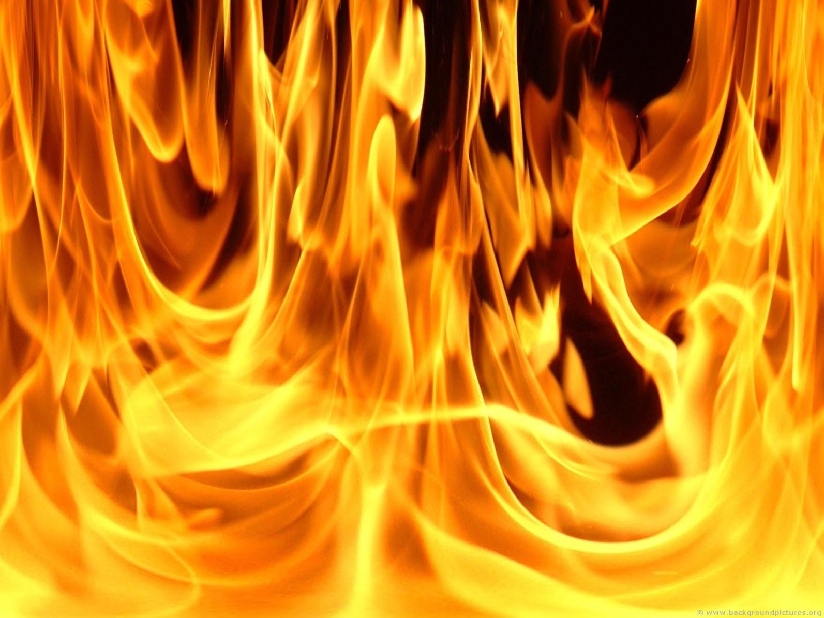
Judgment

Slide 8
Be silent before the Lord GOD!
1:7

Slide 9
Seek the LORD
2:3

Slide 10
Fear God
3:7

Slide 11
Wait for the Lord
3:8

Slide 14
What God WILL Do

Slide 15
Transformation

Slide 16
Community

Slide 17
Integrity and Honesty

Slide 18
Security

Slide 19
Rejoice!

Slide 20
The LORD has taken away the judgments against you, he has turned away your enemies.

Slide 21
In your midst

Slide 22
A warrior who gives victory

Slide 23
He will rejoice over you

Slide 25
Zephaniah 3:18-20
I will remove disaster from you, so that you will not bear reproach for it.
I will deal with all your oppressors at that time. And I will save the lame and gather the outcast, and I will change their shame into praise and renown in all the earth.
At that time I will bring you home, at the time when I gather you; for I will make you renowned and praised among all the peoples of the earth, when I restore your fortunes before your eyes, says the LORD.

