Slide 2
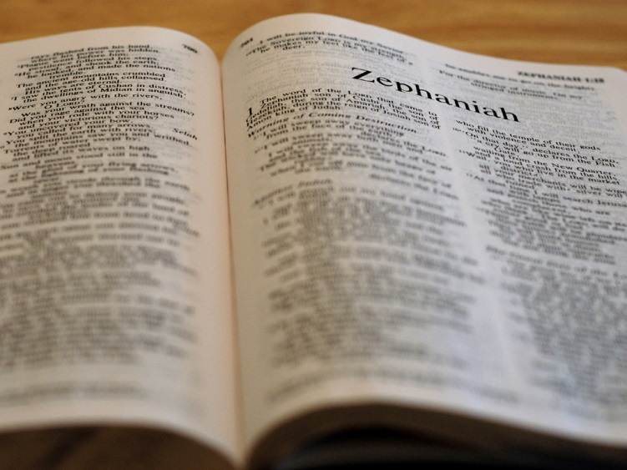

Slide 3
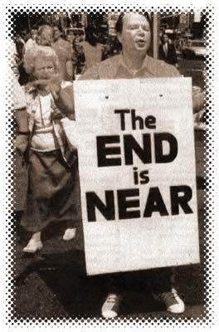
I will utterly sweep away everything from the face of the earth. . .
1:2

Slide 4
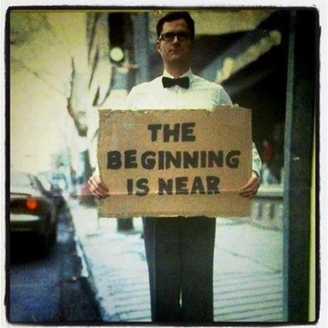
I will bring you home
3:20

Slide 6
What is a prophet?

Slide 7
Zephaniah
Jehovah hides

Slide 8
We take refuge from God in God.
A. W. Tozer

Slide 10
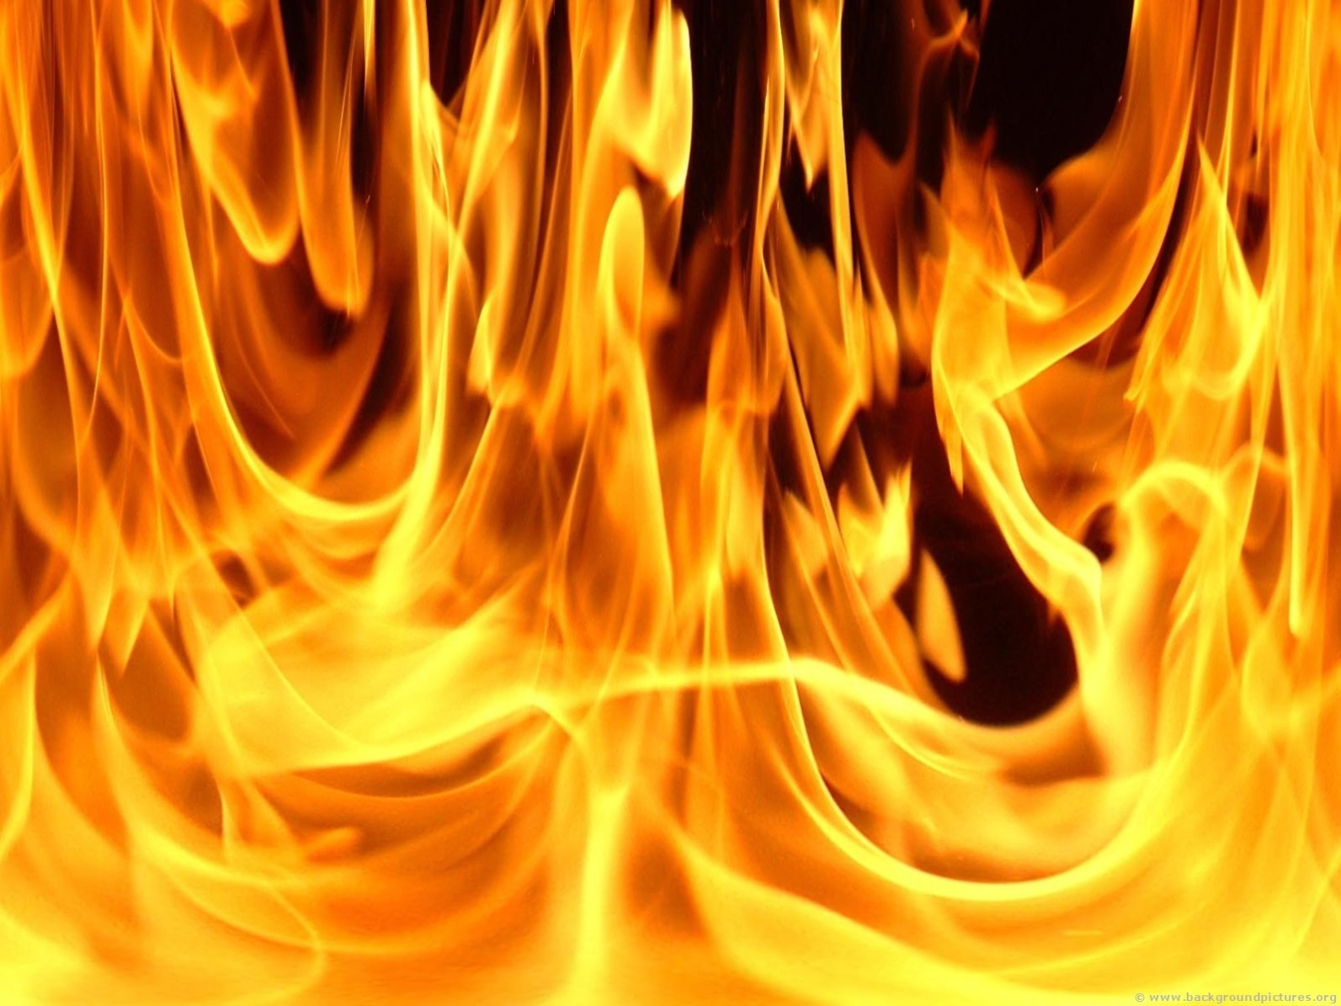
Judgment

Slide 11
Be silent before the Lord GOD!
1:7

Slide 12
Seek the LORD
2:3

Slide 13
Fear God
3:7

Slide 14
Wait for the Lord
3:8

