Slide 2
I. The Question Examined
A) “What” — defining “which things”
B) “Must” — Something is required
C) “I” — It is a personal question
D) “Do” — Active participation
E) “To be saved” — Here is the purpose
Saving is done by another (Titus 2:11-14)

Slide 3
II. The Jailer (Acts 16)
A) “Sirs, what must I do to be saved?” (30)
B) He was formerly an unbeliever.
C) He was told to “believe” (v. 31).
D) Preached to him so the question could be fully answered (vs. 32-34)
E) “...immediately he was baptized...” (33)

Slide 4
III. The Jews (Acts 2)
A) “Brethren, what shall we do?” (v. 37)
B) They said this after realizing that they had crucified the Christ (vs. 22-24)
C) Convicted by Peter’s preaching (36-37)
D) Peter, inspired by the H. S. (v. 4), said repent and be baptized (vs. 38-41)

Slide 5
IV. Saul (Acts 9, 22)
A) Educated and persecuting (22:1-5)
B) Lord, what do you want me to do? (9:6)
C) Penitent to the point of fasting (9:9)
D) Believing and sincerely praying (9:11)
E) He was told by God’s messenger, Annanias, what to do (9:10-19)
F) What was the purpose of his baptism? (22:12-16)

Slide 6
V. 3 Different Answers to Same Question
A) They sure seem different.
1. Jailor - believe and he was baptized
2. Jews - repent and be baptized
3. Saul was just told to be baptized
B) Why the difference?
1. Jailor was an unbeliever.
2. Jews believers needed convinced
3. Saul was a penitent believer when

Slide 7
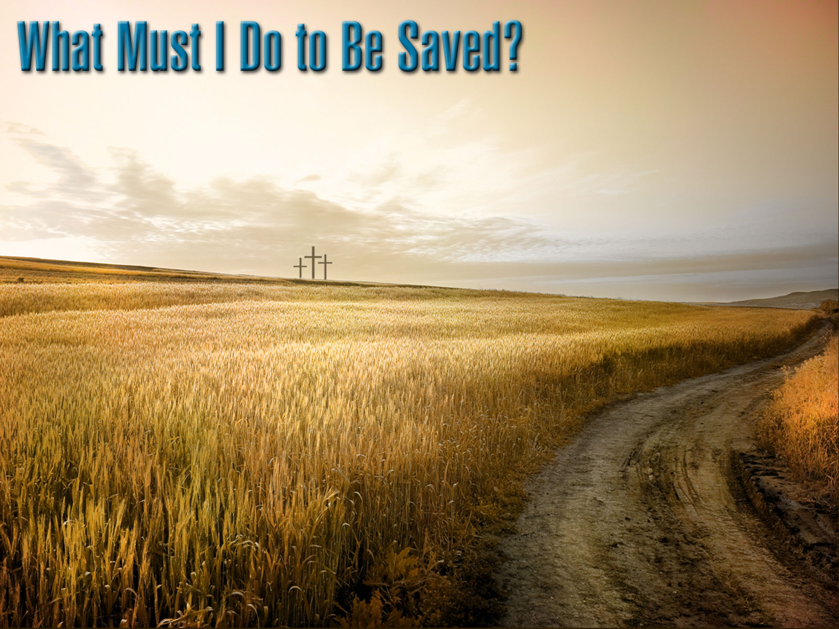
Acts 10:34-35
(34) Opening his mouth, Peter said: “I most certainly understand now that God is not one to show partiality,
(35) but in every nation the man who fears Him and does what is right is welcome to Him.”

Slide 8
Romans 2:11-12
(11) For there is no partiality with God.
(12) For all who have sinned without the Law will also perish without the Law, and all who have sinned under the Law will be judged by the Law;

Slide 9
Hear the WORD of God
Confess Your FAITH in Christ
Be Baptized INTO Christ
Believe in JESUS as Christ
Repent of YOUR Sins
Abide Faithfully IN Christ

