Slide 1
The Empty
Promises
of
“Easter”

Slide 2
The Empty
Promises
of “Easter”
Empty
Cross

Slide 3
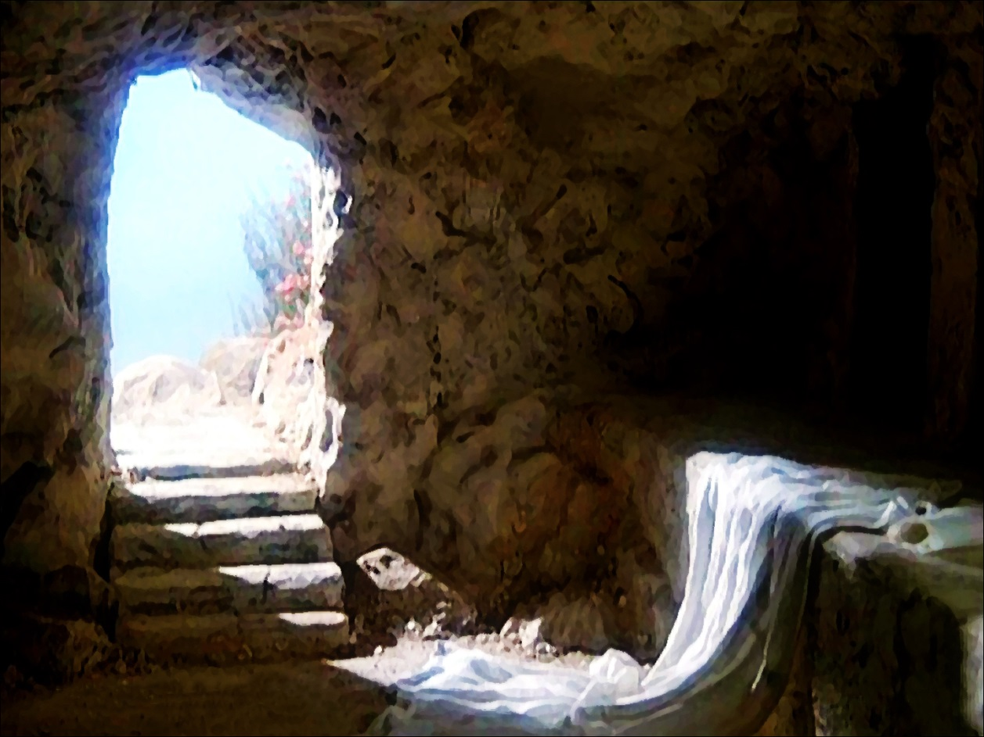
The Empty
Promises
of “Easter”
Empty
Tomb

Slide 4
The Empty
Promises
of “Easter”
Empty
Grave
Clothes

Slide 5
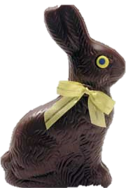
The Empty
Promises
of “Easter”
Empty
Holiday

Slide 6
The Empty
Promises
of “Easter”
Empty
Life

