Slide 1
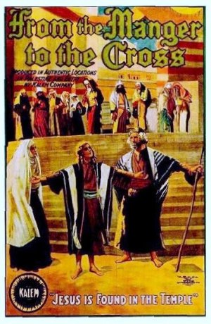
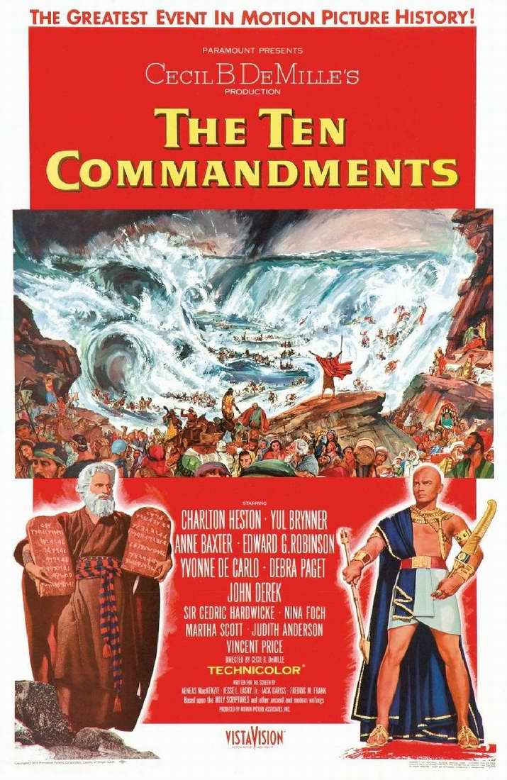
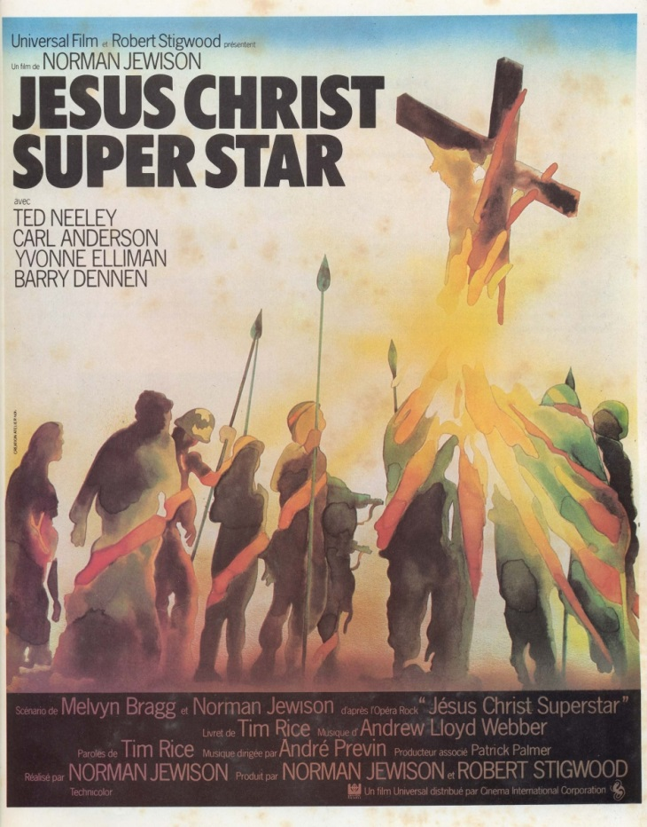

Slide 4
Written across 1600 years.
Written by 40 different authors with a wide range of experiences in life.
Written in various places in various circumstances.
Written in 3 Languages: Hebrew, Aramaic, Greek
Covering Hundreds of Controversial Topics
**Yet There Is Incredible Harmony!

Slide 5
The Bible’s Survival
I. Survival Against Time
II. Survival Against Persecution
III. Survival Against Criticism

Slide 6
“No other book has been so chopped, knifed, sifted, scrutinized, and vilified. What book on philosophy or religion or psychology…has been subject to such a mass attack as the Bible? And yet, the Bible is still loved by millions, read by millions, and studied by millions.” – Bernard Ramm

Slide 7
The Bible Is Incredible
I. A Message Full of Real Prophecy
Isaiah 44:28, 2 Chronicles 36:22
II. A Message Full of Real History
III. A Message Full of Real People

Slide 8
IV. A Message Full of Real Power
Transformed The Literature of the World
Transformed The Laws of the World
Transformed The Leaders of the World
Transformed The Lost of the World
“He who has believed and has been baptized shall be saved; but he who has disbelieved shall be condemned.” - Jesus, Mark 16:16

Slide 10
“For I do not want you to be ignorant of the fact, brothers and sisters, that our ancestors were all under the cloud and that they all passed through the sea.
² They were all baptized into Moses in the cloud and in the sea.
³ They all ate the same spiritual food
⁴ and drank the same spiritual drink; for they drank from the spiritual rock that accompanied them, and that rock was Christ.
1 Corinthians 10:1-11

Slide 11
⁵ Nevertheless, God was not pleased with most of them; their bodies were scattered in the wilderness.
⁶ Now these things occurred as examples to keep us from setting our hearts on evil things as they did.
⁷ Do not be idolaters, as some of them were; as it is written: “The people sat down to eat and drink and got up to indulge in revelry.”
1 Corinthians 10:1-11

Slide 12
⁸ We should not commit sexual immorality, as some of them did—and in one day twenty-three thousand of them died.
⁹ We should not test Christ, as some of them did—and were killed by snakes.
¹⁰ And do not grumble, as some of them did—and were killed by the destroying angel.
¹¹ These things happened to them as examples and were written down as warnings for us, on whom the culmination of the ages has come.”
1 Corinthians 10:1-11

