Slide 2
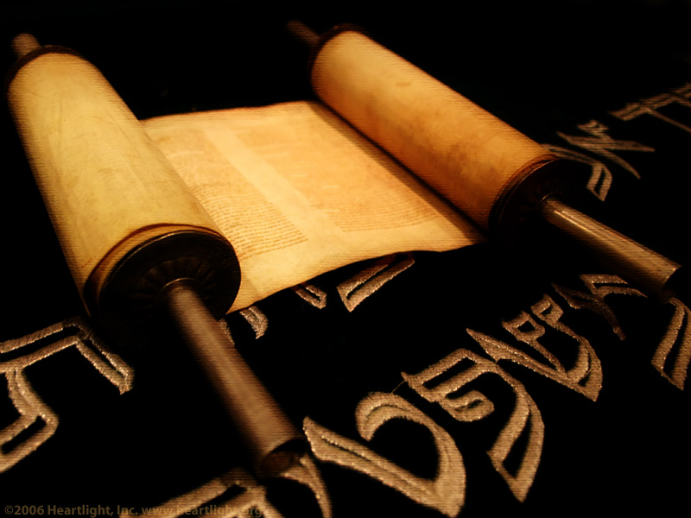
Resolving an
Un-kept Resolution
Psalm
39

Slide 3
Psalm 39
I. David’s Pledge (vs. 1-3)
A) What he decides (v. 1).
1. He vows not to sin in his speech and actions when the ungodly are in his presence.
2. The pledge is noble, sincere and with a good intent.
B) What he does (vs. 2-3)
1. He cannot even say anything nice or good to those people.
2. He does not keep silence about their sinful ways.

Slide 4
Psalm 39
II. David’s Petition (vs. 4-13)
A) Show me!
1. The frailty of life (vs. 4-5)
2. The futility of life (v.6)
B) Save me!
1. Verses 7-9
2. He knows that his only hope is in God.
3. He knows that his punishment comes from God.

Slide 5
Psalm 39
II. David’s Petition (vs. 4-13)
C) Spare me!
1. Verses 10-11
2. He requests that God stop punishing him for his sin and hear his cry for help.
D) Satisfy me!
1. Verses 12-13
2. David wants to experience the joy of a close relationship with the Lord again.

Slide 6
Resolving an Unkept Resolution
Psalm
39

Slide 8
Author
David
David/Korah
Compiler
Solomon
Korah
Suggest
Genesis (man)
Exodus (redemption)
Asaph
Anonymous
David
Hezekiah
Ezra/Neh.
Ezra/Neh.
Leviticus (worship)
Numbers (wandering)
Deuteronomy (word of God)
5 Books
1-41
42-72
73-89
90-106
107-150

