Slide 1
&

Slide 2
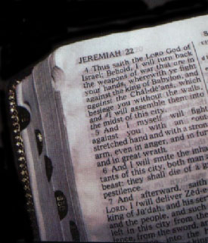
Romans 5:15-18 NKJV
(15) But the free gift is not like the offense. For if by the one man's offense many died, much more the grace of God and the gift by the grace of the one Man, Jesus Christ, abounded to many.
(16) And the gift is not like that which came through the one who sinned. For the judgment which came from one offense resulted in condemnation, but the free gift which came from many offenses resulted in justification.

Slide 3
Romans 5:15-18 NKJV
(17) For if by the one man's offense death reigned through the one, much more those who receive abundance of grace and of the gift of righteousness will reign in life through the One, Jesus Christ.)
(18) Therefore, as through one man's offense judgment came to all men, resulting in condemnation, even so through one Man's righteous act the free gift came to all men, resulting in justification of life.

Slide 4
&

Slide 5
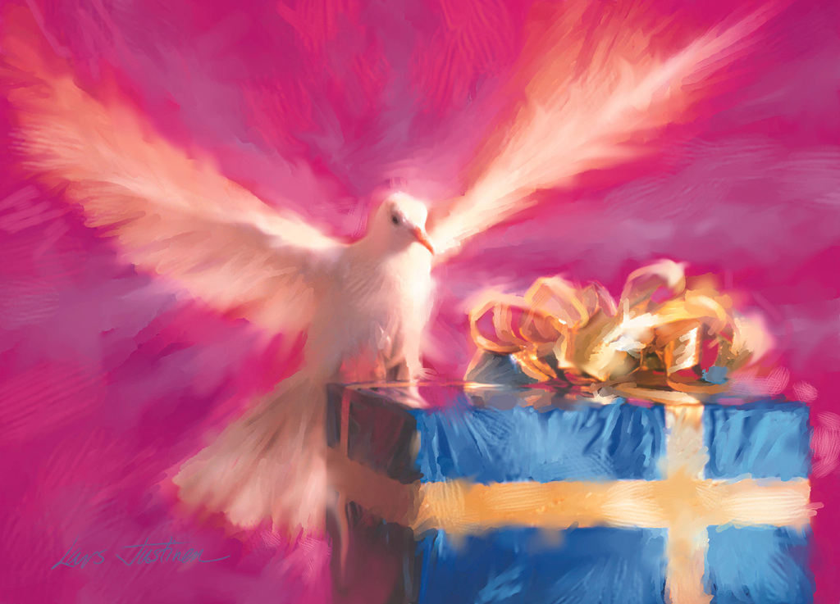
If It’s Free, Why Does It Cost?

Slide 6
If It’s FREE, Why Does It Cost?
I. The Free Gift of Salvation
God’s gift to undeserving men.

Slide 7
“For while we were still helpless, at the right time Christ died for the ungodly. For one will hardly die for a righteous man; though perhaps for the good man someone would dare even to die. But God demonstrates His own love toward us, in that while we were yet sinners, Christ died for us.” (Romans 5:6-8)

Slide 8
If It’s FREE, Why Does It Cost?
I. The Free Gift of Salvation
God’s gift to undeserving men.
Because He loved us.

Slide 9
“By this the love of God was manifested in us, that God has sent His only begotten Son into the world so that we might live through Him. In this is love, not that we loved God, but that He loved us and sent His Son to be the propitiation for our sins.” (1 John 4:9-10)

Slide 10
If It’s FREE, Why Does It Cost?
I. The Free Gift of Salvation
God’s gift to undeserving men.
Because He loved us.
To ALL who will receive it!

Slide 11
“Then He said to me, ‘It is done. I am the Alpha and the Omega, the beginning and the end. I will give to the one who thirsts from the spring of the water of life without cost.’” (Revelation 21:6)
“The Spirit and the bride say, ‘Come.’ And let the one who hears say, ‘Come.’ And let the one who is thirsty come; let the one who wishes take the water of life without cost.” (Revelation 22:17)

Slide 12
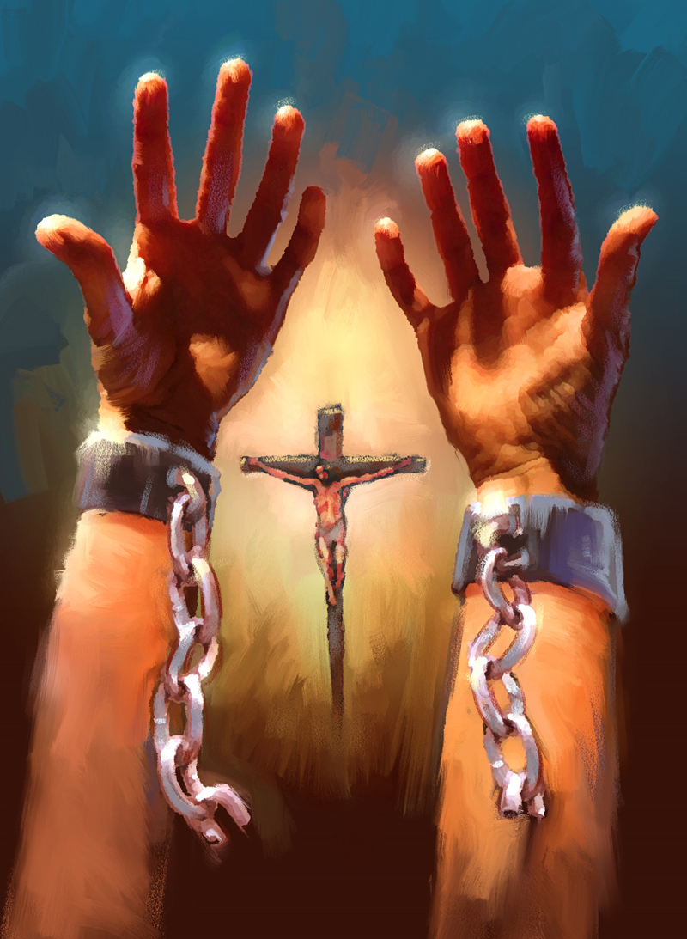
If It’s FREE, Why Does It Cost?
II. The High Cost of Providing the Gift
The Father

Slide 13
“For God so loved the world, that He gave His only begotten Son, that whoever believes in Him shall not perish, but have eternal life.” (John 3:16)
“He who did not spare His own Son, but delivered Him over for us all, how will He not also with Him freely give us all things?” (Romans 8:32)

Slide 14
If It’s FREE, Why Does It Cost?
II. The High Cost of Providing the Gift
The Father
The Son

Slide 15
“Have this attitude in yourselves which was also in Christ Jesus, who, although He existed in the form of God, did not regard equality with God a thing to be grasped, but emptied Himself, taking the form of a bond-servant, and being made in the likeness of men. Being found in appearance as a man, He humbled Himself by becoming obedient to the point of death, even death on a cross.” (Philippians 2:5-8)

Slide 16
“For you know the grace of our Lord Jesus Christ, that though He was rich, yet for your sake He became poor, so that you through His poverty might become rich.” (2 Corinthians 8:9)

Slide 17
If It’s FREE, Why Does It Cost?
II. The High Cost of Providing the Gift
The Father
The Son
The Holy Spirit

Slide 18
“But we should always give thanks to God for you, brethren beloved by the Lord, because God has chosen you from the beginning for salvation through sanctification by the Spirit and faith in the truth. It was for this He called you through our gospel, that you may gain the glory of our Lord Jesus Christ.” (2 Thessalonians 2:13-14)

Slide 19
“Do not grieve the Holy Spirit of God, by whom you were sealed for the day of redemption.” (Ephesians 4:30)

Slide 20
If It’s FREE, Why Does It Cost?
II. The High Cost of Accepting the Gift
Denial of self

Slide 21
“I have been crucified with Christ; and it is no longer I who live, but Christ lives in me; and the life which I now live in the flesh I live by faith in the Son of God, who loved me and gave Himself up for me.” (Galatians 2:20)

Slide 22
“But whatever things were gain to me, those things I have counted as loss for the sake of Christ. More than that, I count all things to be loss in view of the surpassing value of knowing Christ Jesus my Lord, for whom I have suffered the loss of all things, and count them but rubbish so that I may gain Christ,” (Philippians 3:7-8)

Slide 23
If It’s FREE, Why Does It Cost?
II. The High Cost of Accepting the Gift
Denial of self
Jesus as Lord

Slide 24
“But the angel said to them, ‘Do not be afraid; for behold, I bring you good news of great joy which will be for all the people; for today in the city of David there has been born for you a Savior, who is Christ the Lord.’” (Luke 2:10-11)

Slide 25
“Therefore let all the house of Israel know for certain that God has made Him both Lord and Christ—this Jesus whom you crucified.’” (Acts 2:36)
“The word which He sent to the sons of Israel, preaching peace through Jesus Christ (He is Lord of all)” (Acts 10:36)

Slide 26
If It’s FREE, Why Does It Cost?
II. The High Cost of Accepting the Gift
Denial of self
Jesus as Lord
True repentance

Slide 27
“Then He opened their minds to understand the Scriptures, and He said to them, ‘Thus it is written, that the Christ would suffer and rise again from the dead the third day, and that repentance for forgiveness of sins would be proclaimed in His name to all the nations, beginning from Jerusalem.’” (Luke 24:45-47)

Slide 28
“For the sorrow that is according to the will of God produces a repentance without regret, leading to salvation, but the sorrow of the world produces death. For behold what earnestness this very thing, this godly sorrow, has produced in you: what vindication of yourselves, what indignation, what fear, what longing, what zeal, what avenging of wrong!” (2 Corinthians 7:10-11)

Slide 29
It’s Free, And It Does Cost!

